Slide 1
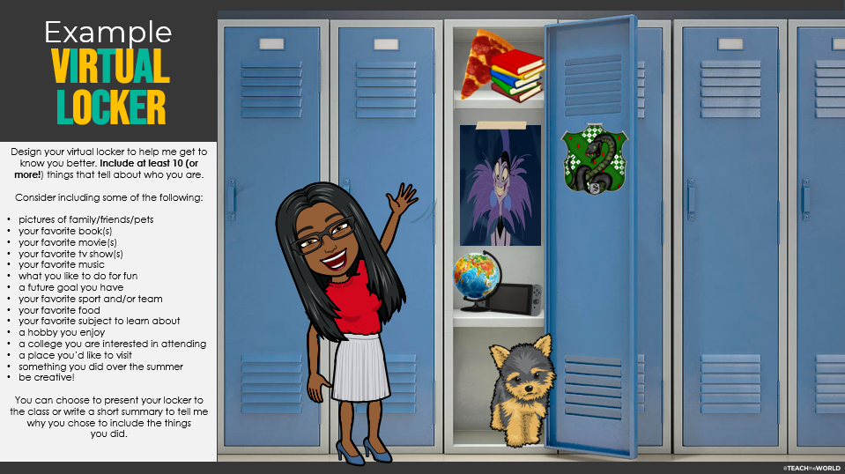
Notes:
To complete a virtual locker hallway, duplicate the slide below this so each student and you have an individual slide. Assign a slide to each student (I do this by naming each slide ahead of time, but you can easily give students a slide #). Share the presentation through Google Slides or Microsoft One Drive/Share Drive. Students can add any pictures that they feel represent who they are as people. If they have bitmojis, they can even add their bitmoji to the slide like I did on this example slide. PRO TIP: When searching for online pictures, put the words “transparent background” after whatever you are looking for to get a picture of items without white background. For example, search “pizza transparent background” to get a pizza without a white background. Then resize and place the items wherever you want them.

Slide 2
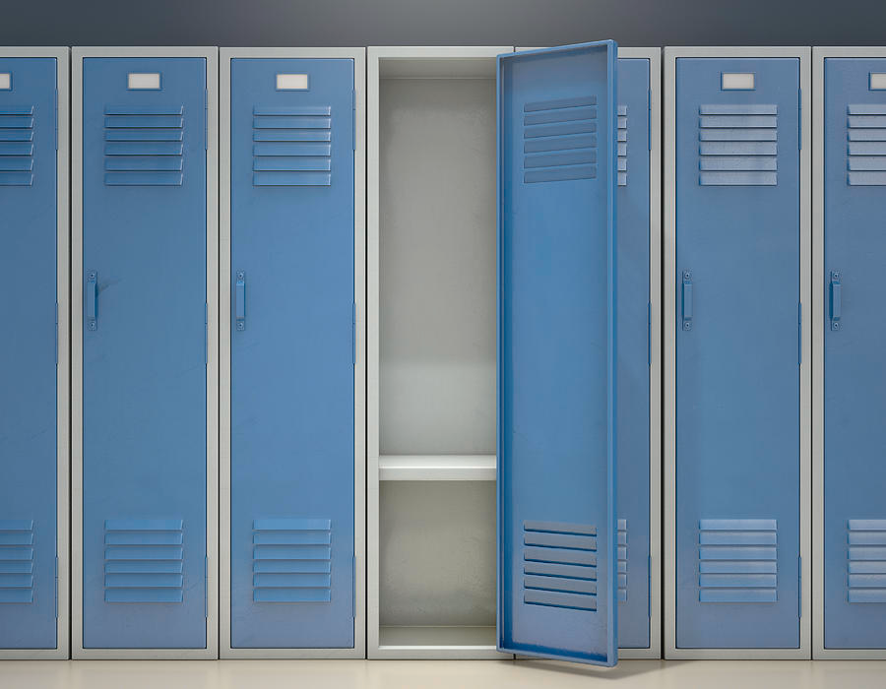
DESIGN
YOUR OWN
VIRTUAL
LOCKER
Design your virtual locker to help me get to know you better. Include at least 10 (or more!) things that tell about who you are.
Consider including some of the following:
pictures of family/friends/pets
your favorite book(s)
your favorite movie(s)
your favorite tv show(s)
your favorite music
what you like to do for fun
a future goal you have
your favorite sport and/or team
your favorite food
your favorite subject to learn about
a hobby you enjoy
a college you are interested in attending
a place you’d like to visit
something you did over the summer
be creative!
You can choose to present your locker to the class or write a short summary to tell me why you chose to include the things
you did.
Notes:
To complete a virtual locker, use the picture

