Slide 1
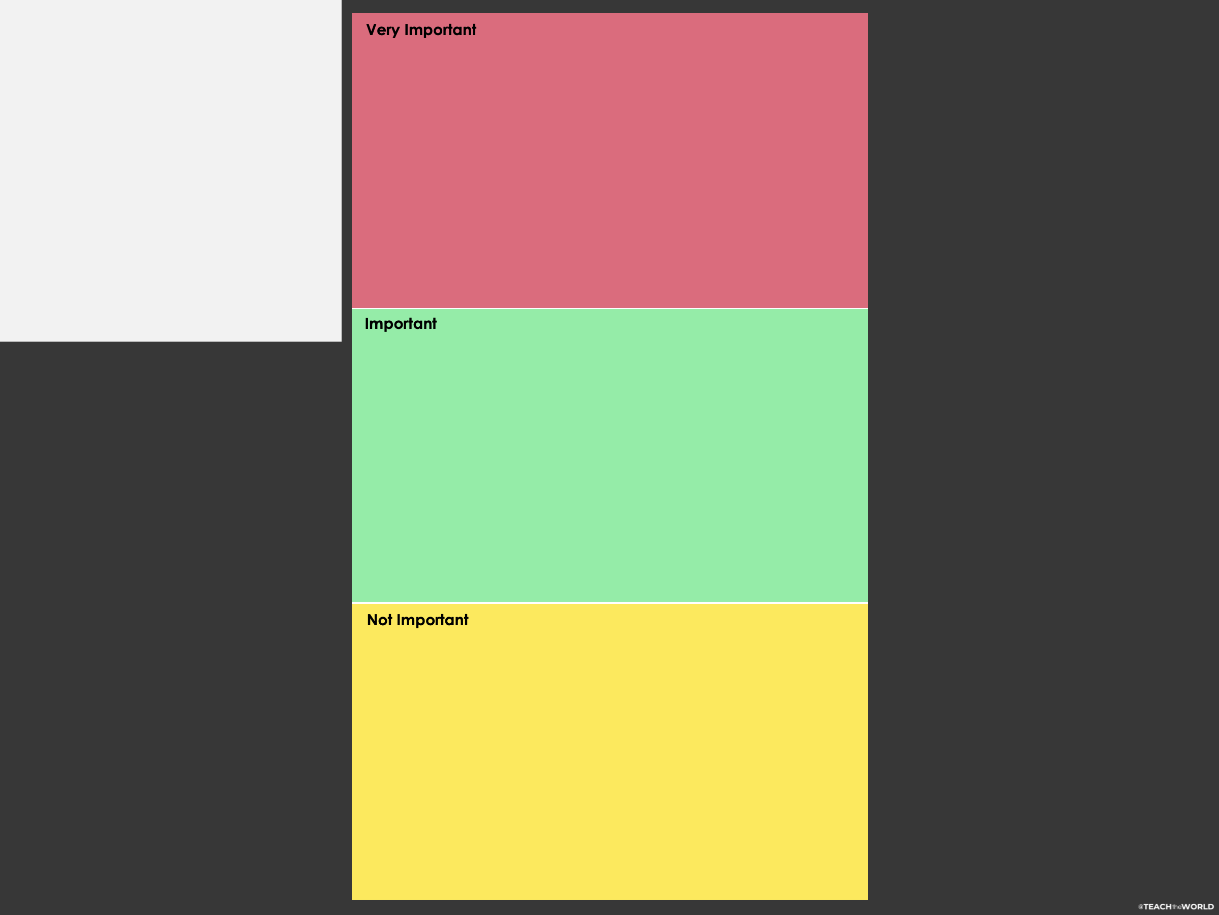
DIRECTIONS:
- Sort values into three categories:
Very Important to Me, Important to Me, Not Important to Me.
- Look at the Very Important to Me category. Narrow this category so that you have no more than 10 values listed here.
- Discuss the values you determined for the Very Important to Me category with your group members. Together, agree upon 5 values to share with the rest of the class.
- After sharing, work with your classmates to generate a list of the most important values determined out of all the groups. Condense the list to 5 ultimate values that are most important to the class as a whole.

Slide 2
In this classroom we value…
What classroom expectations can be created, based on these values?

