Slide 1
True STEM and STEAM Integration Angela Compton
Includes An Excerpt From: Project Based Learning as a Vehicle To Promote Engagement and Achievement: A Focus On STEM (2020)
By Angela Compton and Erica Auguste
Available at bit.ly/SEALEDSI

Slide 2
The Engagement Problem (Be sure you check out the engagement toolkit and engagement resources in this repository!)

Slide 3
Developing a Definition of Engagement
Engagement is . . .
A predictor of educational outcomes
An indicator that students are actively involved in their learning
A flexible state that can be increased by improving instruction
An indicator that can be used to target intervention for academic success
Multi-dimensional construct
Source: Fredricks et. al, (2016)
Notes:
15 Minutes

Slide 4
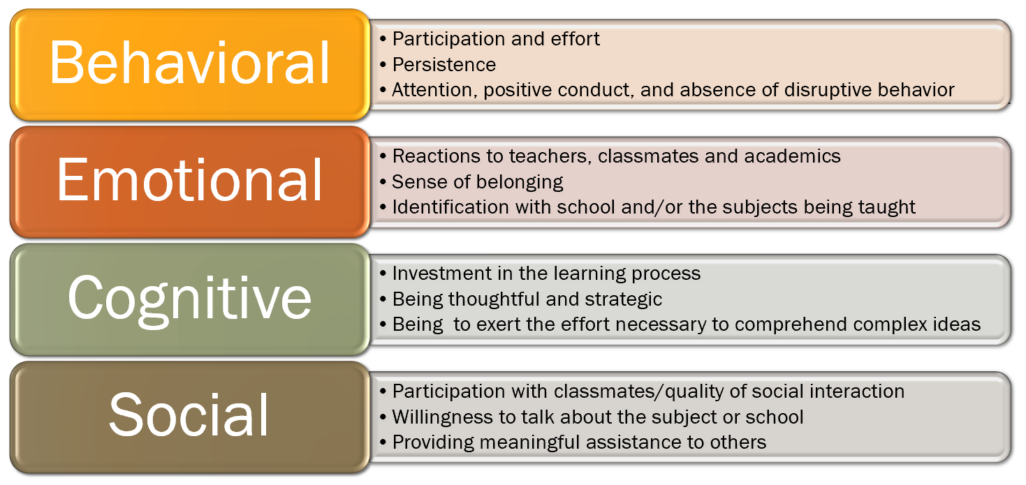
The Multi-Dimensional Nature of Engagement
Source: Fredricks et. al, (2016)
Notes:
Interactive if time allows - what might these various elements look like? Which do you see as missing from your classroom.

Slide 5
Why This Matters
There is a disconnect between what is being taught in school and the skills students will need for the real world.
Students, especially marginalized student groups, feel that the goals and purposes of education are not the same as their goals and purposes. For these students, education is no longer culturally relevant.
Disengagement is how students show that disconnect (Toshalis, 2015).
Only 8% of low-SES students finish a 4-year college degree by their mid-20s (Lenz, 2015).
Think about who makes up the L25 at your schools . . .
SES/Race/Gender/ELL/ESE-->Marginalized populations
Goals of Education

Slide 6
Educational Theory Supporting PBL/ STEM
Theoretical support for PBL/STEM is also supported via Dewey’s learning by doing principals.
According to Christensen, Knezek and Tyler-Wood (2015), active learning is:
(1) relevant to real-world applications,
(2) offer students an authentic opportunity to solve real-world problems, &
(3) use the application of prior knowledge and experiences to solve current problems.

Slide 7
Connection to Critical Pedagogy
There is a great deal of theoretical overlap between Dewey’s principles of active learning and critical pedagogy.
Duncan-Andrade and Morrell (2008) highlight the importance of critical pedagogy in urban schools to address the disconnect that many marginalized students have with the goals and purpose of education.
Critical pedagogy relies on the idea of praxis as a center of education
identifying a problem,
analyzing it
creating and implementing a plan of action
This is closely aligned to the framework behind project-based learning and STEM.

Slide 8
STEM: A Component of PBL

Slide 9
Notes:
Sometimes PBL can be both. Great Plankton Race as example.
Tissue Box for Evolution → MBE, PBL

Slide 10
The Value of PBL on Achievement
PBL, and especially STEM approaches, when implemented consistently and with fidelity, have the potential to increase achievement, interest, and engagement of marginalized student groups who are also underrepresented in STEM fields (Malkiewich and Chase, 2019, Scott-Parker and Barone-Nugent, 2019)
Bicer and Capraro (2019) conducted a quasi-experimental study of mathematics achievement growth at 64 STEM and non-STEM schools in Texas. While the study demonstrated no change in achievement growth in the entire student population, Latino students and African American students at the STEM schools demonstrated a higher growth rate than at their counterparts at non-STEM schools.
Notes:
Think back to the L25 we talked about earlier.

Slide 11
The Value of STEM on Engagement
Scott-Parker and Barone Nugent (2019) conducted a small case study of 4 Year 10 Australian girls that demonstrated significant changes in student engagement student dispositions to both math and science. In addition, this study found that pairing the students with young, female mentors helped challenge the stereotype that science is conducted by old men. While this study had severe limitations, it supports the importance of authentic, hands on science as a vehicle for increasing student engagement.
Your students will remember the activities and the connections they make long after the things they have memorized have faded.
You can use the engagement survey in this repository to examine the impact of your STEM activities.
Visit the contrasting cases tool kit in the repository to learn how to make the most from your STEM activities.

Slide 12
How to get the most out of your STEM activity
Providing project goals that are content-focused can increase student retention of science/mathematics learning, as opposed to goals that are outcome-based (Malkiewich and Chase, 2019).
Example:
Design a balloon car that will travel 3 meters.
Versus
Design a car that will minimize friction and air resistance to travel 3 meters.

Slide 13
Resources for Implementing STEM

Slide 14
Notes:
Sometimes PBL can be both. Great Plankton Race as example.
Tissue Box for Evolution → MBE, PBL

Slide 15
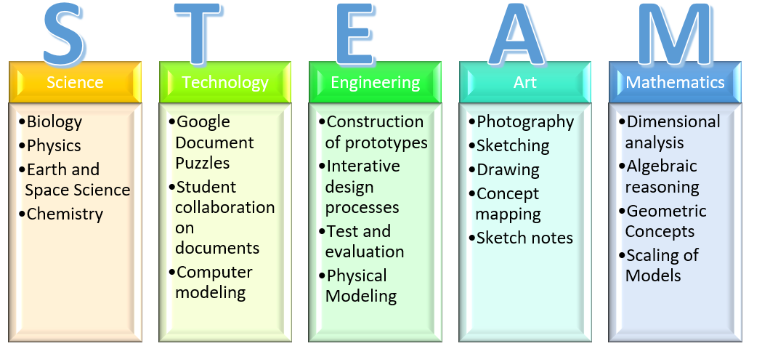
STEM Infusion versus STEM Integration
STEM Infusion simply involves two or more STEM disciplines in a project.
STEM INTEGRATION explicitly teaches two or more of the subjects in tandem with each out.
Art is often included in STEM, as art is an integral part of all STEM fields!
Examples of STEM/STEAM topics can be found below.
Choose two or more topics, plan a lesson that addresses student learning in BOTH topics, and you are on your way to STEAM integration!
STEAM projects are also addressed in the PBL toolkit found in this repository if you are looking for more!

Slide 16
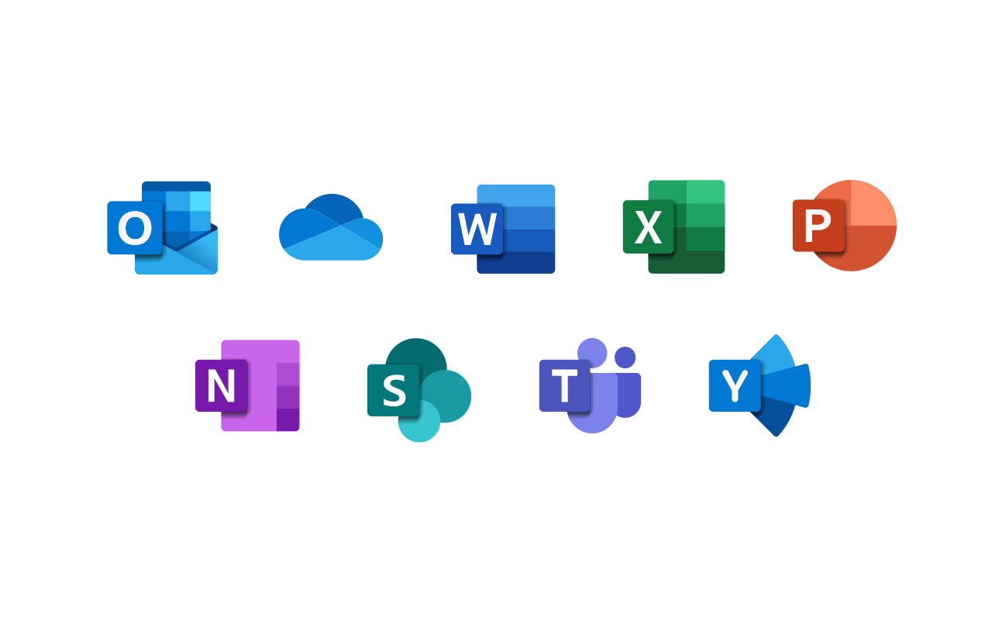
Technology Integration
-Escape rooms are a great example of Technology integration with any other subject. You can use an escape room in any subject, and provide explicit instruction in technology by showing your students how to do what is required of them.
-Modeling in Science and Math using programs like PhET and Explore Learning is another great way to integrate science and technology.
-Data analysis projects that require computations and graphs using excel (great for stats and advanced science classes)
-Our current situation lends itself well to integrating technology, but students often fall flat on their face when they are not supported with explicit instruction. We can not be angry when students do not know how to do a skill we have not yet given them. Explicit instruction in technology levels the playing field for students who may not have had access to technology at home.

Slide 17
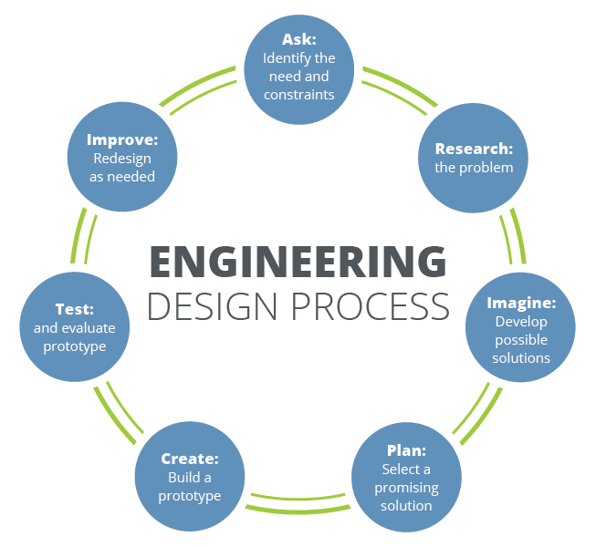
Engineering Design Process
Providing explicit instruction in the engineering process along with another subject is all that you need to have a STEM or STEAM integrated lesson.
You can pace these activities to take multiple classes. A true engineering design process activity will involve multiple prototypes.
Scaffolding required for students that are easily frustrated. (Check out the UDL toolkit in this section of the repository)

Slide 18
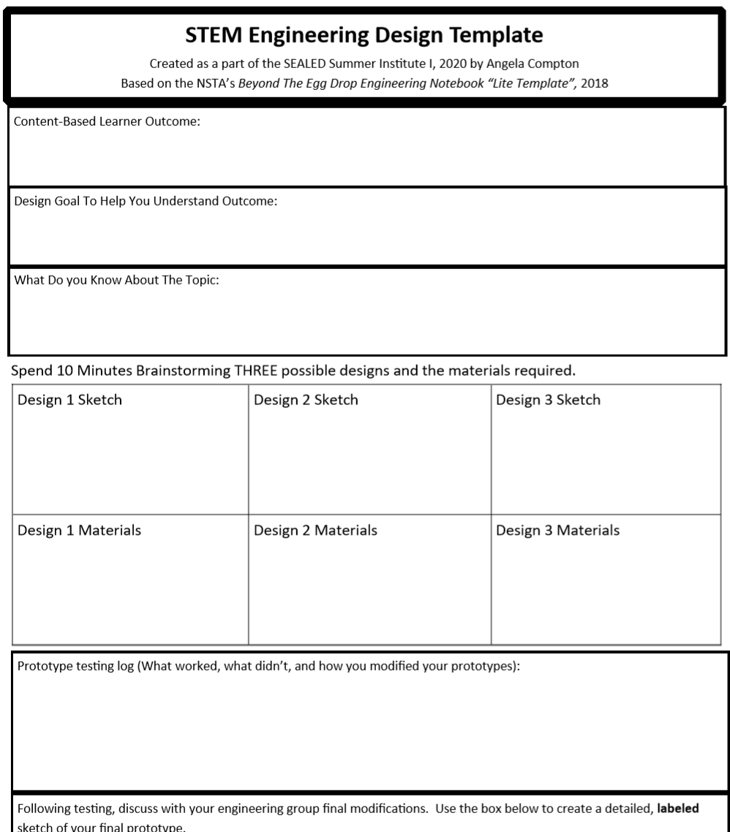
Resources to help with STEM Approaches
This design template is found in this tool kit and is based on the NSTA’s Beyond The Egg Drop, a must-have for 9-12 physical science teachers!

Slide 19
Benefits of STEM on Student Confidence and Motivation
-Highly engaging
-Shows practical applications of science and math content
-Engineering Practices employ higher-order thinking and problem solving
-Encourages innovation and collaboration.
-Students can be exposed to the idea that failure is an important part of life. This is critical to developing problem-solving skills.
Student quote: “I don’t like not doing things well. People judge you if you can’t do things well, and I don’t like being judged.”

Slide 20
Resources for Implementing Maker Based Education
(Which can overlap with STEM)

Slide 21
Notes:
Sometimes PBL can be both. Great Plankton Race as example.
Tissue Box for Evolution → MBE, PBL

Slide 22
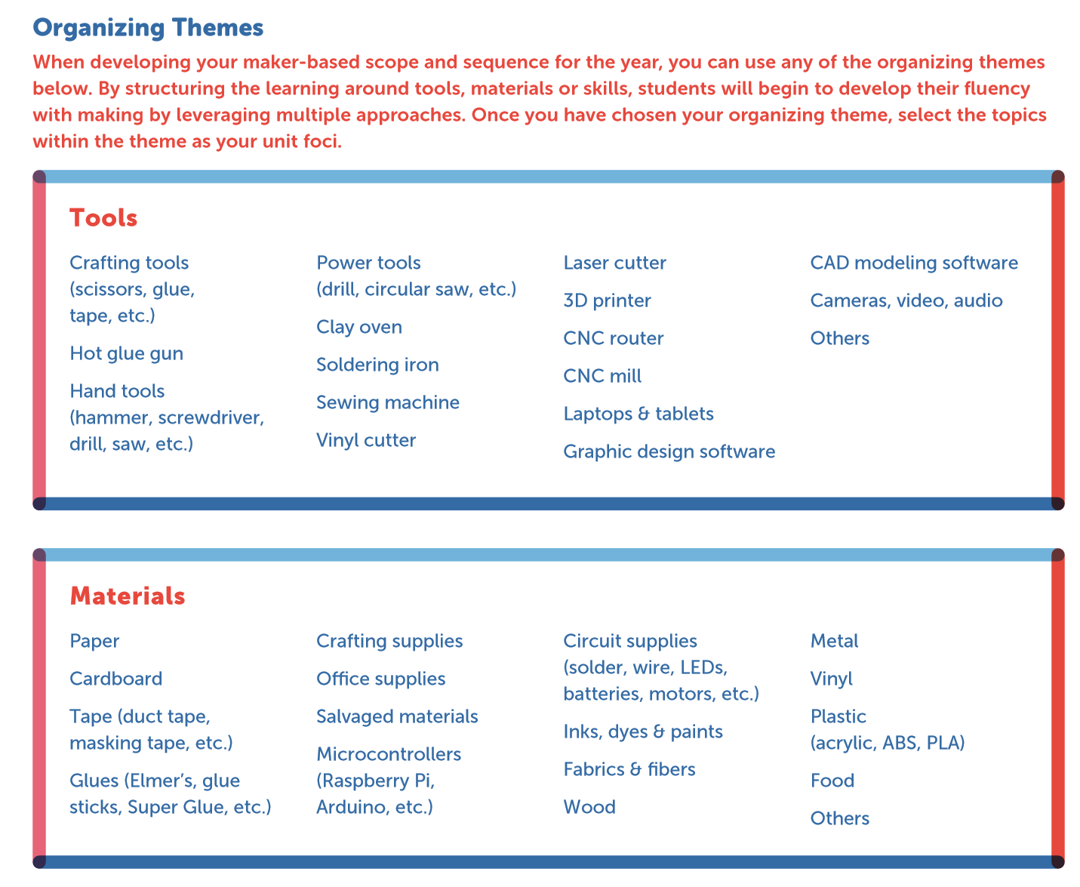
Resources to help with Maker- Based Approaches are available in the repository.
Source: SMU Maker Education Project (2018)

Slide 23
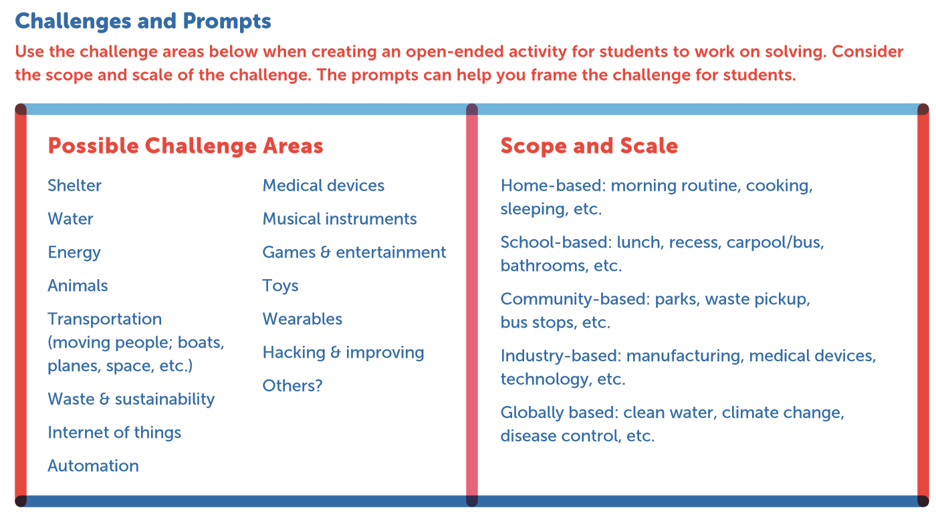
Source: SMU Maker Education Project (2018)

Slide 24
These resources are found in the PBL section of the repository under “Planning Tools”
Example activity:
After reading “Zane and the Hurricane,” students were tasked with making a prototype home to withstand a hurricane and describe how it’s features are designed to withstand hurricane conditions..
First, they were asked to brainstorm the weather features of a hurricane.
(Content-focused goal)
Then, they were asked to sketch the home they would like to construct.
Finally, students built and tested the prototype
There are several resources in this repository to assist in planning a unit.
Source: SMU Maker Education Project (2018)
Notes:
S

Slide 25
Getting the most out of your STEM activities

Slide 26
How to get the most out of your STEM Activity
Providing project goals that are content-focused can increase student retention of science/mathematics learning, as opposed to goals that are outcome-based (Malkiewich and Chase, 2019).

Slide 27
How to get the most out of your STEM Activity
Take the time to create resources that will utilize the concept of contrasting cases (comparisons) to promote students to make deeper meaning of their new content
Examining multiple representations of a concept provides instructional scaffolding to allow students to make deeper meaning from their new science/math content, thereby supporting the development of higher-order questioning (Hall and Miro, 2016; Malkiewich and Chase, 2019).
These contrasting cases are an excellent opportunity to link assessment-aligned questions to your PBL to prepare for end of year assessments.

Slide 28
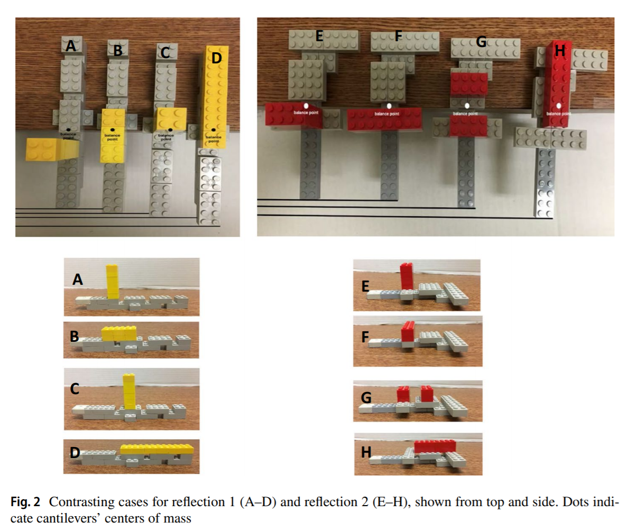
How to get the most out of your STEM Activity
Contrasting cases are the BEST WAY to connect your accountability goals to your activity.
You can even use EOC/FSA style questions and visual representations.
Examples:
Ask students to evaluate parabolas for differences
Ask students to compare various representations of cells for difference
Source: Malkiewich and Chase (2019)

Slide 29
Examples of STEM projects

Slide 30
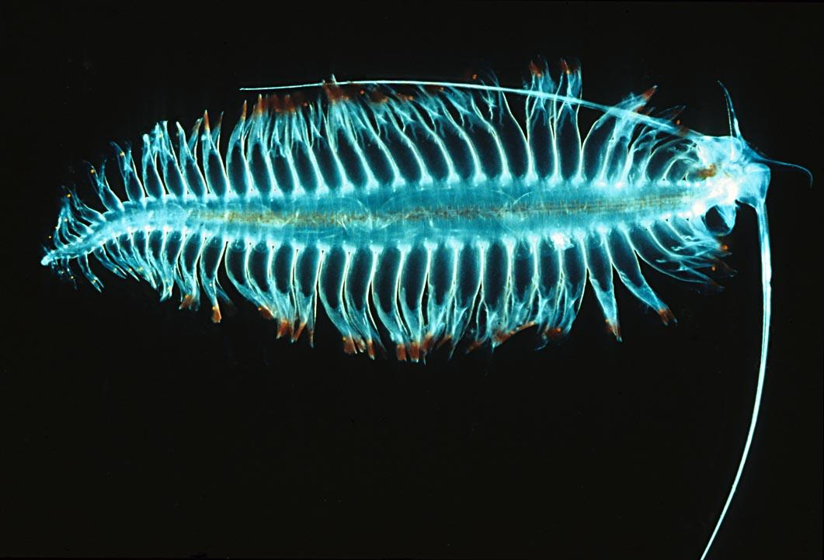
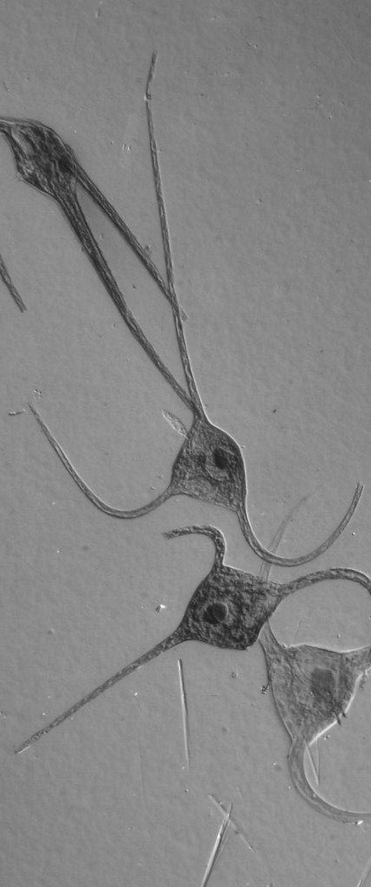
The Great Plankton Race
A STEAM Lesson Example from the Marine and Environmental Science Academy of EPA

Slide 31
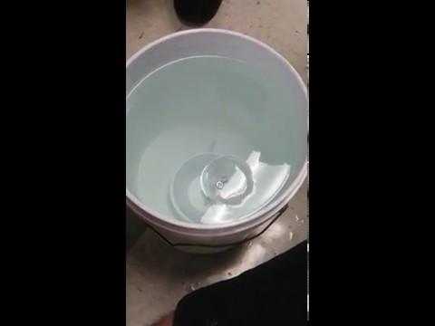
Students apply previous knowledge of buoyancy and plankton structure to engineer a plankton that will have the slowest sink rate

Slide 32
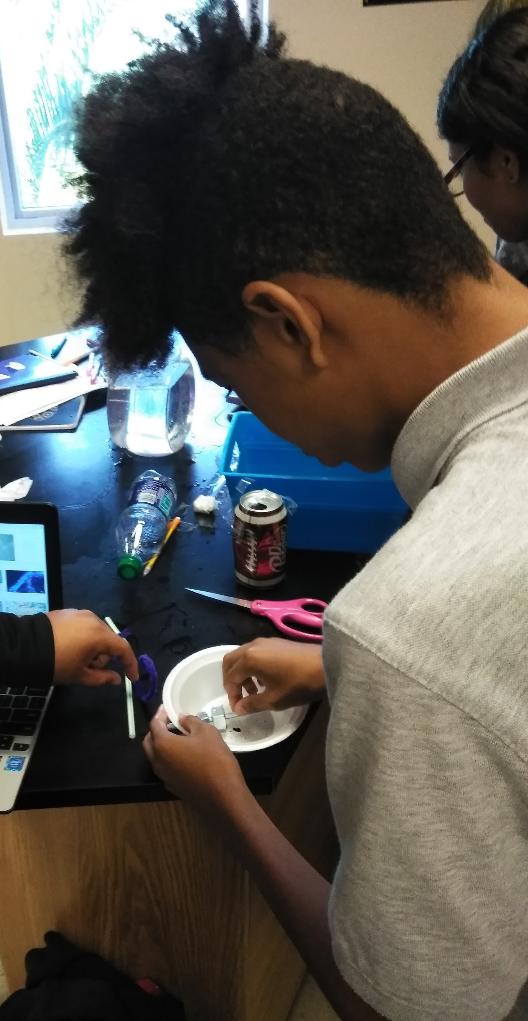
Part 1
(Previous day)
Four initial designs

Slide 33
Design Template NSTA - Beyond the Eggdrop
Sample student work follows

Slide 34
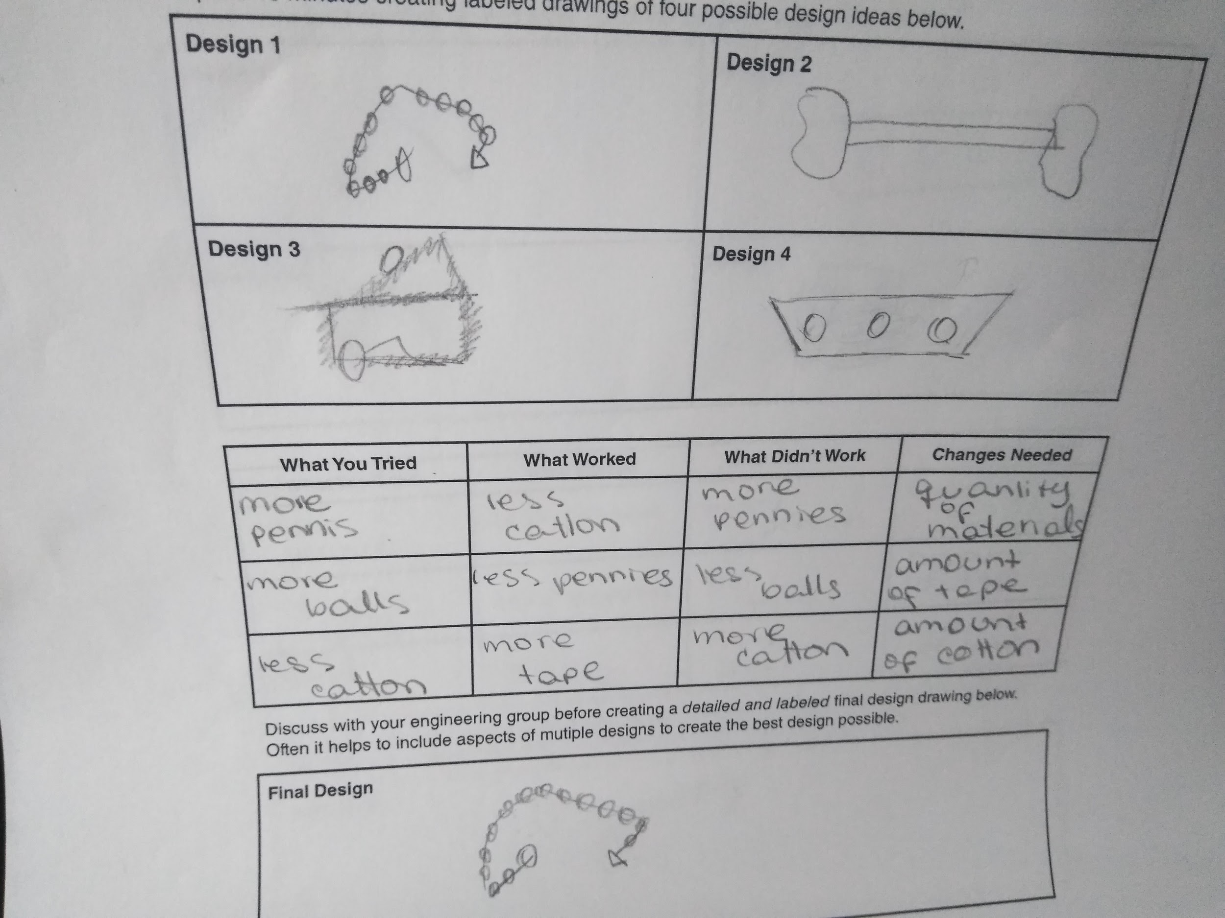

Slide 35
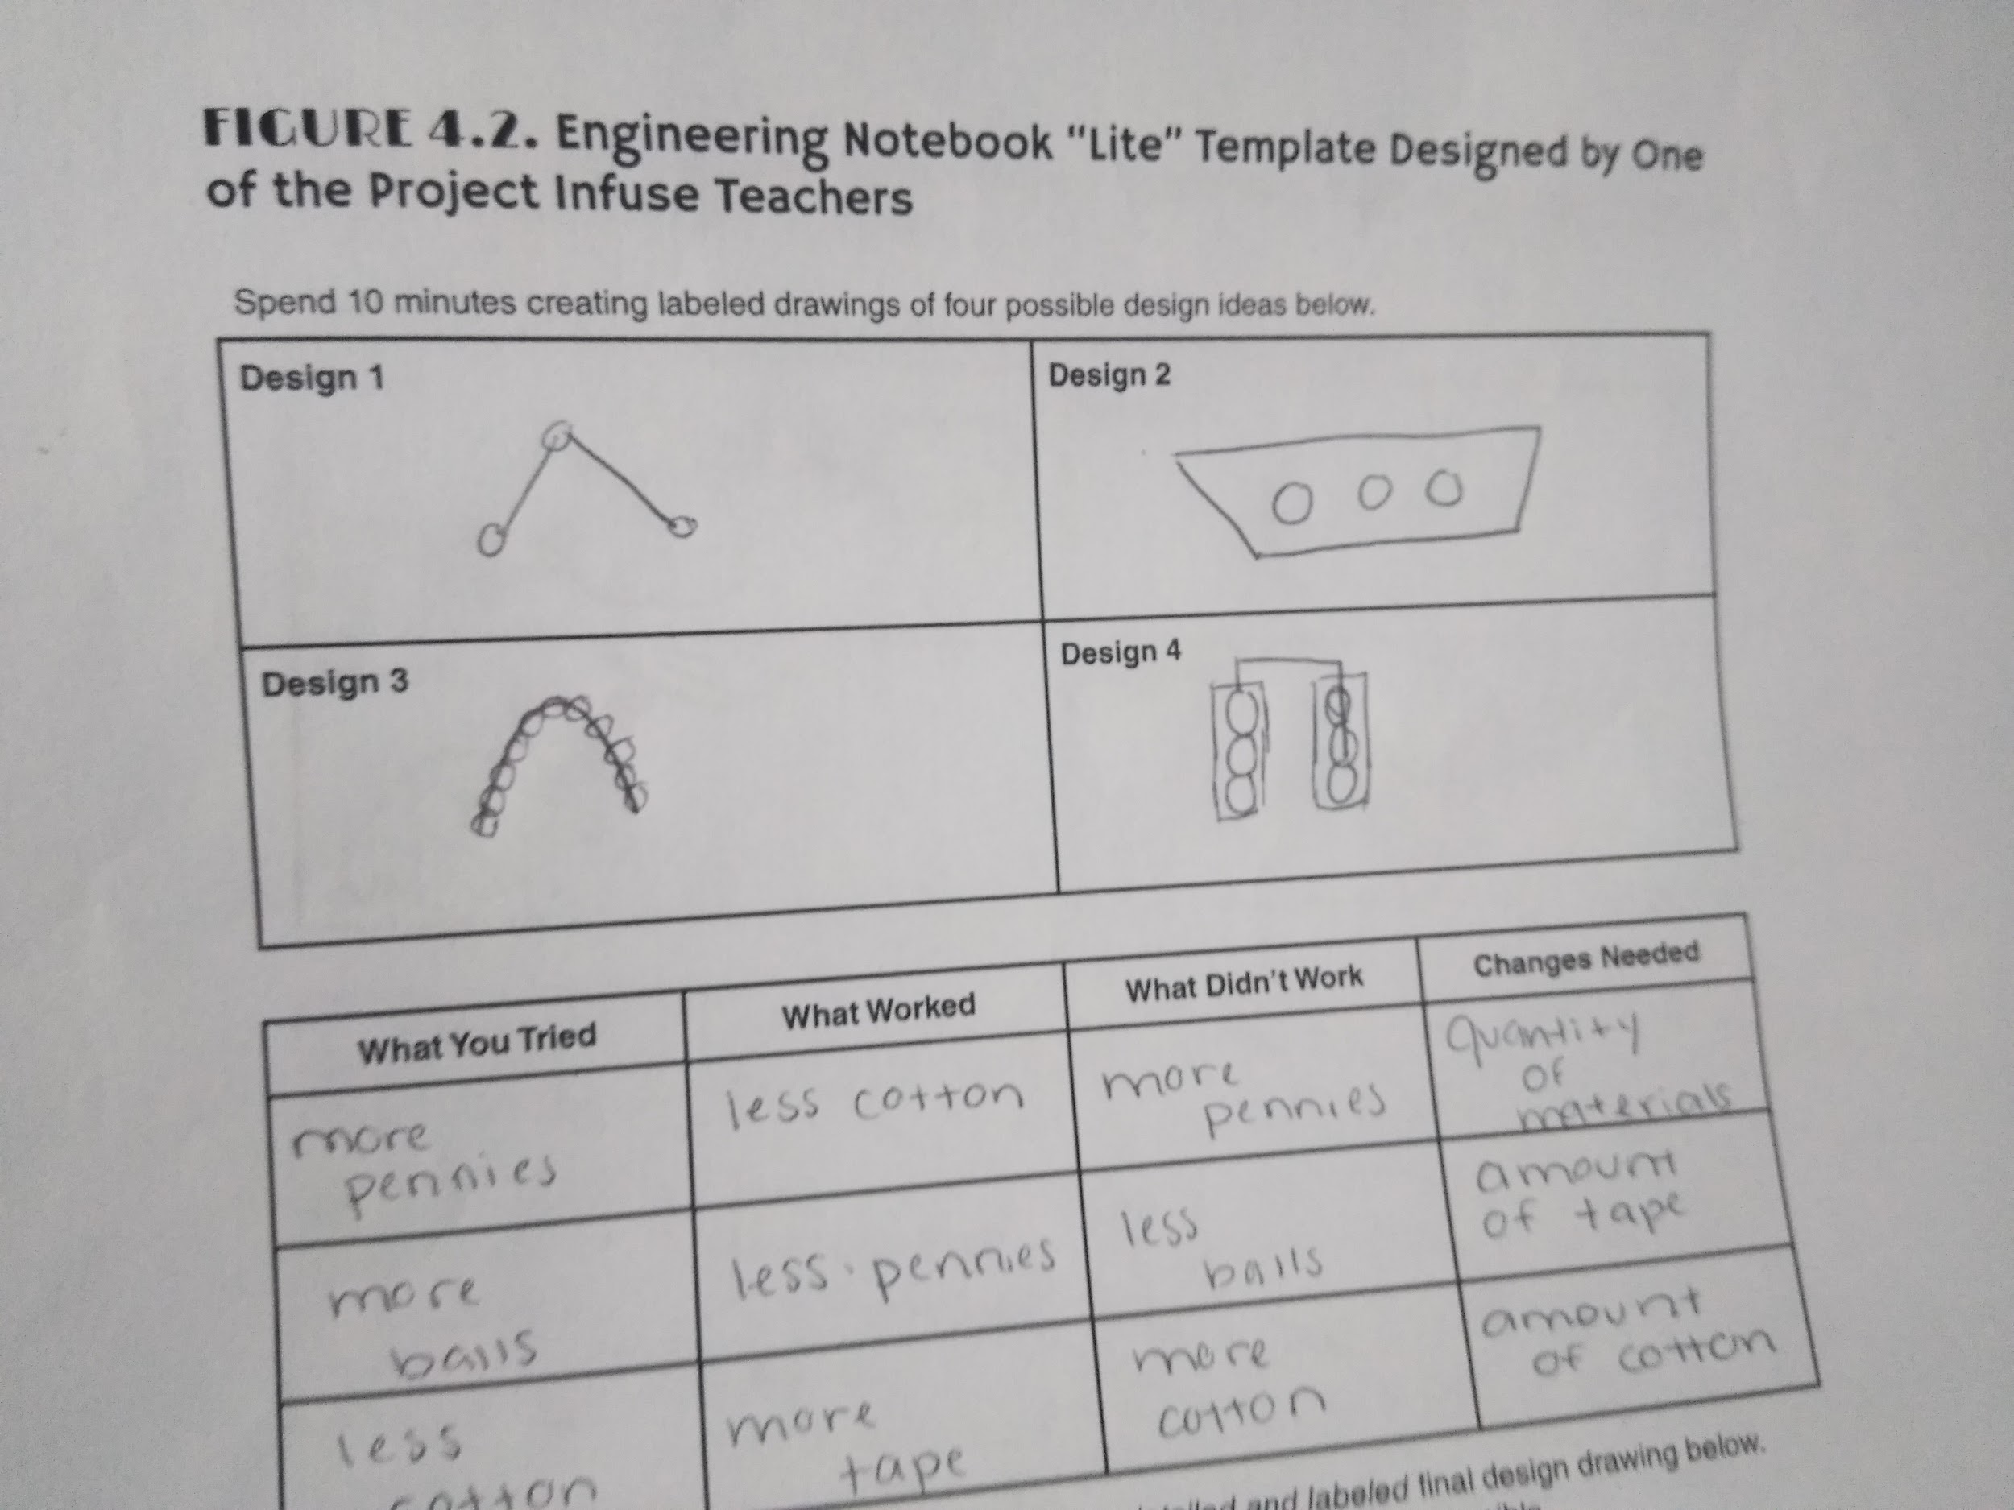

Slide 36
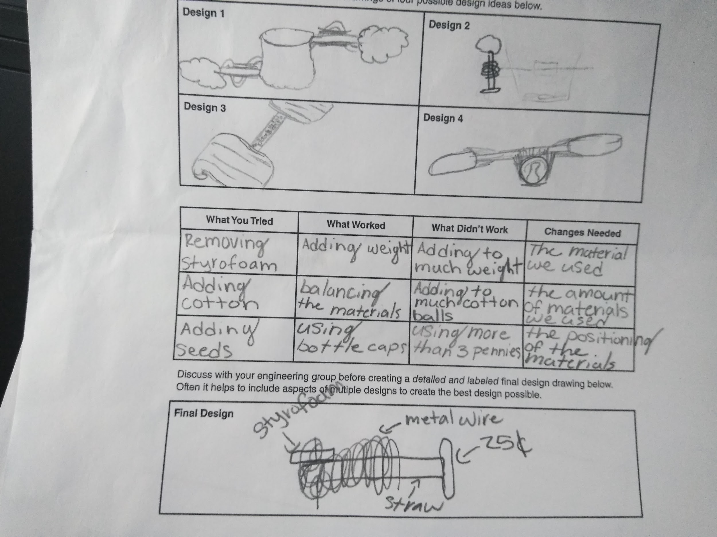

Slide 37
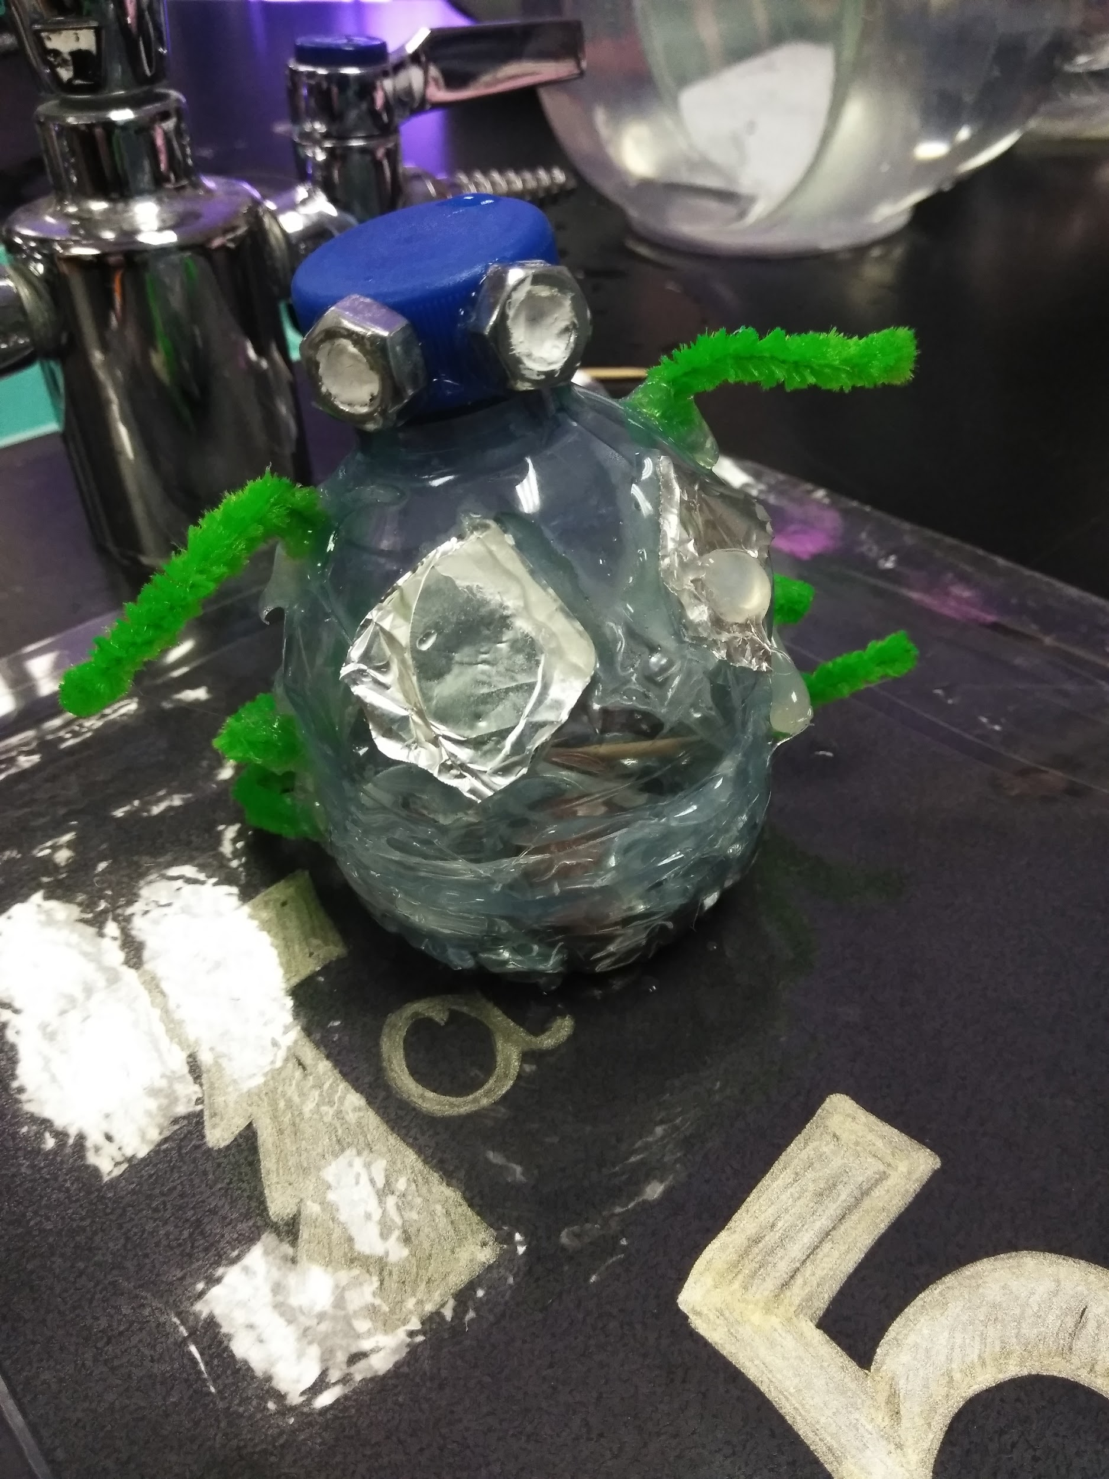
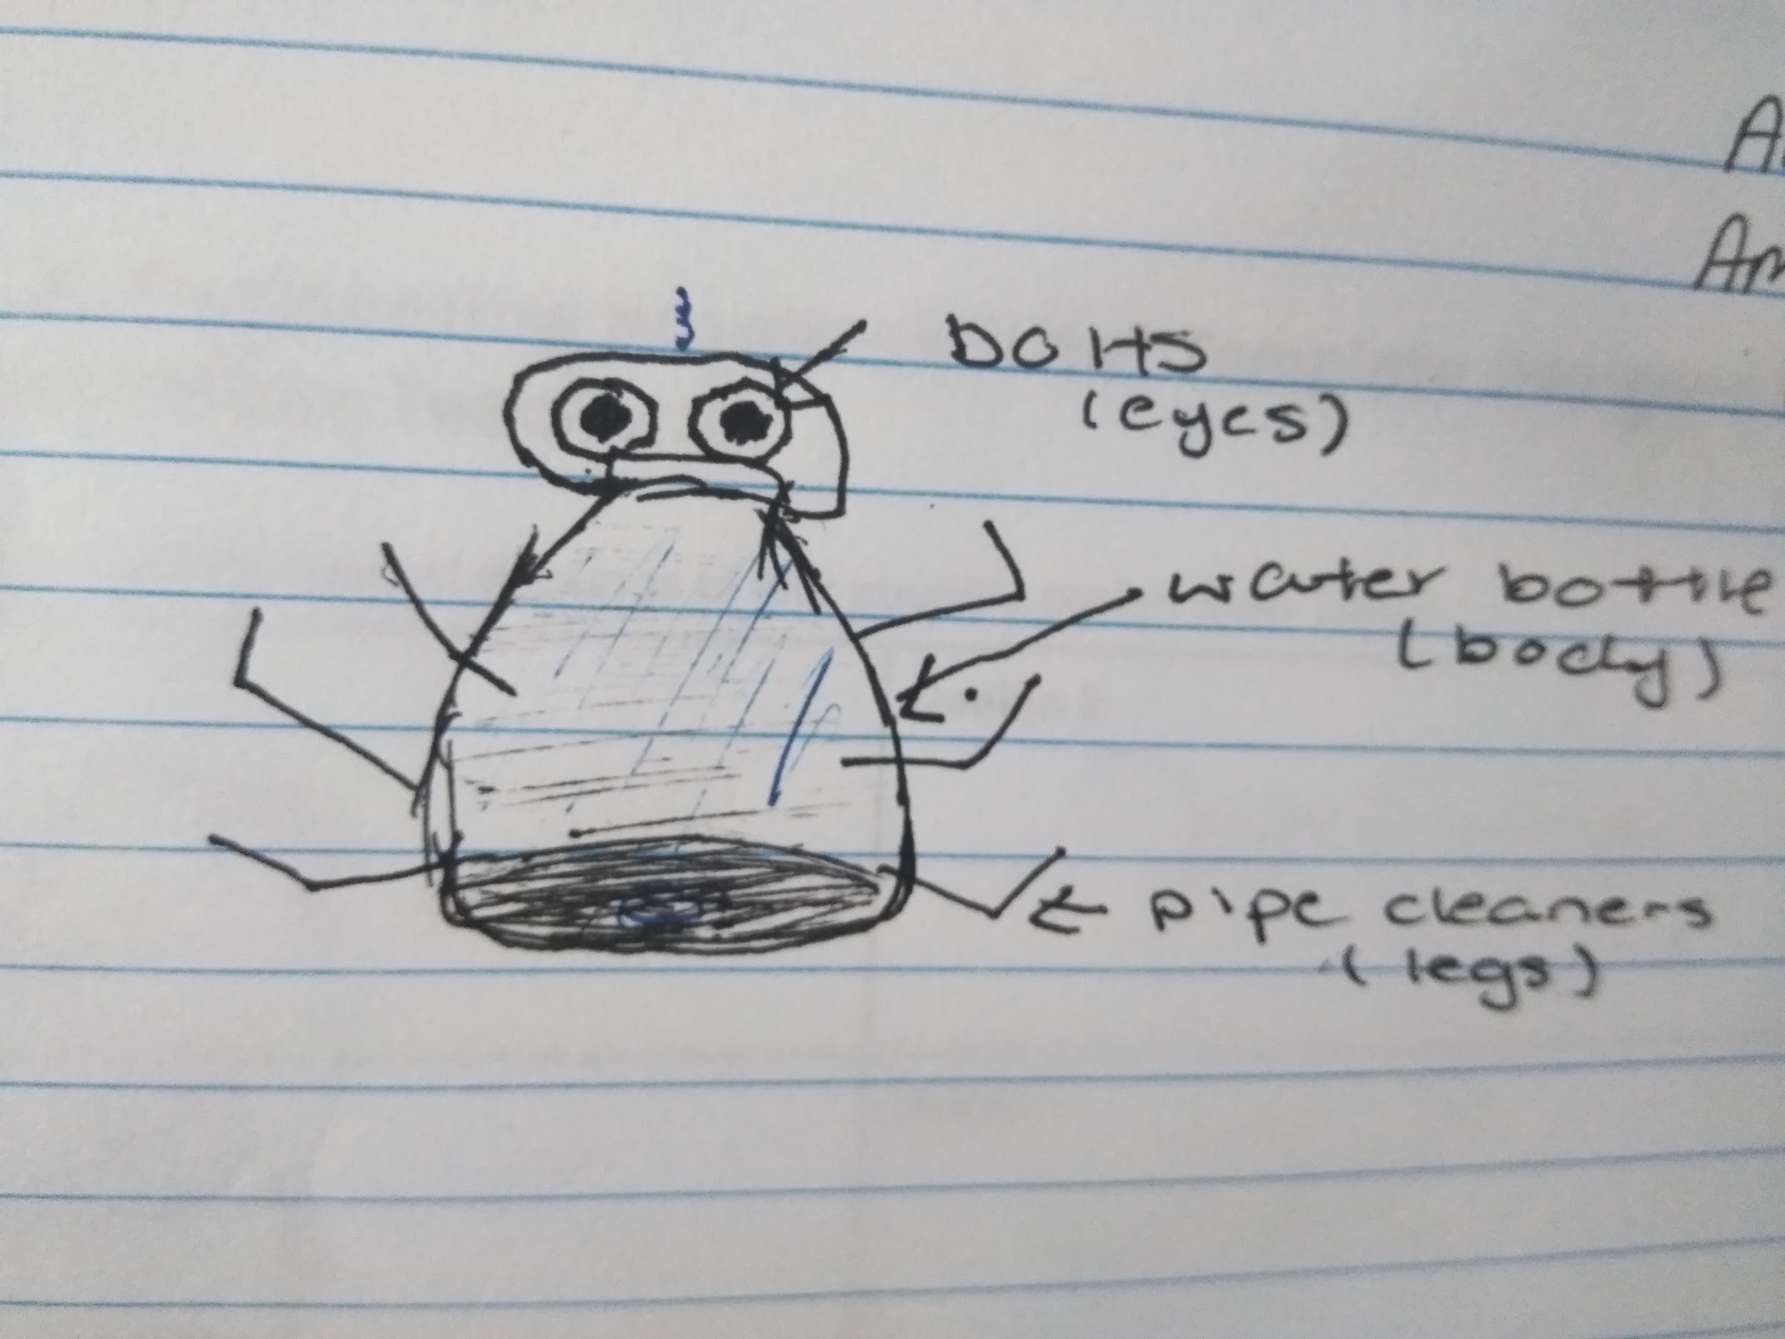
Plan → Prototype→ Testing → Refining

Slide 38
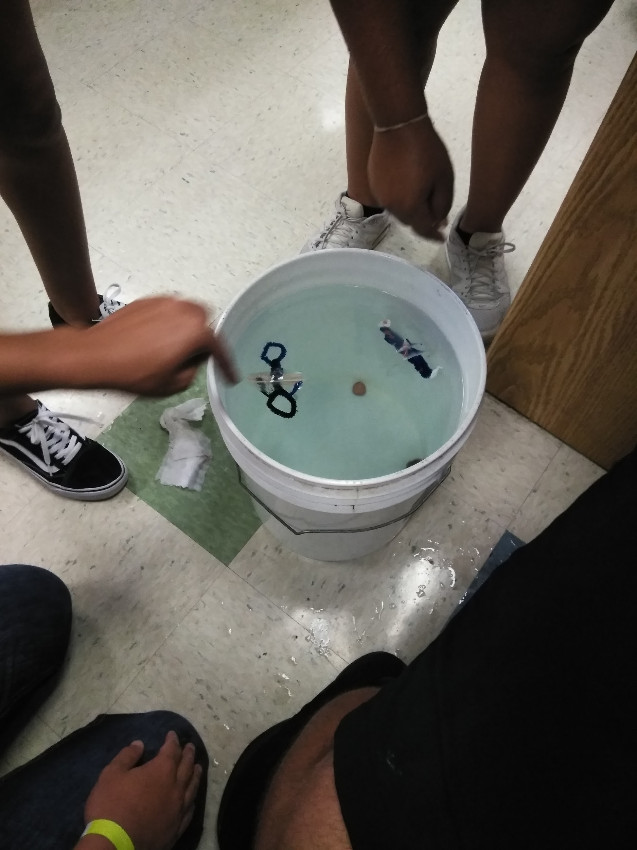
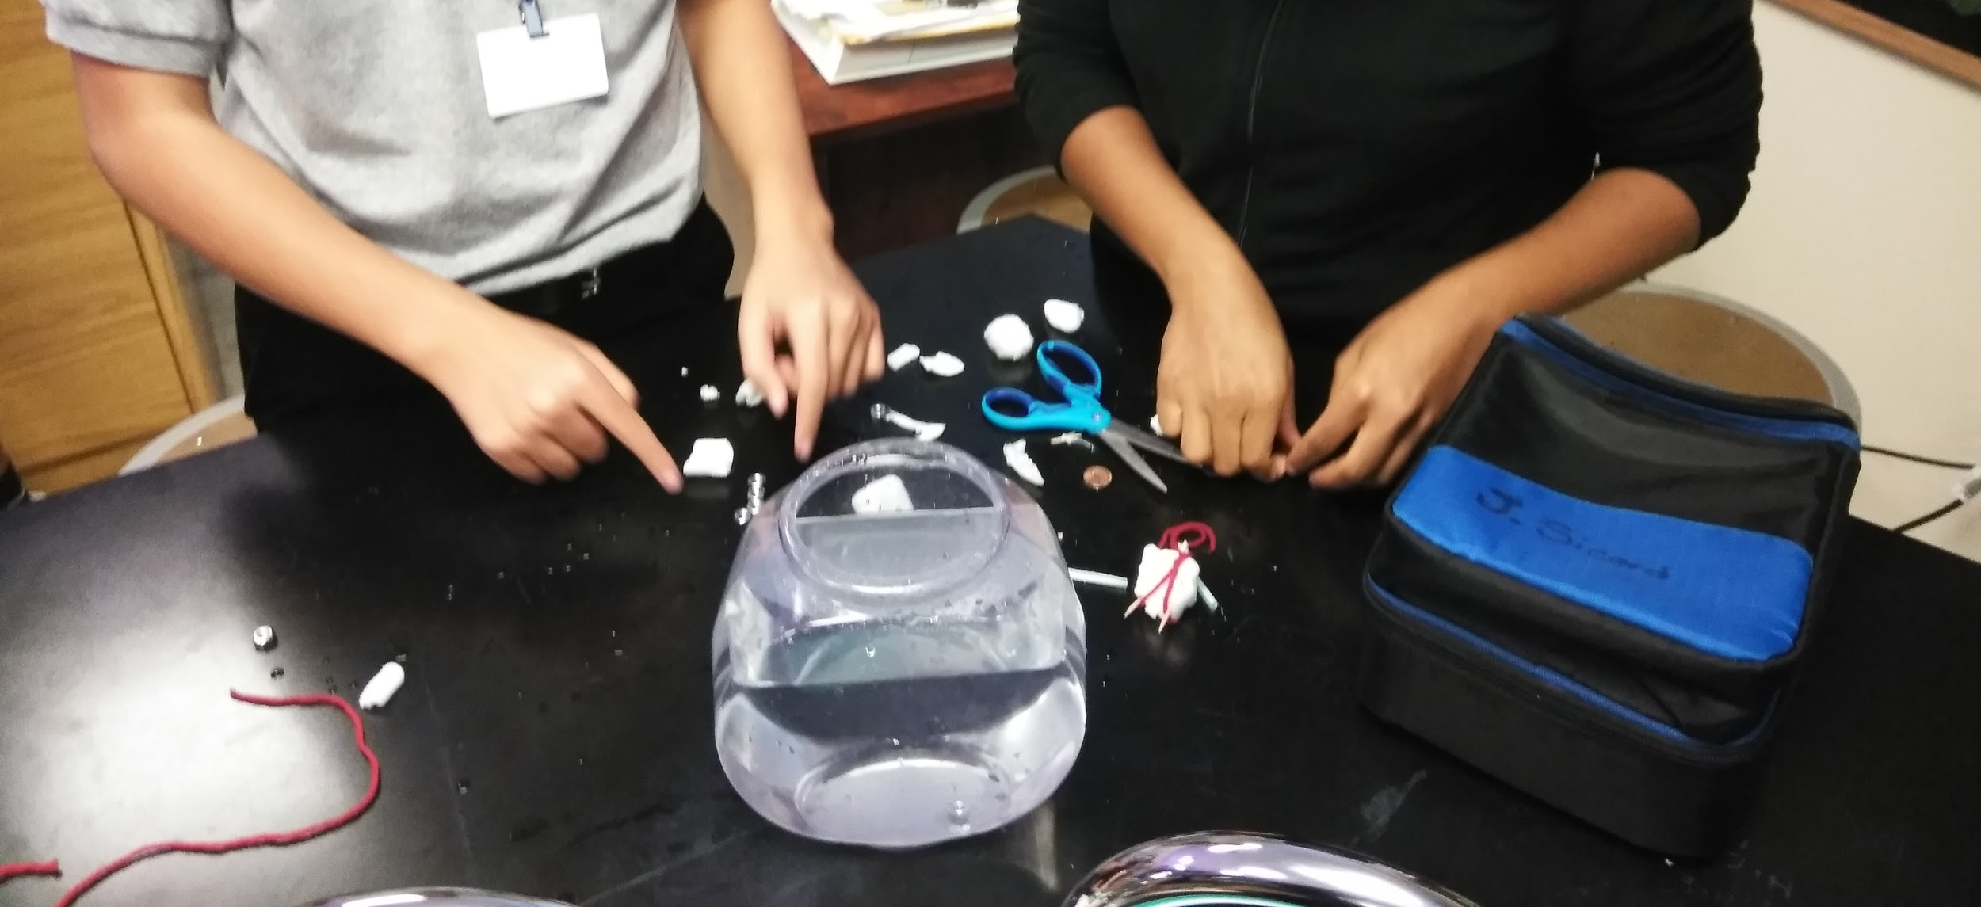
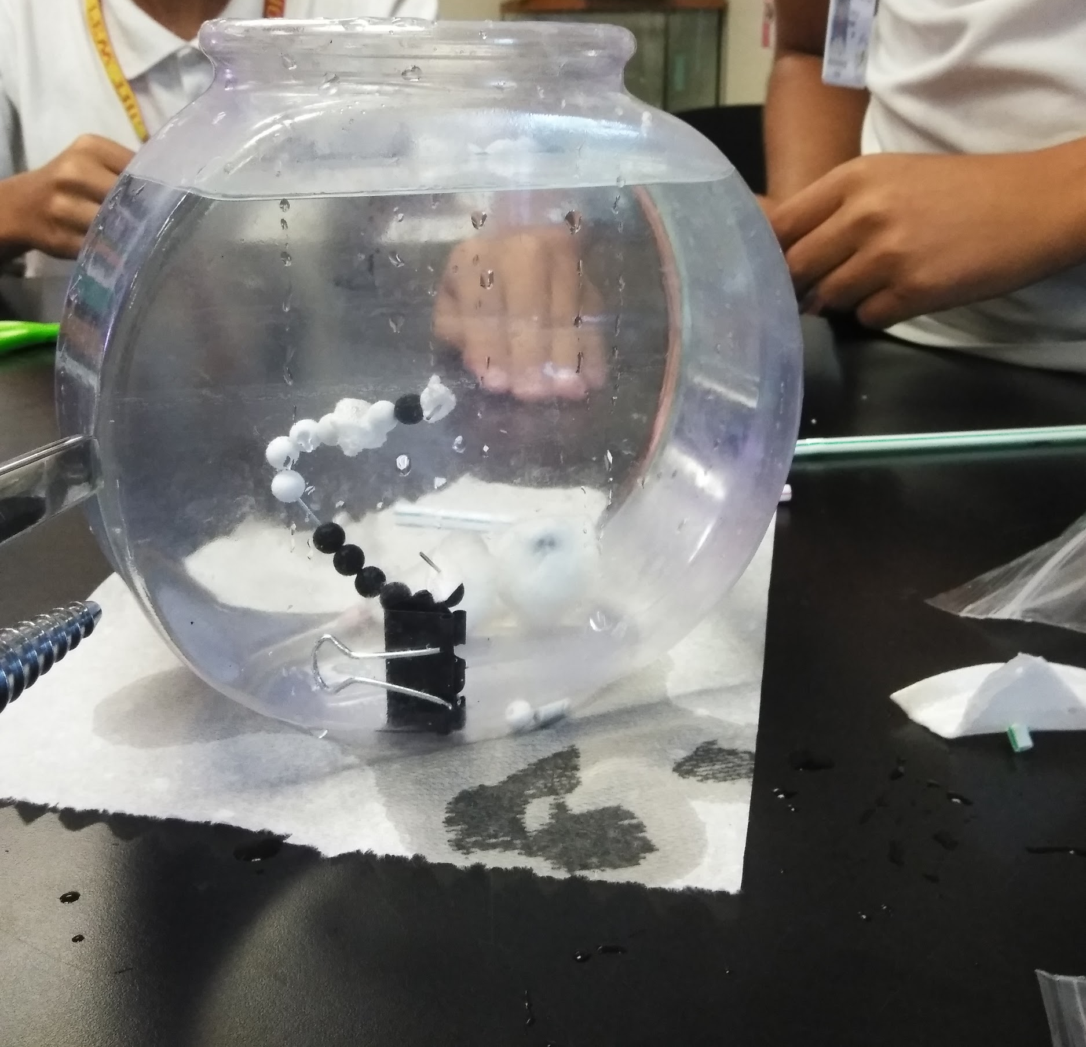

Slide 39
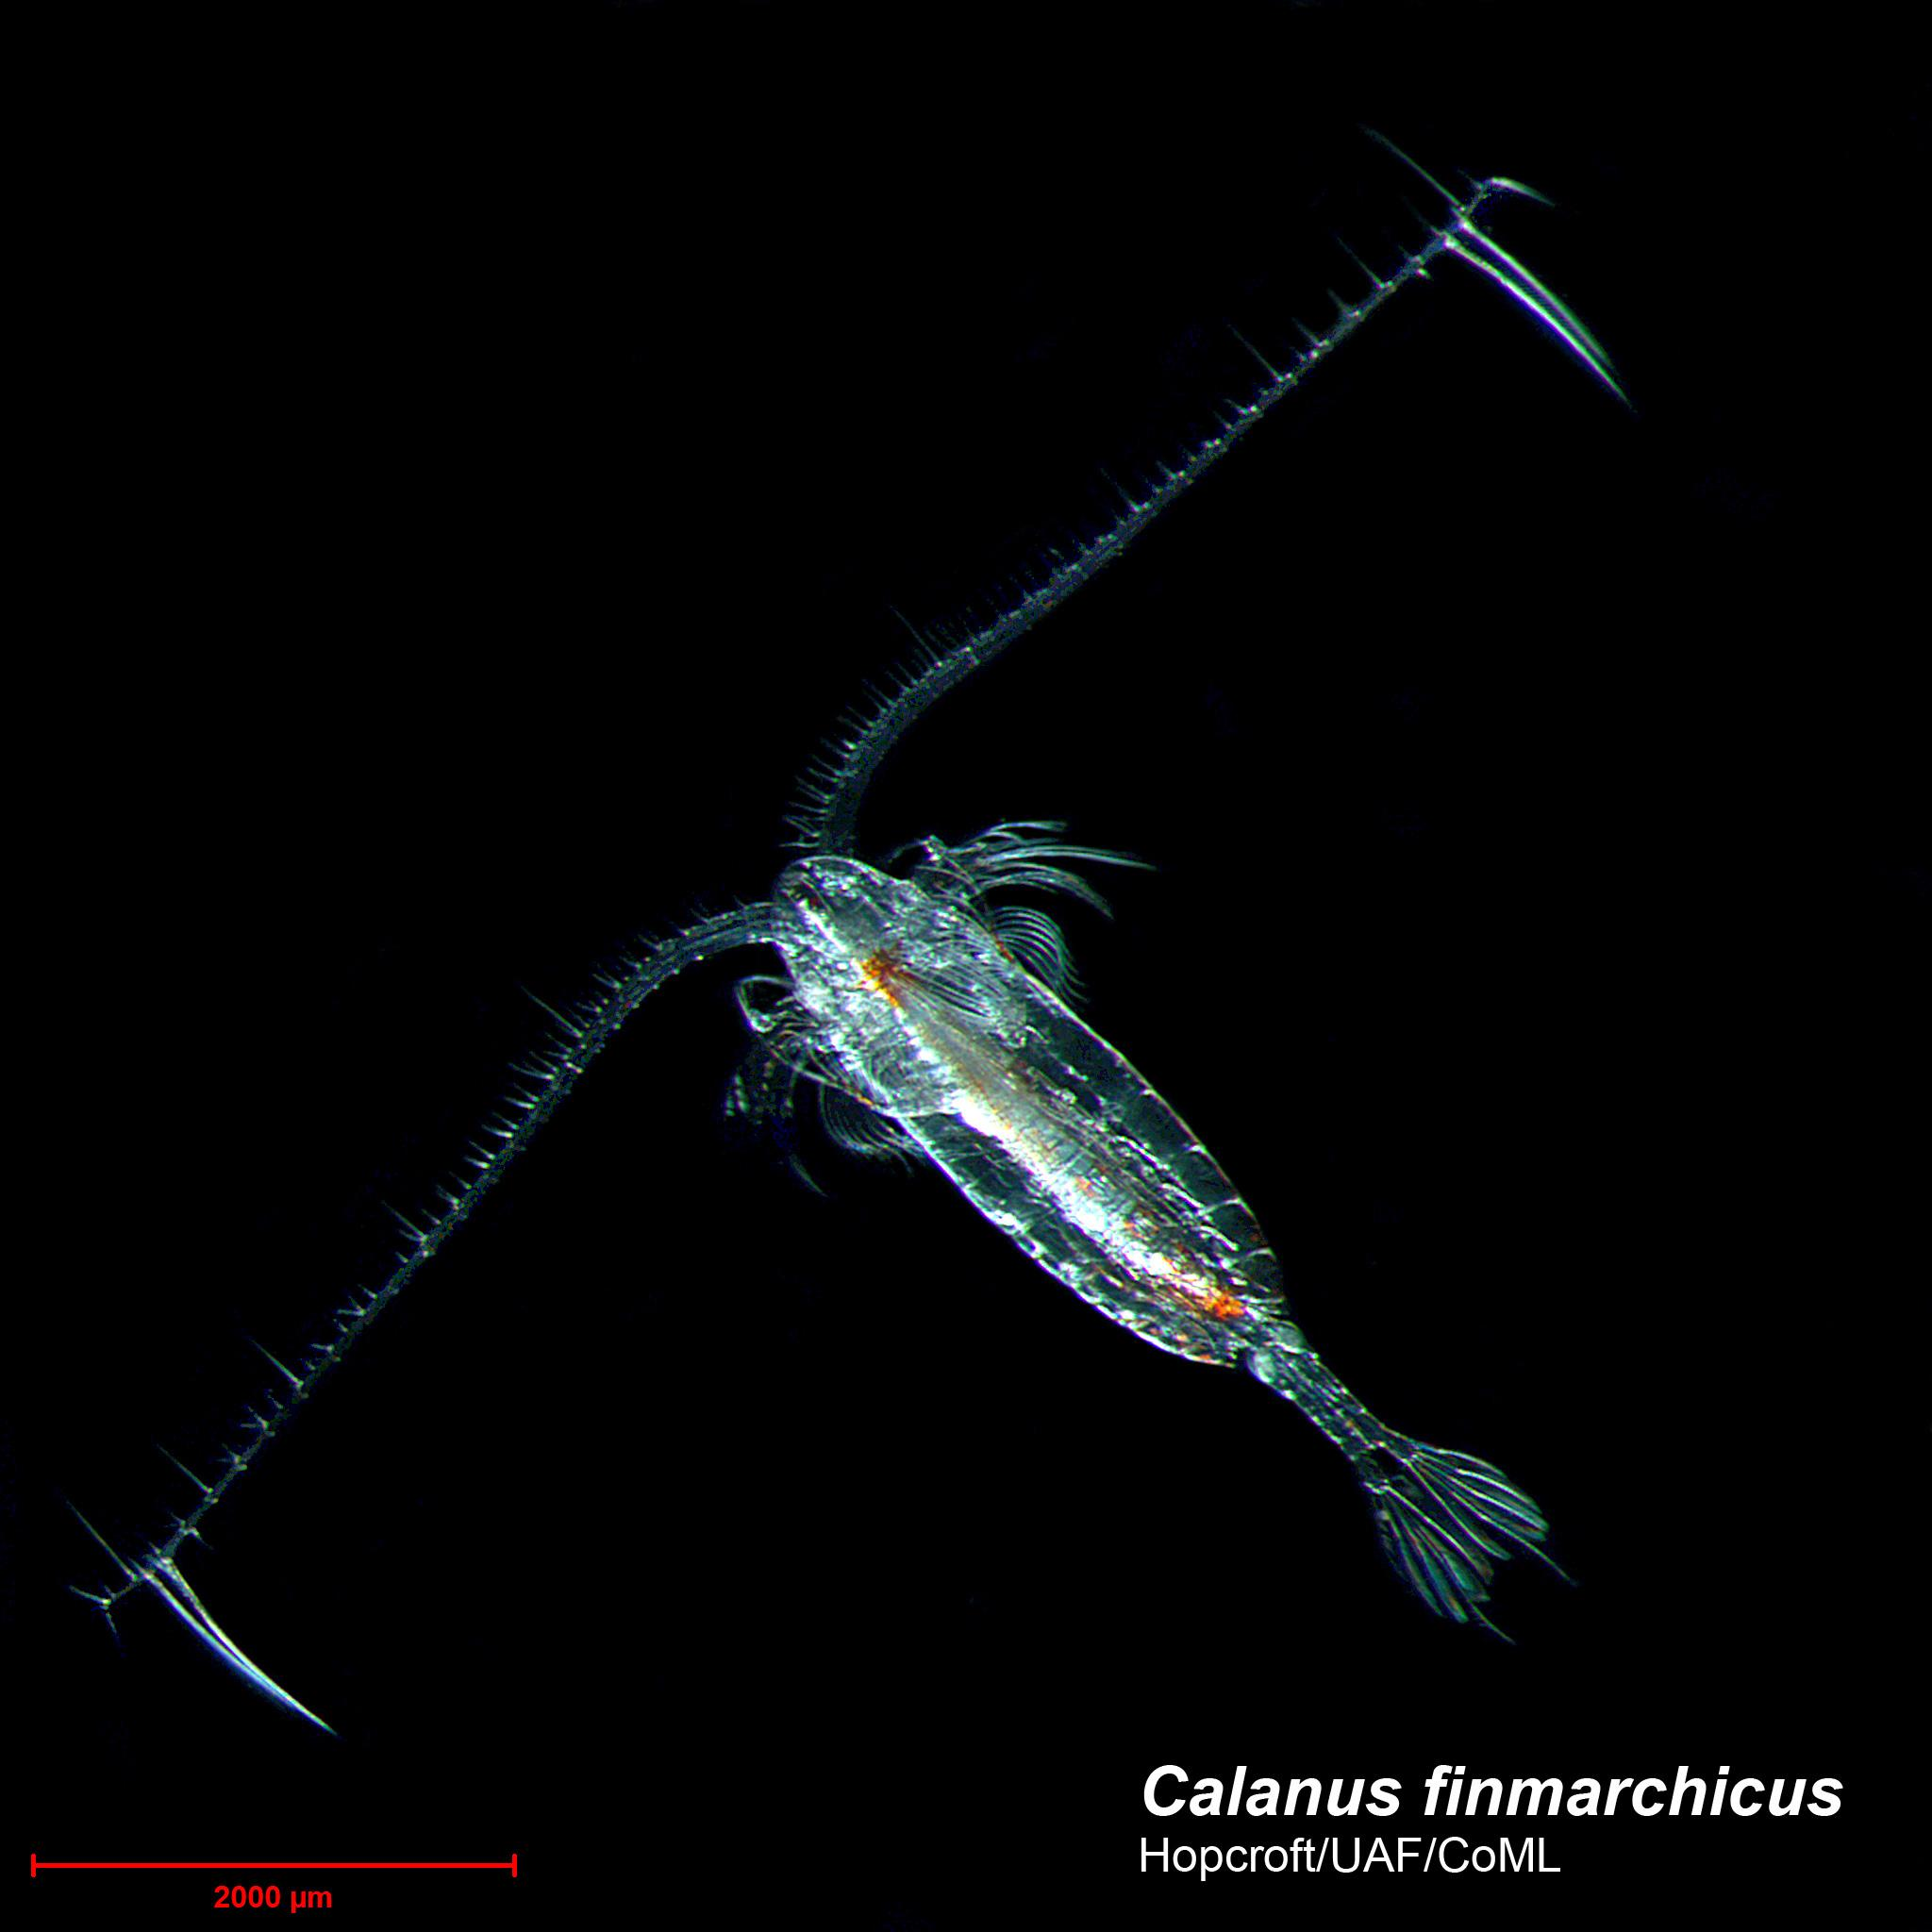
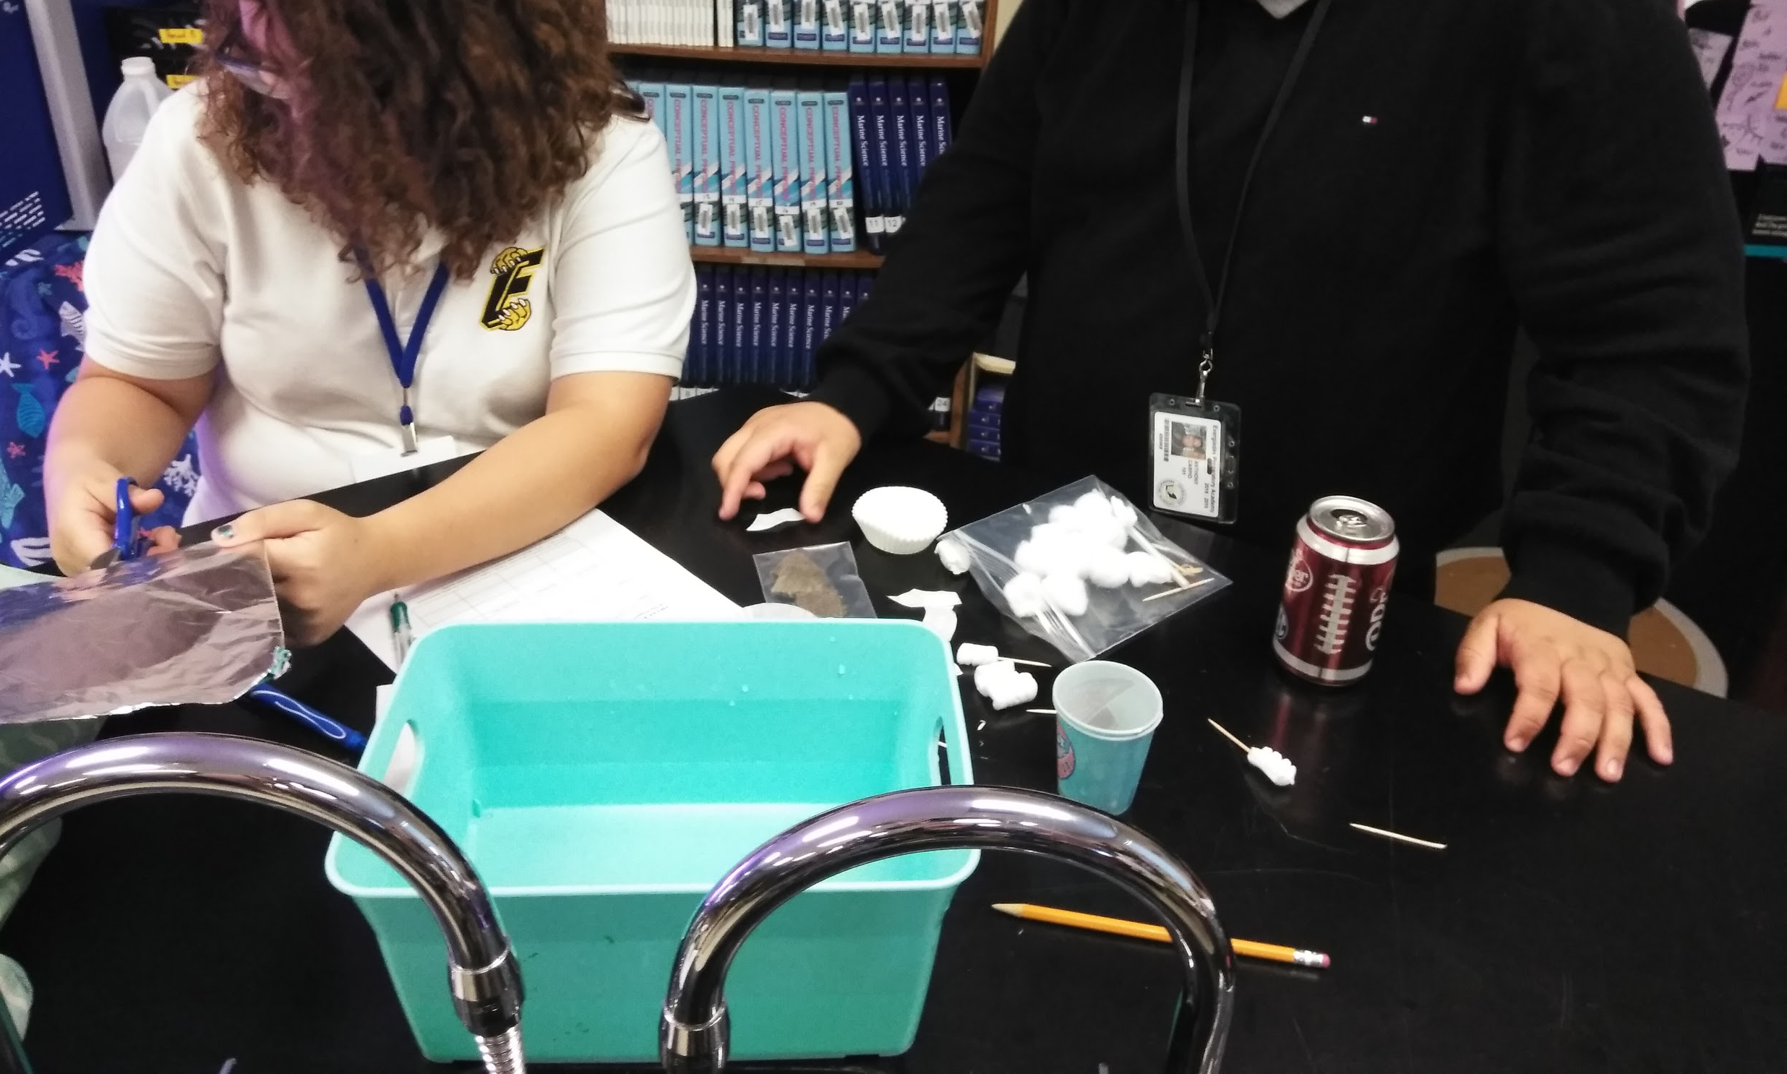
In addition to science practices and engineering and design, students worked on 21st Century Skills like collaboration.

Slide 40
Summative Reporting (Tied entire unit together)
Summative questions:
1. What are plankton?
2. What are major ways plankton can be classified?
3. How does buoyancy differ between phytoplankton and zooplankton?
4. Which type of plankton prefers to stay in the photic zone? Why?
5. Include a sketch and list the special adaptations for your plankton
a. Include the adaptations your plankton may have
b. List how its adaptations allow it to evade predators
c. Were there any trade-offs for buoyancy that make it more vulnerable to predators?
6. Make a list of the materials you used in your plankton and how they behaved alone in the water.
7. Why do the objects behave differently when connected to one another?
8. How did you modify your design between day 1 and day 2.
9. Include a graph of your average sink rate versus the volume displacement for your plankton and at least 6 other plankton in class.
a. Do you see a TREND in volume displacement compared to sink rate?
b. What might this mean?
Write a two to three paragraph entry in your engineering journal the process you used to create and test your plankton. Connect the adaptations you included in your design to the success of your design. Reflect on which designs worked best in the class and how your design compared.

Slide 41
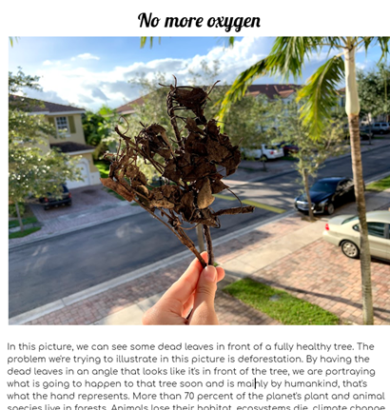
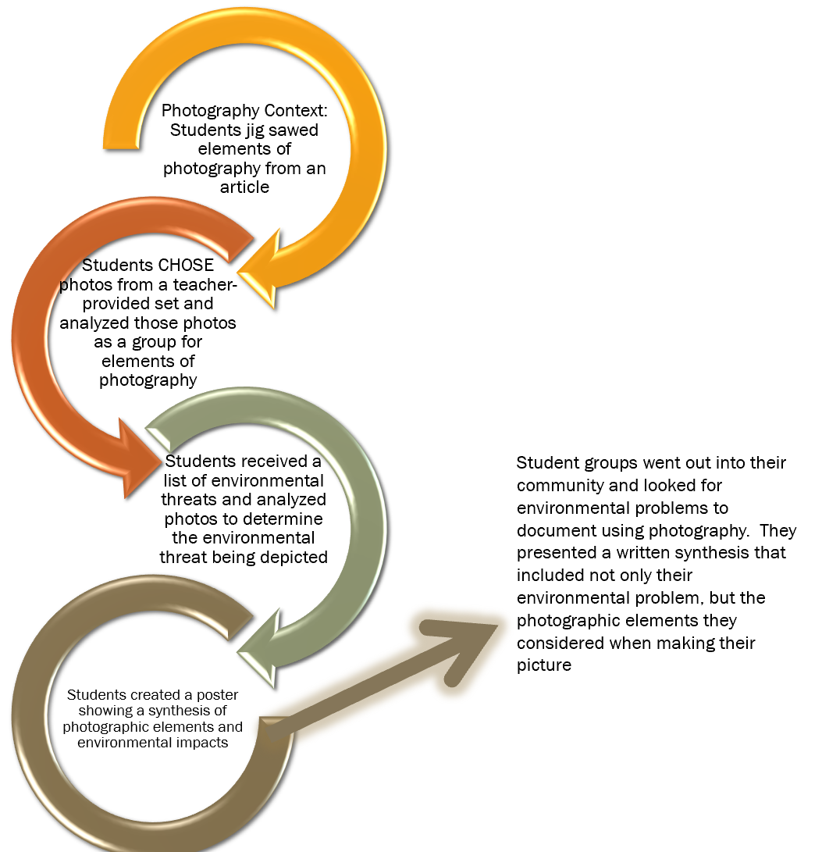
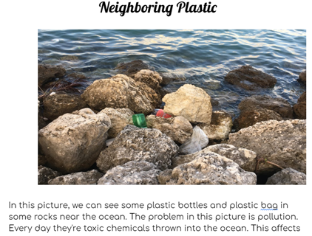
Example - Fairchild Challenge Conservation Photography
This STEAM example is covered in the PBL Resource - it is GREAT for literacy because you can have students work on their writing as they work to the final product!

Slide 42
Growing Beyond Earth, A Multi-Disciplinary STEM Project

Slide 43
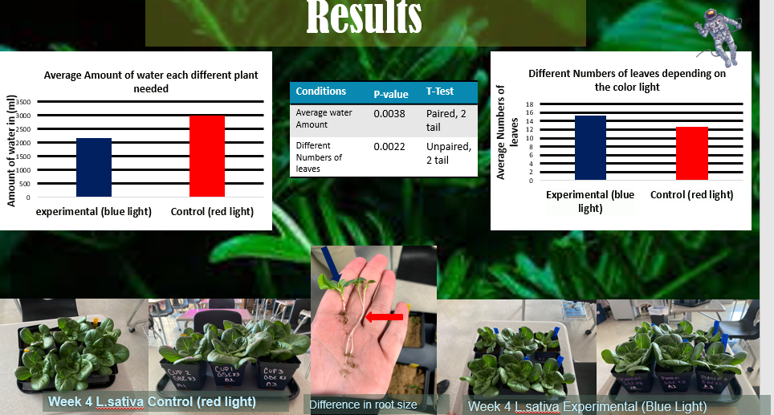
Growing Beyond Earth
-Students grow cultivars chosen by NASA in the classroom and collect data on plant growth
-Students tested different wavelengths of light in a side-by-side trial.
(Direct application of explicitly taught science practices)
-Students constructed the boxes from parts provided, operated tunable lights, and had to troubleshoot issues experienced with the boxes.
-Following data collection, students used excel to analyze data and create graphs, as well as powerpoint to create a presentation, following explicit instruction (Technology integration)
-Students conducted statistical analysis to determine if the differences in their experimental data were significant, after an explicit lesson in statistical methods. (Mathematics integration).
-Students presented their data to NASA at Fairchild’s Research Symposium and is eventually used to inform the VEGGIE project on the ISS.

Slide 44
THANK YOU!

Slide 45
References
Beckett, G.H., Hemmings, A., Maltbie, C., Wright, K., and Sherman, M. (2015). An evaluation study of the CincySTEM ITEST projects: Experience, peer support, professional development and sustainability. Journal of STEM Teacher Education, 50 (1), p. 3-17.
Bicer, A. and Capraro, R.M. (2019). Mathematics achievement in the secondary high school context of STEM and non-STEM schools. School Science and Mathematics.
Christensen, R., Knezek, G., and Tyler-Wood, T. (2015). Alignment of hands-on STEM engagement activities with positive STEM dispositions in secondary school students. Journal of Science Education and Technology, 24, p. 898-909. DOI https://doi.org/10.1007/s10956-015-9572-6
Duncan-Andrade, J.M., and Morrell, E. (2008). The art of critical pedagogy: Possibilities for moving from theory to practice in urban schools. Counterpoints, 285, p. 23-48.
Eisenkraft, A. and Freake, S.C. (Eds.). (2018). Beyond the Eggdrop: Infusing engineering into high school physics. NSTA Press
Fredricks, J.A., Wang, M., Linn, J.S., Hofkens, T.L., Sung, H., Parr, A., and Allerton, J. (2016). Using qualitative methods to develop a survey measure of math and science engagement. Learning and Instruction, 43, p. 5-15.

Slide 46
References (Continued)
Hall, A. and Miro, D. (2016). A study of student engagement in project-based learning across multiple approaches to STEM education programs. School Science and Mathematics, 116 (6), p. 310-319.
Honey, M., Pearson, G., & Schweingruber, H. (2014). STEM integration in K-12 education: Status, prospects, and an agenda for research. The National Academies Press. (Free download available at: http://www.nap.edu/catalog/18612/stem-integration-in-k-12-education-status-prospects-and-an)
Lenz, B. (2015). Transforming schools using project based assessment and Common Core Standards.
Malkiewich, L.J. and Chase, C.C. (2019). What’s your goal? The importance of shaping the goals of engineering tasks to focus learners on the underlying science. Instructional Science, 47, p. 551-558. DOI: https://doi.org/10.1007/s11251-019-09493-2
SMU Maker Education Project. (2018). STEM Engineering Template. Southern Methodist University. Retrieved October 24, 2018, from http://smumakeredproject.org/. NO LONGER AVAILABLE.
Toshalis, E. (2015). Make me!: Understanding and engaging student resistance in school. Harvard Education Press.

