Slide 1
Welcome Message
Given our unique PD delivery format, we ask that for the time being you mute your microphones. Your experiences and views as educators are greatly valued; therefore, we have built in opportunities for constructive dialogue, feedback and questions throughout our session. We will get started shortly and we thank you for your cooperation.
Notes:
Richard will read the opening welcome message

Slide 2
Virtual PD Protocol
Please keep your microphones muted when not participating.
Please keep cameras on, unless you need to step away for personal circumstances.
If you have a question, please use the Zoom chat feature.
Please maintain professionalism and decorum if differences of opinion arise over content.
For technical issues please refer to facilitator Professor Young using Zoom chat.
Notes:
Richard will read the opening welcome message

Slide 3
Attendance Requirements
In order to receive the $100 stipend and Master Plan Points, you must attend all 3 sessions on your agenda
8:30 – 10:30 am
10:45 am – 12:45 pm
1:30 – 3:30 pm
We will use Whova’s app activity tracker to verify attendance
If you have an issue with Whova and need to receive the Zoom link directly, keep the Whova page open in the background
Notes:
Michelle will read the opening welcome message

Slide 4
Stipend & Master Plan Points
By now, you should have sent a completed W-9 form to Dolores Romero-Aldana (dolores.romero-aldana@miami.edu)
After we verify attendance, UM will process the $100 stipends.
You can expect to receive a check in the mail to the address on your W-9 by the end of August.
At the same time, we will send your information to the M-DCPS Office of Professional Development & Evaluation. They will then add this PD to your My Learning Plan.
You can expect to see the PD listed within the next few weeks.
Notes:
Michelle will read the opening welcome message

Slide 5
Universal Design for Learning and Student Engagement
Presented by: Richard Dominguez and Michelle Izquierdo
This work was made possible due to a grant from the U.S. Department of Education, Award Number U423A170078. The content of this presentation does not necessarily reflect the views or policies of the U.S. Department of Education nor does mention of trade names, commercial products or organizations imply endorsement by the U.S. Government.
Notes:
Michelle and Richard will introduce themselves and Professor Young and welcome all participant.

Slide 6
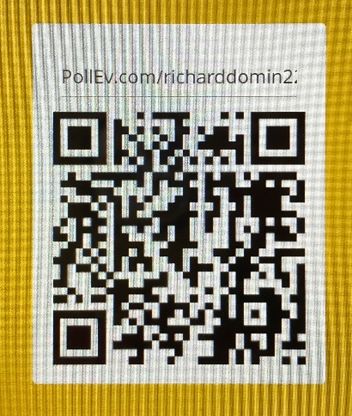
Ice Breaker
What is the first word that comes
to mind when your hear UDL?
Answer the question by choosing one:
Scanning the QR Code
logging in to PollEv.com/richarddomin224
text richarddomin224 to 22333
Notes:
Michelle will present and explain the Ice Breaker while Richard monitors the responses and motivates the participants.

Slide 7
To understand what Universal Design for Learning (UDL) is, it helps to understand what it’s not. The word universal may throw you off. It may sound like UDL is about finding one way to teach all kids. But UDL actually takes the opposite approach.
6 Most Common Myths:
UDL has no research behind it.
UDL is just differentiation
UDL is only good for students with IEP’s
If I purchase a UDL product then I’m doing UDL
UDL is just good teaching
To make UDL work I have to use technology
Notes:
Richard will present while Richard monitors the chat.

Slide 8
What exactly is UDL?
Universal Design for Learning (UDL) is a way of thinking about teaching and learning that helps give all students an equal opportunity to succeed.
This approach offers flexibility in the ways students access material, engage with it and show what they know.
Developing lesson plans this way helps all kids, but it may be especially helpful for kids with learning and thinking differences
Notes:
Michelle will present while Richard monitors the chat.

Slide 9
UDL Principles:
3 Principles:
Multiple means of…
Representation
Engagement
Expression
Notes:
Richard will present while Michelle monitors the chat.

Slide 10
Multiple means of representation
Gives learners various ways to acquire the necessary information for academic success. For example, textbooks are primarily visual. But providing text, audio, video and hands-on learning gives all kids a chance to access the material in whichever way is best suited to their learning strengths.
Notes:
Richard will present while Michelle monitors the chat.

Slide 11
Multiple means of engagement
Encourages teachers to look for multiple ways to motivate students. Letting kids make choices and giving them assignments that feel relevant to their lives are some examples of how teachers can sustain students’ interest.
Notes:
Richard will present while Michelle monitors the chat.

Slide 12
Multiple means of expression
Provides learners with alternatives for demonstration of recently acquired knowledge. For example, students might get to choose between taking a pencil-and-paper test, giving an oral presentation or doing a group project.
Notes:
Richard will present while Michelle monitors the chat.

Slide 13
Notes:
Richard will make reference to this sheet being one of the resource document available at the end of the presentation.

Slide 14
Learning and Thinking Differences and UDL
UDL helps all students. But here are some of the ways it may be especially helpful to kids with learning and thinking differences:
UDL is regarded so highly that it’s mentioned by name in the nation’s main education law. The Every Student Succeeds Act (ESSA) encourages states and districts to use federal funding to help teachers expand the use of UDL.
Notes:
Michelle will present while Richard monitors the chat.

Slide 15
Discussion Question
When we refer to a diverse group of students, we are referring to the aspects of culture and identity in the classroom. What are the aspects of culture and identity?
Answers
Race
Ethnicity
Gender
Age
Sexual Orientation
Appearance
Self-esteem
Traditions
Religion
Language
Neighborhood
Interests/hobbies
Relationships with parents/friends
School
History: ancestry
Notes:
Michelle will read the question and Richard will go over the answers once the participant have shared their responses.

Slide 16
Break 10 minutes

Slide 17
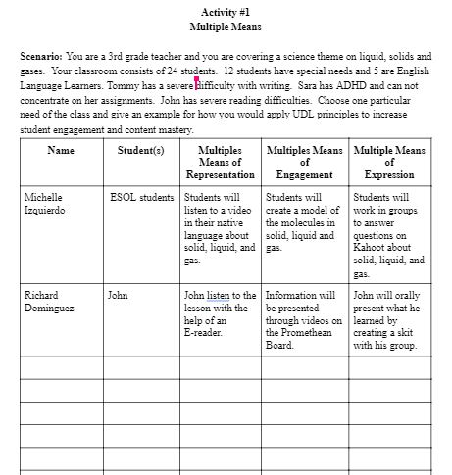
Activity #1 Multiple Means
Provide one example for each of the 3 multiple means on the provided document located on the google drive.
Notes:
Michelle will present the activity while Richard monitors the responses.

Slide 18
UDL Lesson planning
Now that we know what UDL is, how do we start using it effectively?
A few things to always keep in mind when creating your lesson plans:
Intentional proactive planning addressing distinct student needs.
Address individual differences with background knowledge, affect, strategies, etc. (Consider what students know, strengths and weaknesses, and what engages them).
Recognize that every student is unique and plan accordingly, paying attention to students in the margins (i.e., struggling and advanced) in anticipation that a broader range of students will benefit.
Address the instructional demands including goals, methods, materials, and assessments while considering available resources.
Maintain rigor of the lesson while providing necessary supports.
Reduce the barriers in the curriculum by embedding supports during initial planning
Notes:
Michelle will present while Richard monitors the chat.

Slide 19
Here is an example of what a UDL lesson plan format may look like for your content/special areas. The areas highlighted in Orange are the ones to pay close attention to when creating your plans. These areas make the difference between regular plans and UDL plans. The UDL lesson plan contains within it the 5E model:
Engage
Explore
Explain
Elaborate
Evaluate
In the UDL lesson plan they are listed as Before, During and After
Notes:
Richard will present while Michelle monitors the chat.

Slide 20
UDL Lesson planning for online platforms
Notes:
Richard will present while Michelle monitors the chat.

Slide 21
UDL Lesson planning for online platforms
The quality of student engagement correlates directly with the quality of student learning: An engaged student learns better. While convenience, accessibility, and flexibility attract many students to online learning, the learning environment can be alienating if not thoughtfully designed.
The learners drawn to online learning bring an increasing diversity of abilities and represent vast differences economically, geographically, racially, linguistically, religiously, culturally, and sexually. As a result, traditional online instruction that is, for example, text-based, driven by information provision, and assessed through regurgitation will not offer the flexibility to meet the variety of learning needs. In this light, the role of the instructor and the design of the learning environment are the primary determining factors in student engagement (Pianta, R. C., Hamre, B. K., and Allen, J. P., 2012).
Student learning outcomes depend on the depth and quality of their engagement in learning. Since the early 2000s, the concept of engagement has gained a lot of attention from researchers (Sharan, S. and I. Tan., 2008). Scholars often define engagement as a complex construct that consists of behavioral, cognitive, and emotional components, and argue instructors should attend to each one of these components to effectively engage their learners.
Notes:
Richard will present while Michelle monitors the chat.

Slide 22
Technology
A central focus of UDL is to promote the development of new curricular materials and learning technologies that are flexible enough to accommodate the unique learning styles of a wide range of individuals, including children with disabilities. (Strobel, 2007)
Software/Websites
Classroom Screen
E-reader
Grammarly
Newsela
Spelling City
Brainpop
Kahoot
Handheld Devices
I-pads
Cell Phones
Tablets
Apps/Moble Tools (calendar & reminders)
Lap Tops
Popular Classroom
Technology
Presentation Tools
Internet Videos
QR Codes
Promethean Boards
PowerPoint Presentations
Notes:
Michelle will present while Richard monitors the chat.

Slide 23
Assistive Technology
A term used to describe any device or service that increases, maintains, or improves the functional performance of an individual with a disability.
Notes:
Michelle will present while Richard monitors the chat.

Slide 24
Discussion Question #2
What UDL strategies did you experience as a learner during this professional development?
Answer:
Multiple Means of Representation - PowerPoint, Oral Discussion, Video with Closed Captions
Multiple Means of Engagement- Poll Everywhere, Small Break Out Groups, and QR code for accessibility.
Multiple Means of Expression- Provided choice for Autonomy with the activity ( Write and/or Orally Discuss)
Notes:
Richard will present and Michelle will guide the answers

Slide 25
End of Session
Evaluations
Do NOW – Qualtrics Survey (PD Feedback for SEALED Presenters)
Click on the link within the Zoom chat for this session to complete the evaluation
Do LATER - MDCPS My Learning Plan Evaluation
Once your attendance has been confirmed and registration information submitted to the M-DCPS Office of Professional Development and Evaluation, this session will appear on your MLP (this will take a few weeks).
Notes:
Michelle will present this slide Richard will monitor the chat.

Slide 26
Udl Resources
http://castprofessionallearning.org/free-udl-resources-and-tips/
file:///C:/Users/richa/OneDrive/Desktop/UDL%20Article%201.pdf
file:///C:/Users/richa/OneDrive/Desktop/UDL%20Article%202.pdf
file:///C:/Users/richa/OneDrive/Desktop/UDL%20Article%203.pdf
file:///C:/Users/richa/OneDrive/Desktop/UDL%20Article%204.pdf
https://sites.google.com/site/udlguidelinesexamples/
https://www.theudlproject.com/udl-tools---all-grades.html
https://sites.google.com/site/udlguidelinesexamples/
Notes:
Richard will explain all resources and Michelle will ,monitor the chat

Slide 27
Udl examples for lesson planning
Sample lesson plan template and examples:
http://www.udlcenter.org/aboutudl/udlguidelines/principle1
http://www.udlcenter.org/aboutudl/udlguidelines/principle3
http://www.udlcenter.org/aboutudl/udlguidelines/principle2
Notes:
Richard will explain all resources and Michelle will ,monitor the chat

Slide 28
REFERENCES
Strobel, W., Arthanat, S., Bauer, S., & Flag, J. (2007). Universal design for learning:
Critical Need Areas for People with Learning Disabilities. Rehabilitation
Engineering Research Center on Technology Transfer, 81-98.
An Evmenova, A. (2018). Preparing teachers to use universal design for learning
to support diverse learners . Journal of Online Learning Research 4 (2),
147-171.
Marino, M. T., Israel, M., Beecher, C. C., & Basham, J. D. (2012). Students’ and
teachers’ perceptions of using video games to enhance science
instruction. Journal of Science Education and Technology. Advance online
publication. doi:10.1007/ s10956-012-9421- 9
Every Student Succeeds Act (ESSA). (2015). U.S. Department of Education. Retrieved July 14, 2020, from https://www.ed.gov/essa?src=rn
Pianta, R. C., Hamre, B. K., and Allen, J. P. Teacher-student relationships and engagement: Conceptualizing,
measuring, and improving the capacity of classroom interactions. In S. Christenson, A. Reschly, and C. Wylie
(Eds.). Handbook of Research on Student Engagement. Springer, New York, 2012, 365-386.
Sharan, S. Student engagement in learning. In S.Sharan, and I. Tan (Eds.) Organizing Schools for Productive
Learning. Springer, New York, 2008, 41-45.
Notes:
Michelle and Richard will cover the citations.

