Slide 1
Project Based Learning (PBL) Angela Compton
Includes An Excerpt From: Project Based Learning as a Vehicle To Promote Engagement and Achievement: A Focus On STEM (2020)
By Angela Compton and Erica Auguste
Available at bit.ly/SEALEDSI

Slide 2
The Engagement Problem (Be sure you check out the engagement toolkit and engagement resources in this repository!)

Slide 3
Developing a Definition of Engagement
Engagement is . . .
A predictor of educational outcomes
An indicator that students are actively involved in their learning
A flexible state that can be increased by improving instruction
An indicator that can be used to target intervention for academic success
Multi-dimensional construct
Source: Fredricks et. al, (2016)
Notes:
15 Minutes

Slide 4
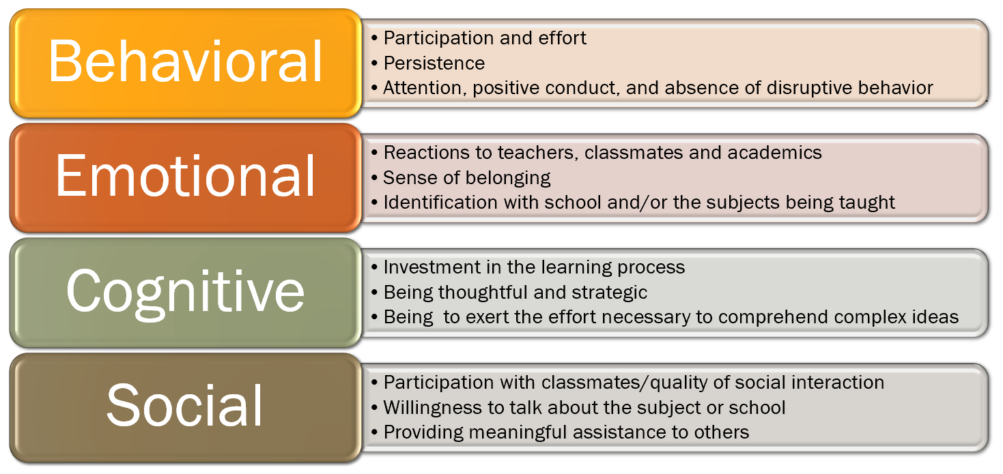
The Multi-Dimensional Nature of Engagement
Source: Fredricks et. al, (2016)
Notes:
Interactive if time allows - what might these various elements look like? Which do you see as missing from your classroom.

Slide 5
Why This Matters
There is a disconnect between what is being taught in school and the skills students will need for the real world.
Students, especially marginalized student groups, feel that the goals and purposes of education are not the same as their goals and purposes. For these students, education is no longer culturally relevant.
Disengagement is how students show that disconnect (Toshalis, 2015).
Only 8% of low-SES students finish a 4-year college degree by their mid-20s (Lenz, 2015).
Think about who makes up the L25 at your schools . . .
SES/Race/Gender/ELL/ESE-->Marginalized populations
Goals of Education

Slide 6
Educational Theory Supporting PBL
Theoretical support for PBL/STEM is also supported via Dewey’s learning by doing principals.
According to Christensen, Knezek and Tyler-Wood (2015), active learning is:
(1) relevant to real-world applications,
(2) offer students an authentic opportunity to solve real-world problems, &
(3) use the application of prior knowledge and experiences to solve current problems.

Slide 7
Connection to Critical Pedagogy
There is a great deal of theoretical overlap between Dewey’s principles of active learning and critical pedagogy.
Duncan-Andrade and Morrell (2008) highlight the importance of critical pedagogy in urban schools to address the disconnect that many marginalized students have with the goals and purpose of education.
Critical pedagogy relies on the idea of praxis as a center of education
identifying a problem,
analyzing it
creating and implementing a plan of action
This is closely aligned to the framework behind project-based learning.

Slide 8
PBL, STEM and MBE
Holy initials, Batman!

Slide 9
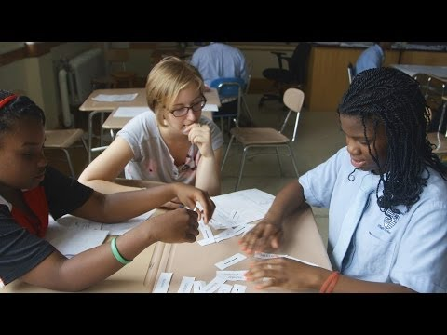
Notes:
Erica:1.
1. After watching this video; have you already been doing PBL in your classroom?
2. How can you bring this to your classroom?
7 minute Video
10 minute Discussion

Slide 10
Notes:
Sometimes PBL can be both. Great Plankton Race as example.
Tissue Box for Evolution → MBE, PBL

Slide 11
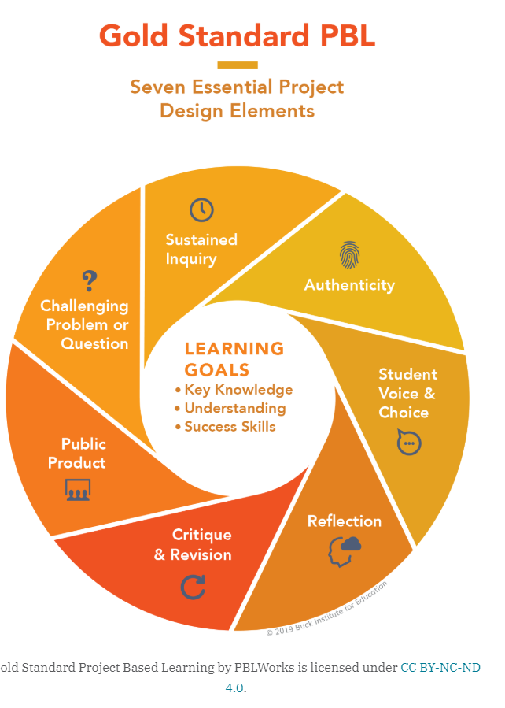
Essential Design Elements of PBL
Source: Buck Institute for Education (2019)

Slide 12
Keep it Simple - Beginning PBL
Source: Buck Institute for Education (2019)
Notes:
BIE resources used to be better organized. I now find their website incredibly confusing, so pertinent information has been uploaded to the google drive.

Slide 13
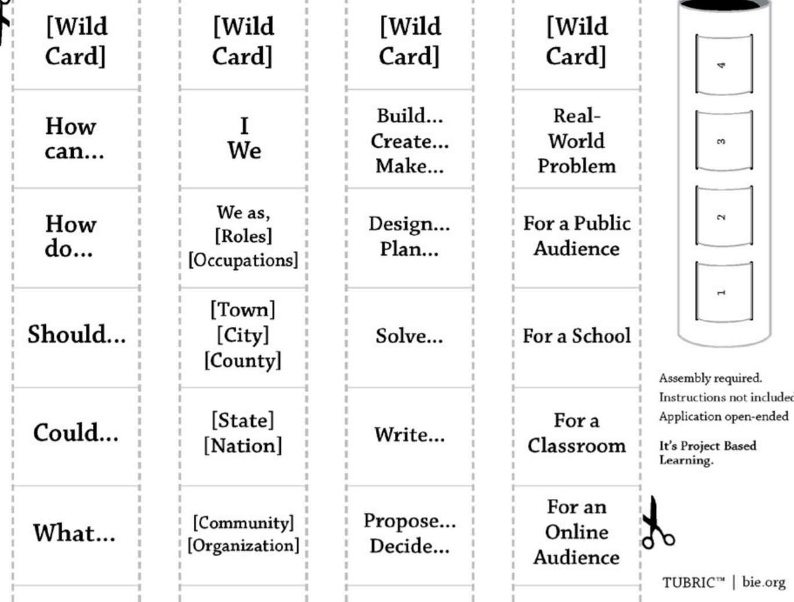
No one ACTUALLY builds the tubric
BUT if you are new to PBL makes the components of design simple
Source: Buck Institute for Education (2019)
Notes:
When I was first learning PBL, this Tubric was an ah-hah moment. Once I saw it this way, I realized I could design anything for my students.

Slide 14
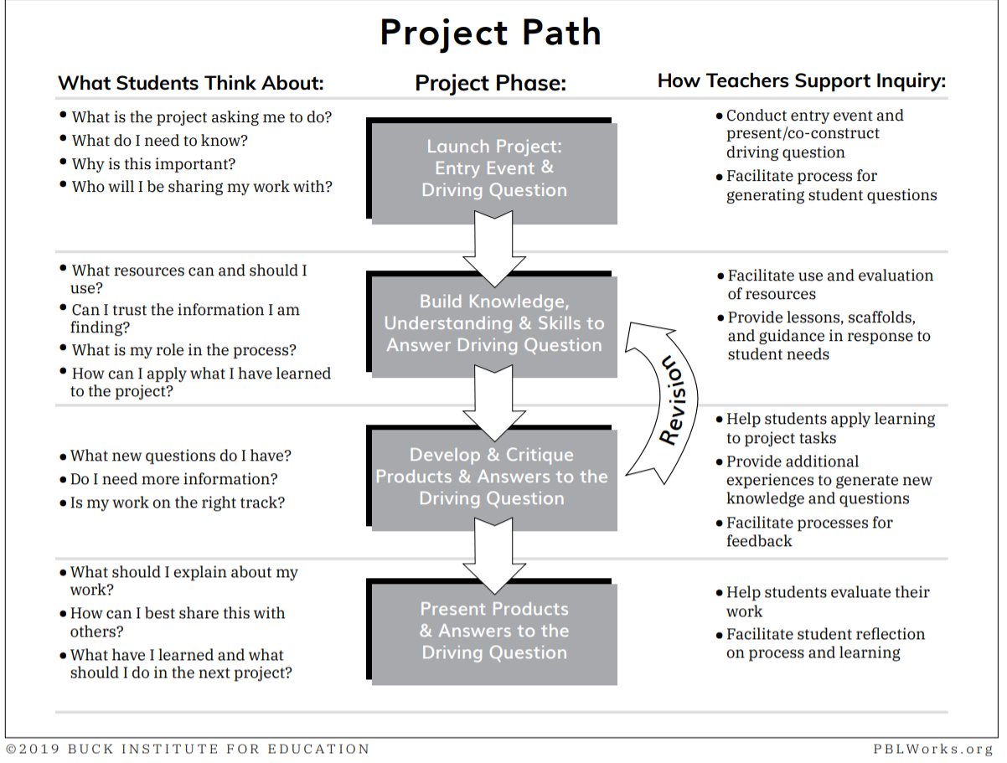
Source: Buck Institute for Education (2019)

Slide 15
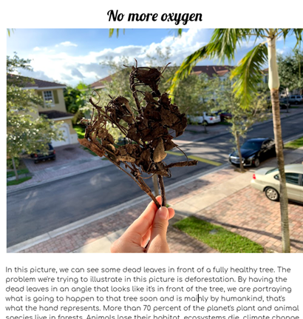
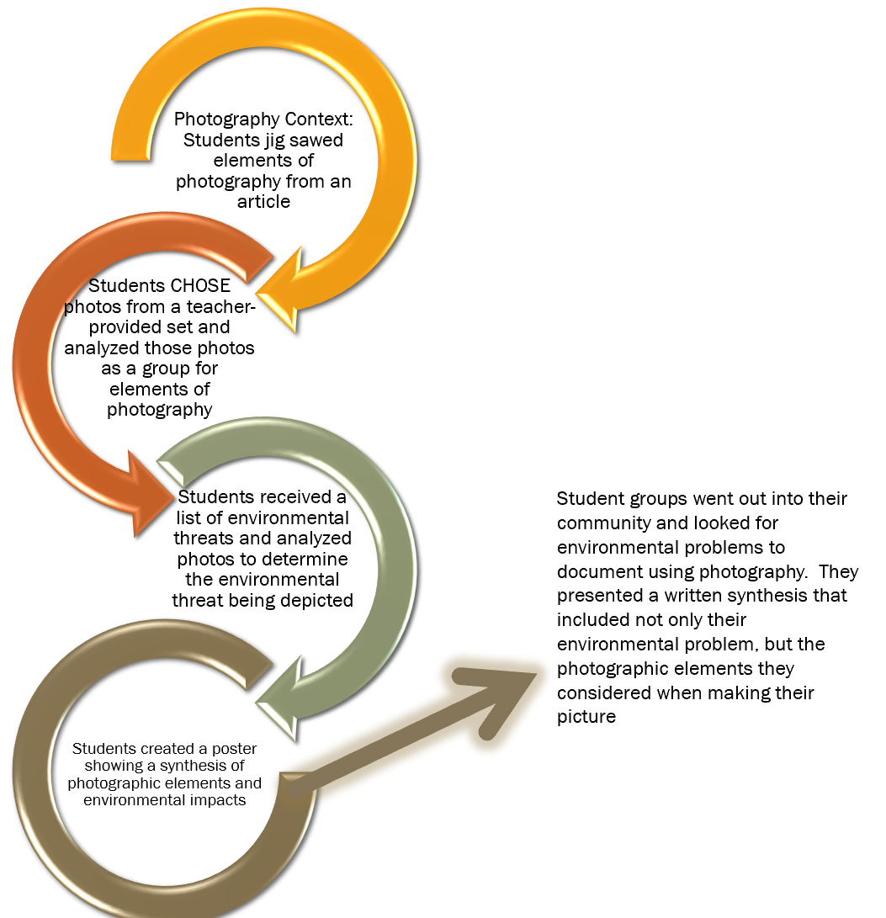
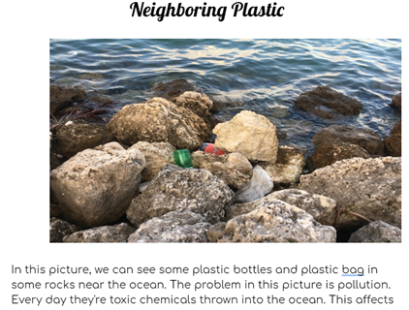
Example - Fairchild Challenge Conservation Photography
PBL is GREAT for literacy because you can have students work on their writing as they work to the final product!

Slide 16
How to get the most out of your PBL
Length/scope of PBL can be customized to the teachers’ setting/pacing, curricular requirement, and instructor-developed resources will be provided to facilitate teacher-developed PBL and/or STEM activities.
Keys | Examples
1.Real World
2.Core Learning
3.Collaboration
4.Student Driven
5.Assessment

Slide 18
How to Get Your CSS, Coach or Administration to BUY IN

Slide 19
The Value of PBL on Achievement
PBL, and especially STEM approaches, when implemented consistently and with fidelity, have the potential to increase achievement, interest, and engagement of marginalized student groups who are also underrepresented in STEM fields (Malkiewich and Chase, 2019, Scott-Parker and Barone-Nugent, 2019)
Bicer and Capraro (2019) conducted a quasi-experimental study of mathematics achievement growth at 64 STEM and non-STEM schools in Texas. While the study demonstrated no change in achievement growth in the entire student population, Latino students and African American students at the STEM schools demonstrated a higher growth rate than at their counterparts at non-STEM schools.
Notes:
Think back to the L25 we talked about earlier.

Slide 20
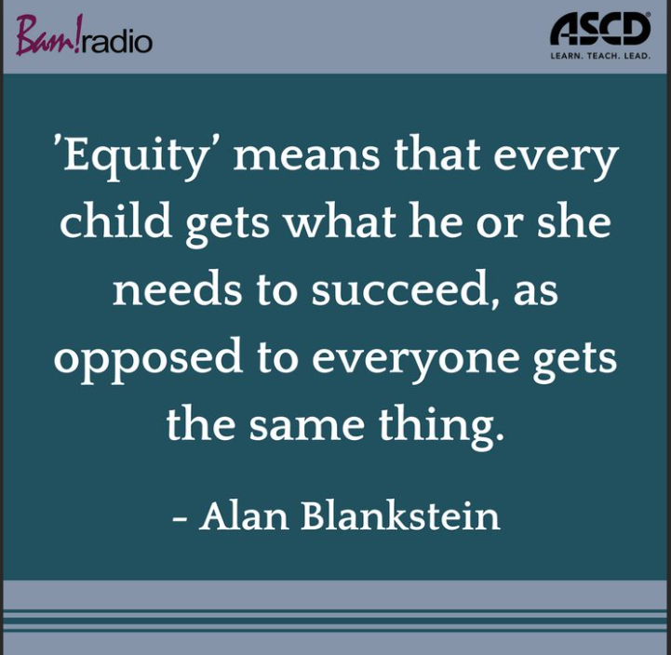
Notes:
The achievement gap is not going away with the methods we are currently using. If anything, student perceptions of ability and interest are DECREASING, especially in STEM fields, for marginalized student groups. By rethinking how we approach learning concepts, we offer our students an opportunity to see themselves as mathematicians, as engineers, as scientists.

Slide 21
The Value of PBL on Engagement
Scott-Parker and Barone Nugent (2019) conducted a small case study of 4 Year 10 Australian girls that demonstrated significant changes in student engagement student dispositions to both math and science. In addition, this study found that pairing the students with young, female mentors helped challenge the stereotype that science is conducted by old men. While this study had severe limitations, it supports the importance of authentic, hands on science as a vehicle for increasing student engagement.
Your students will remember the activities and the connections they make long after the things they have memorized have faded.
You will be able to use the survey measure provided with this section to gauge how YOUR students respond to the PBL you create. You will be amazed how perceptions will shift about learning over time.

Slide 22
How to get the most out of your PBL
Providing project goals that are content-focused can increase student retention of science/mathematics learning, as opposed to goals that are outcome-based (Malkiewich and Chase, 2019).
Example:
Make a brochure for fisherman that highlights the ways that sea grasses and seaweeds differ in terms of structure and classification
Vs
Make a brochure for fisherman that highlights the differences between sea grasses and sea weeds

Slide 23
How to get the most out of your PBL
Take the time to create resources that will utilize the concept of contrasting cases (comparisons) to promote students to make deeper meaning of their new content
Examining multiple representations of a concept provides instructional scaffolding to allow students to make deeper meaning from their new science/math content, thereby supporting the development of higher-order questioning (Hall and Miro, 2016; Malkiewich and Chase, 2019).
These contrasting cases are an excellent opportunity to link assessment-aligned questions to your PBL to prepare for end of year assessments.

Slide 24
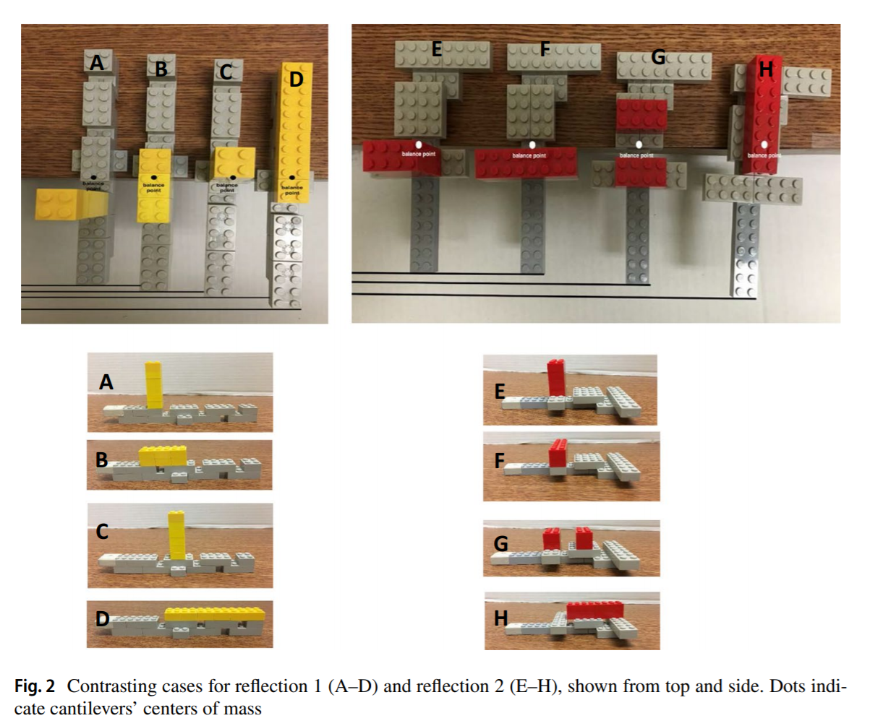
How to get the most out of your PBL
Contrasting cases are the BEST WAY to connect your accountability goals to your activity.
You can even use EOC/FSA style questions and visual representations.
Examples:
Ask students to evaluate parabolas for differences
Ask students to compare various representations of cells for difference
Source: Malkiewich and Chase (2019)

Slide 25
Notes:
Sometimes PBL can be both. Great Plankton Race as example.
Tissue Box for Evolution → MBE, PBL

Slide 26
Be sure to check out the STEM and Maker-based items in the SEALED Repository

Slide 27
References
Beckett, G.H., Hemmings, A., Maltbie, C., Wright, K., and Sherman, M. (2015). An evaluation study of the CincySTEM ITEST projects: Experience, peer support, professional development and sustainability. Journal of STEM Teacher Education, 50 (1), p. 3-17.
Bicer, A. and Capraro, R.M. (2019). Mathematics achievement in the secondary high school context of STEM and non-STEM schools. School Science and Mathematics.
Buck Institute for Education. (2019) Home: MyPBLWorks. Retrieved June 06, 2020, from https://my.pblworks.org/.
Christensen, R., Knezek, G., and Tyler-Wood, T. (2015). Alignment of hands-on STEM engagement activities with positive STEM dispositions in secondary school students. Journal of Science Education and Technology, 24, p. 898-909. DOI https://doi.org/10.1007/s10956-015-9572-6
Duncan-Andrade, J.M., and Morrell, E. (2008). The art of critical pedagogy: Possibilities for moving from theory to practice in urban schools. Counterpoints, 285, p. 23-48.
Eisenkraft, A. and Freake, S.C. (Eds.). (2018). Beyond the Eggdrop: Infusing engineering into high school physics. NSTA Press
Fredricks, J.A., Wang, M., Linn, J.S., Hofkens, T.L., Sung, H., Parr, A., and Allerton, J. (2016). Using qualitative methods to develop a survey measure of math and science engagement. Learning and Instruction, 43, p. 5-15.
Gsahsa 4088. (2010, Decemeber 2) Student Disengagement [Video] YouTube https://www.youtube.com/watch?v=d8lxGL33WQE

Slide 28
References (Continued)
Hall, A. and Miro, D. (2016). A study of student engagement in project-based learning across multiple approaches to STEM education programs. School Science and Mathematics, 116 (6), p. 310-319.
Honey, M., Pearson, G., & Schweingruber, H. (2014). STEM integration in K-12 education: Status, prospects, and an agenda for research. The National Academies Press. (Free download available at: http://www.nap.edu/catalog/18612/stem-integration-in-k-12-education-status-prospects-and-an)
Lenz, B. (2015). Transforming schools using project based assessment and Common Core Standards.
Malkiewich, L.J. and Chase, C.C. (2019). What’s your goal? The importance of shaping the goals of engineering tasks to focus learners on the underlying science. Instructional Science, 47, p. 551-558. DOI: https://doi.org/10.1007/s11251-019-09493-2
SMU Maker Education Project. (2018). STEM Engineering Template. Southern Methodist University. Retrieved October 24, 2018, from http://smumakeredproject.org/. NO LONGER AVAILABLE.
Toshalis, E. (2015). Make me!: Understanding and engaging student resistance in school. Harvard Education Press.

