Slide 1
Why Engagement Angela Compton
An Excerpt From: Project Based Learning as a Vehicle To Promote Engagement and Achievement: A Focus On STEM (2020)
By Angela Compton and Erica Auguste
Available at bit.ly/SEALEDSI

Slide 2
Developing a Definition of Engagement
Engagement is . . .
A predictor of educational outcomes
An indicator that students are actively involved in their learning
A flexible state that can be increased by improving instruction
An indicator that can be used to target intervention for academic success
Multi-dimensional construct
Source: Fredricks et. al, (2016)
Notes:
15 Minutes

Slide 3
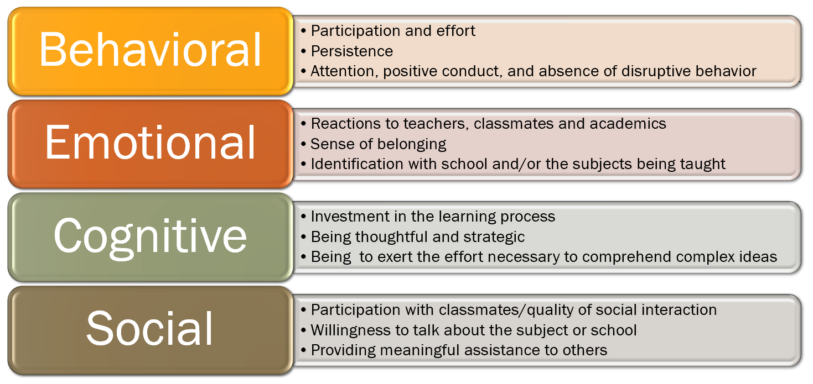
The Multi-Dimensional Nature of Engagement
Source: Fredricks et. al, (2016)
Notes:
Interactive if time allows - what might these various elements look like? Which do you see as missing from your classroom.

Slide 4
Why This Matters
There is a disconnect between what is being taught in school and the skills students will need for the real world.
Students, especially marginalized student groups, feel that the goals and purposes of education are not the same as their goals and purposes. For these students, education is no longer culturally relevant.
Disengagement is how students show that disconnect (Toshalis, 2015).
Only 8% of low-SES students finish a 4-year college degree by their mid-20s (Lenz, 2015).
Think about who makes up the Lowest 25 at your schools . . .
SES/Race/Gender/ELL/ESE-->Marginalized populations
Goals of Education

Slide 5
Using Measures of Engagement to Gauge Student Growth
Using a measure for engagement regularly in your classroom will allow you to
Identify disengaged students who need intervention
Gauge how student perceptions of learning change over the course of the year
Give you a tool with which to immediately gauge the effectiveness of individual activities in your classroom.
This toolkit includes a Student Engagement Survey in a google forms format (Designed for 6-12 Math And Science) and based on Fredricks et. al, (2016). It can be modified for any context.

Slide 6
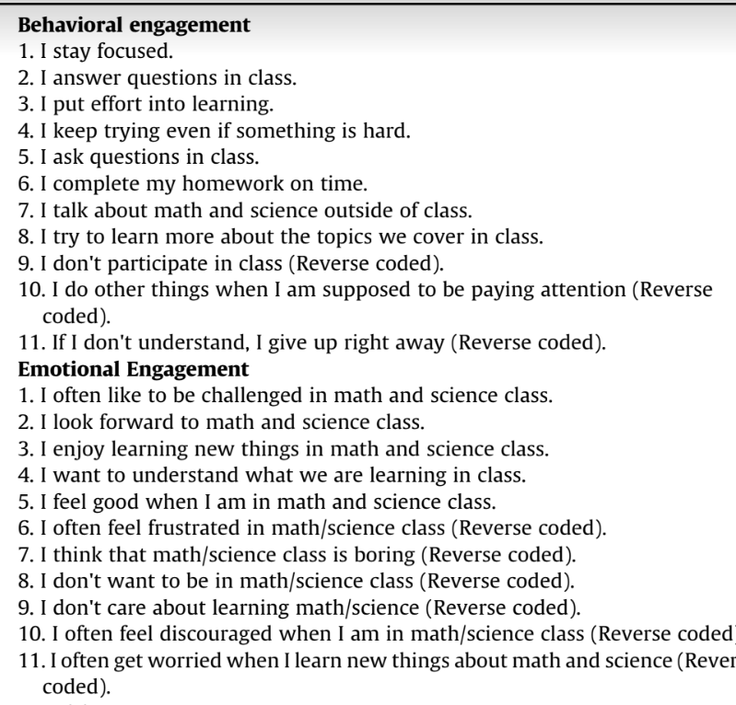
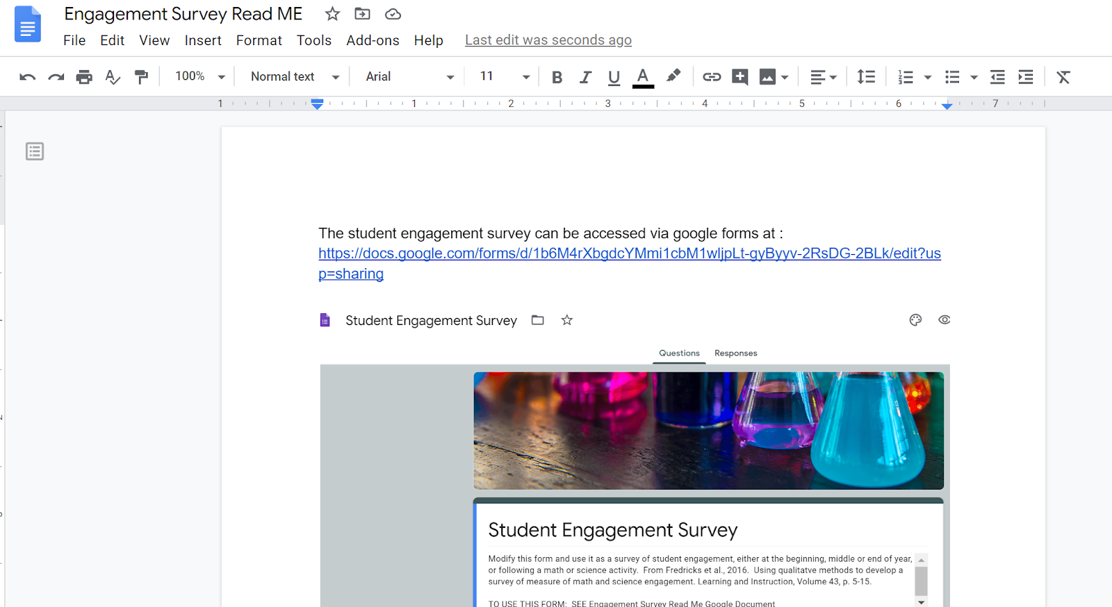
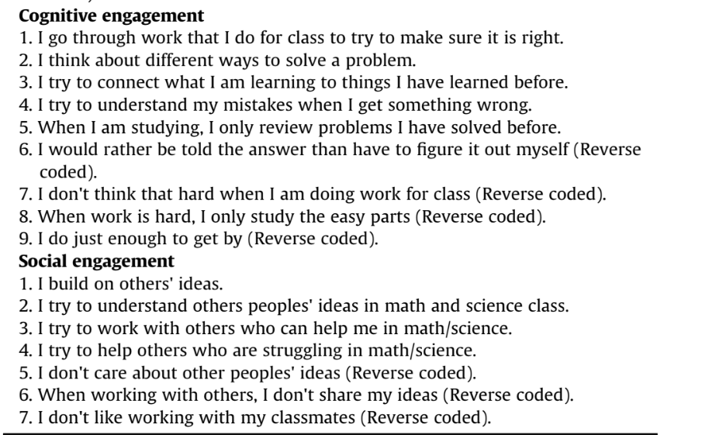
Engagement Survey (Available as a part of this toolkit)
From Fredricks et. al, (2016)

Slide 7
References
Fredricks, J.A., Wang, M., Linn, J.S., Hofkens, T.L., Sung, H., Parr, A., and Allerton, J. (2016). Using qualitative methods to develop a survey measure of math and science engagement. Learning and Instruction, 43, p. 5-15.
Lenz, B. (2015). Transforming schools using project based assessment and Common Core Standards.
Toshalis, E. (2015). Make me!: Understanding and engaging student resistance in school. Harvard Education Press.

