Slide 1
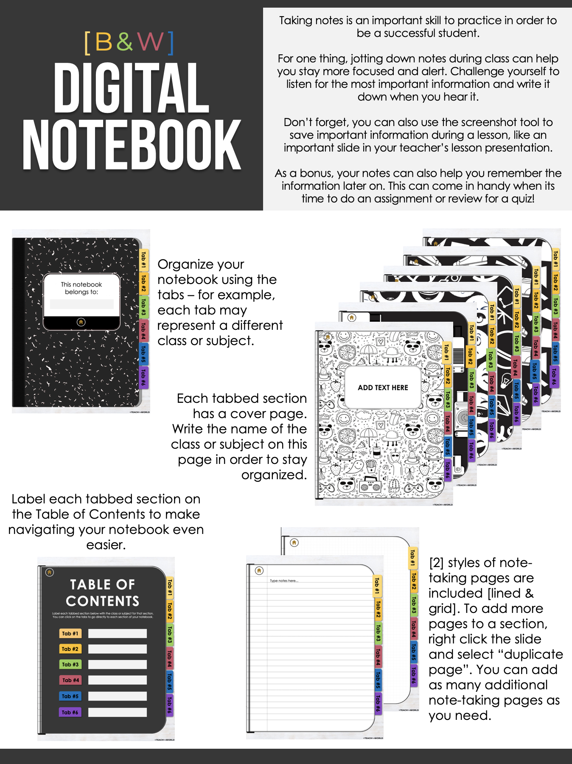

Slide 2
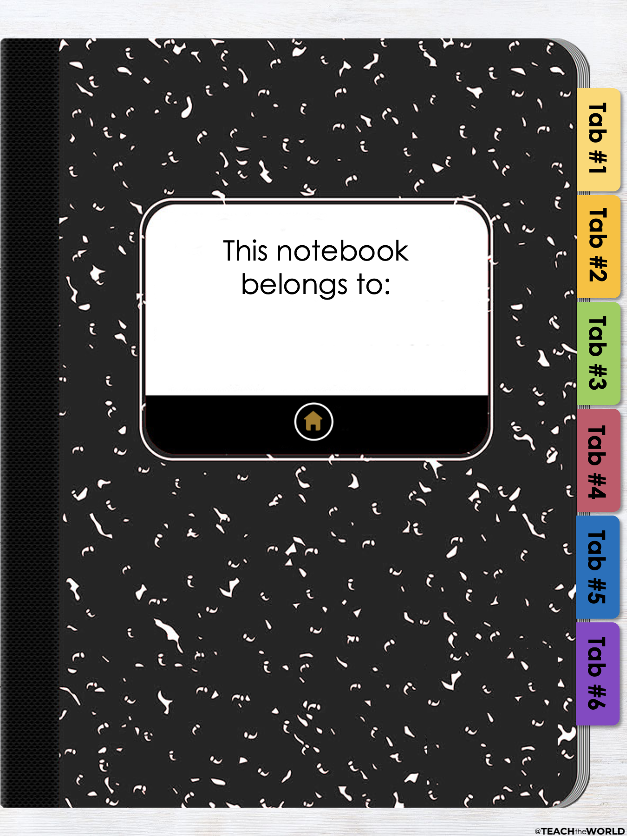

Slide 3
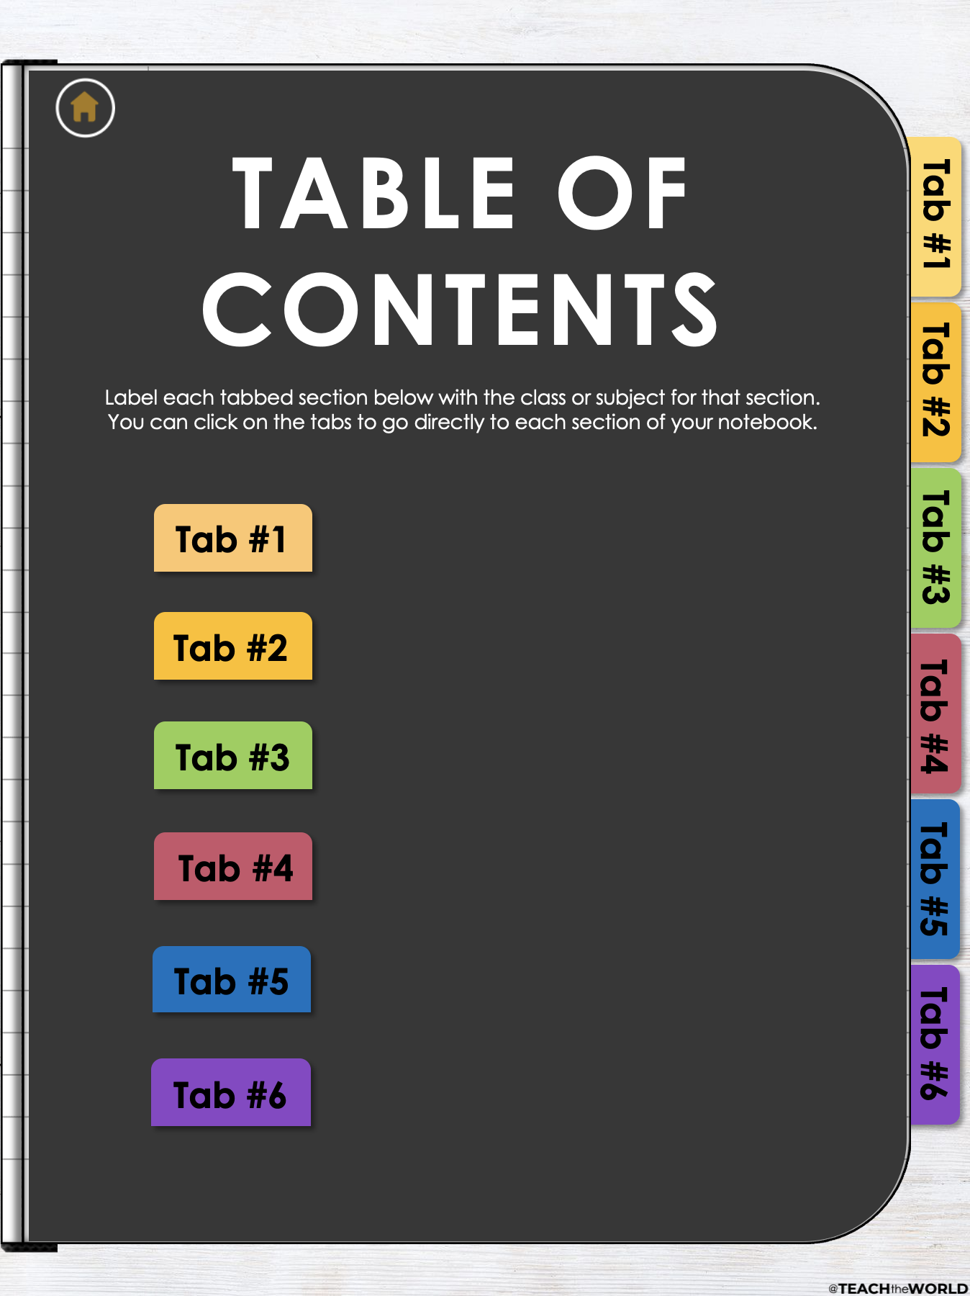

Slide 4
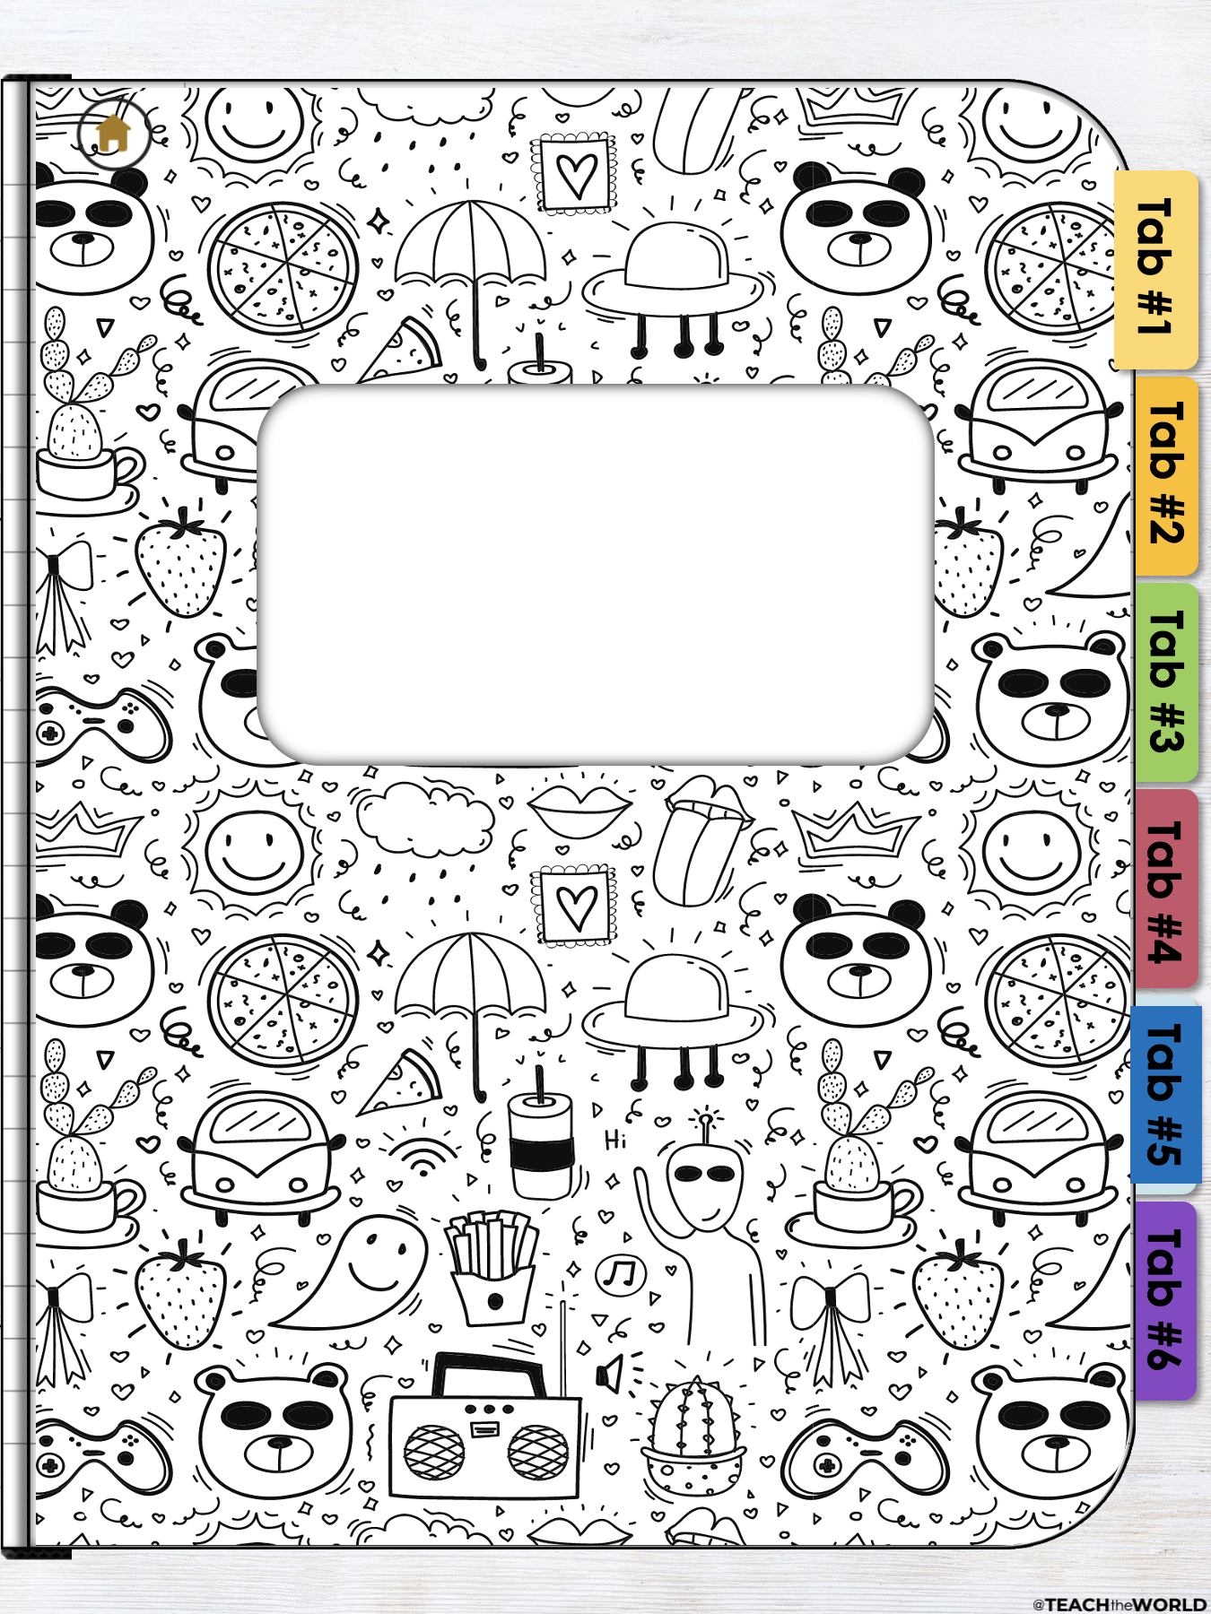
ADD TEXT HERE

Slide 5
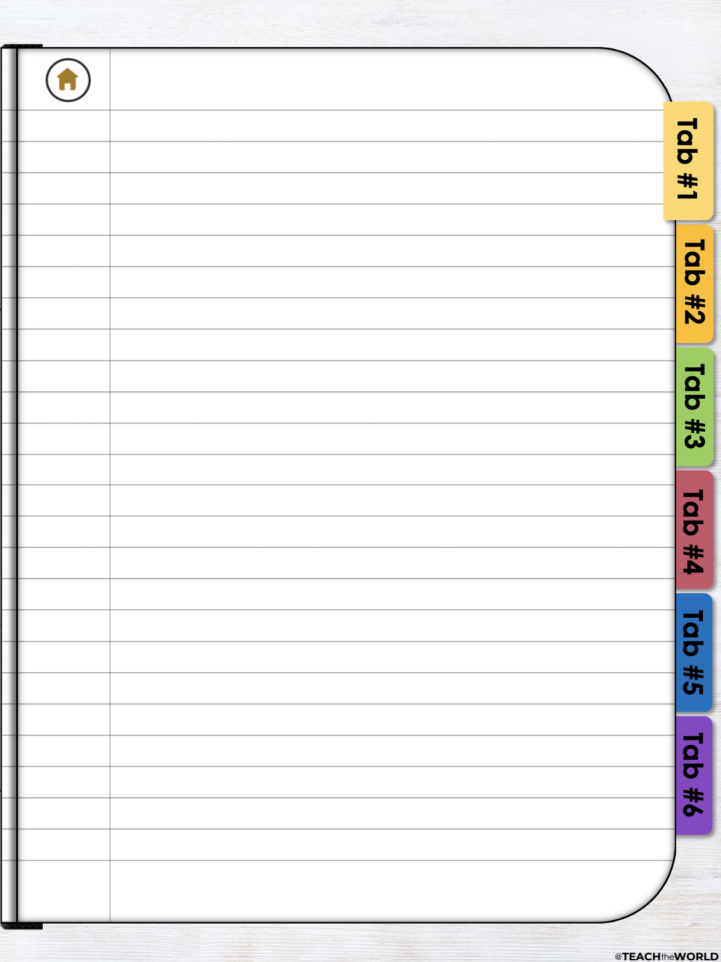
Type notes here...

Slide 6


Slide 7
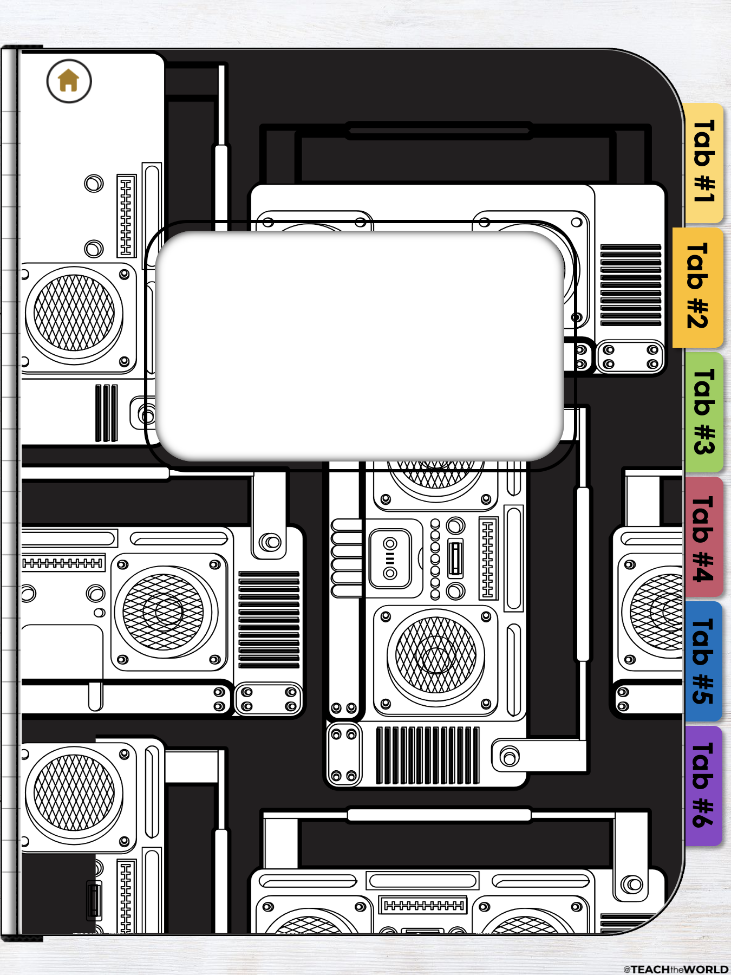
ADD TEXT HERE

Slide 8
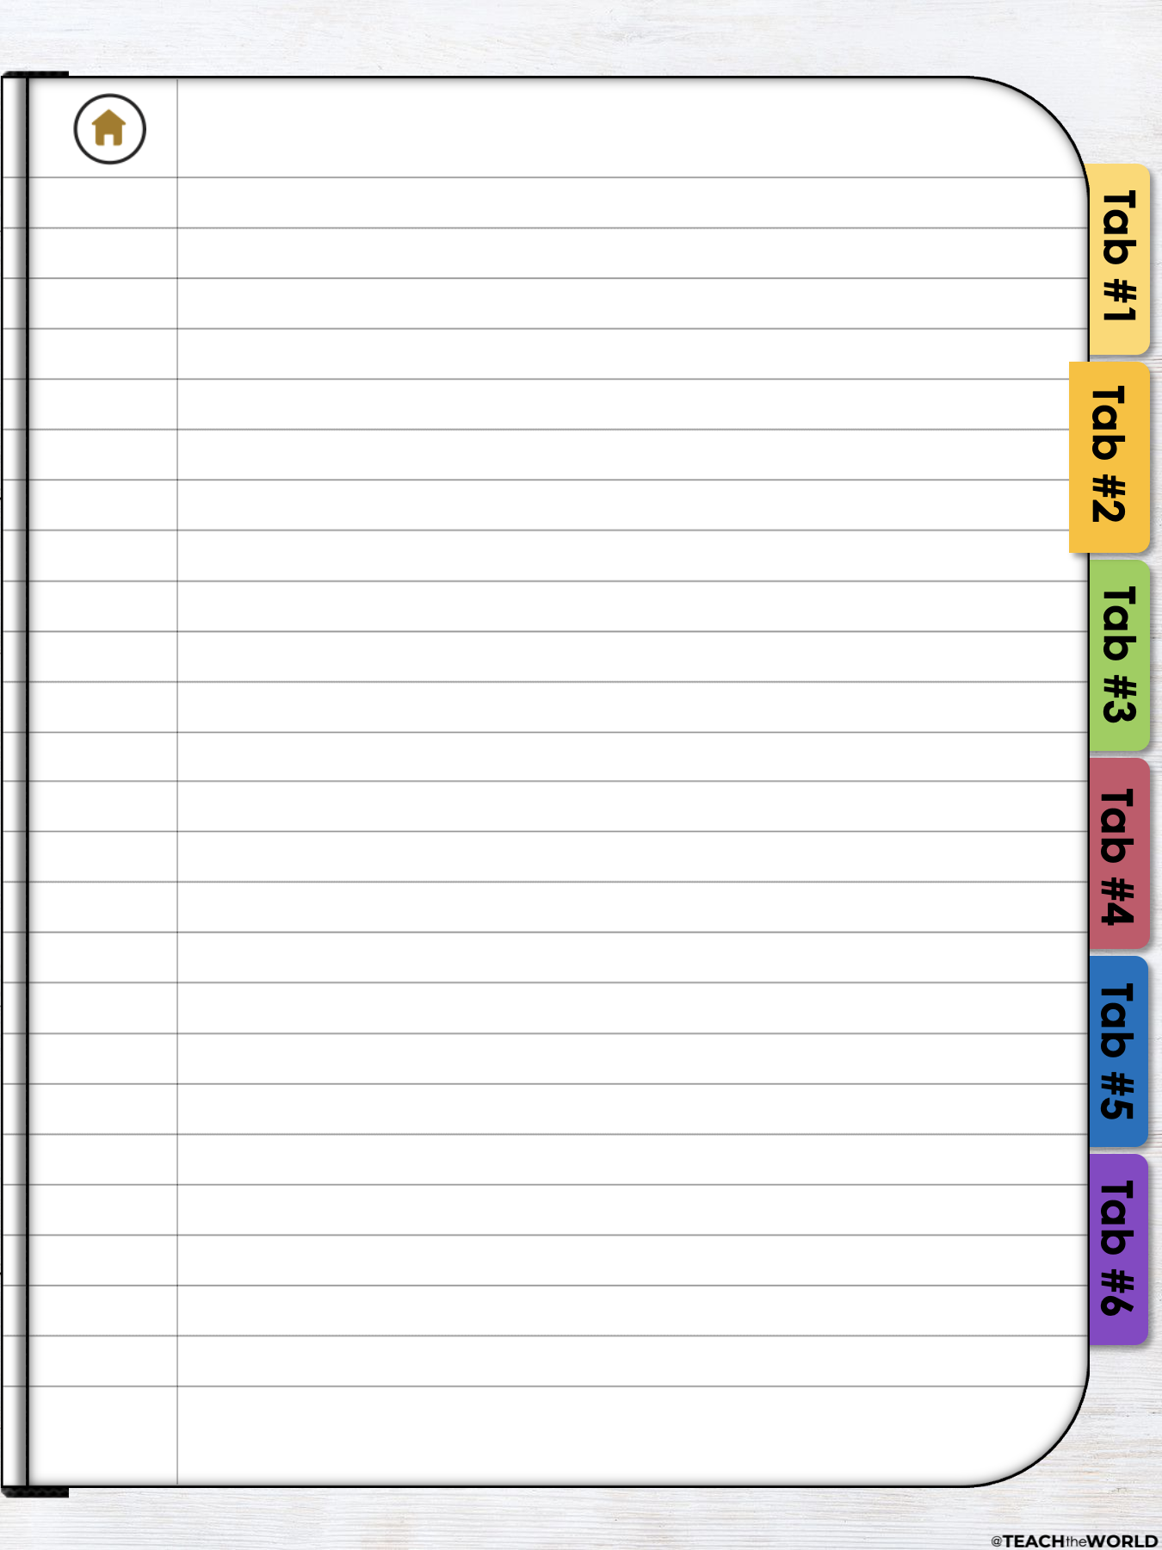
Type notes here...

Slide 9


Slide 10

ADD TEXT HERE

Slide 11
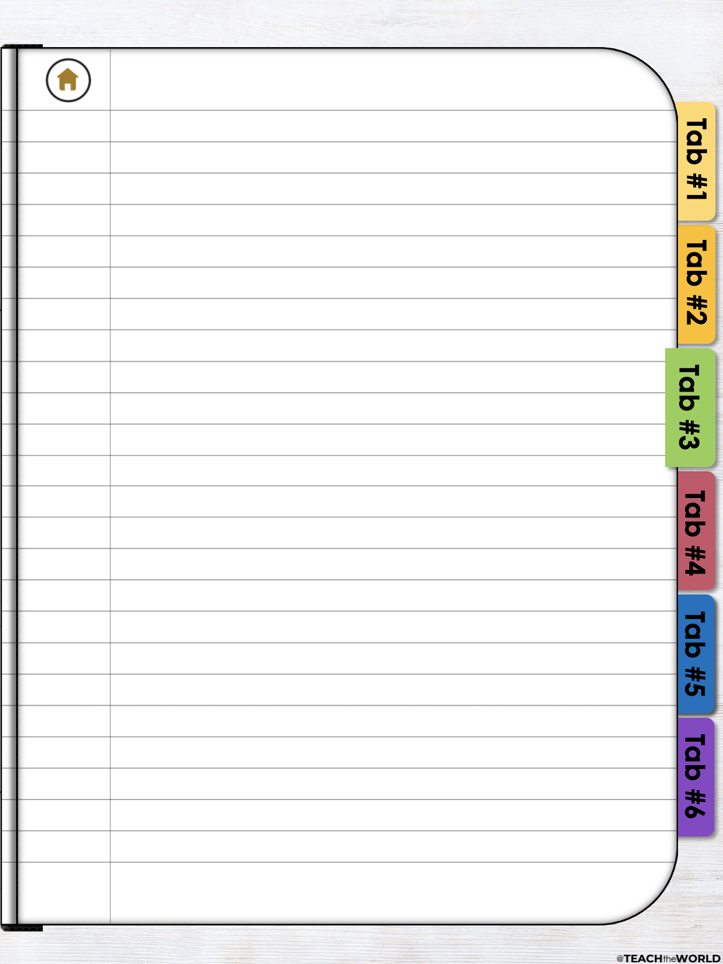
Type notes here...

Slide 12


Slide 13

ADD TEXT HERE

Slide 14
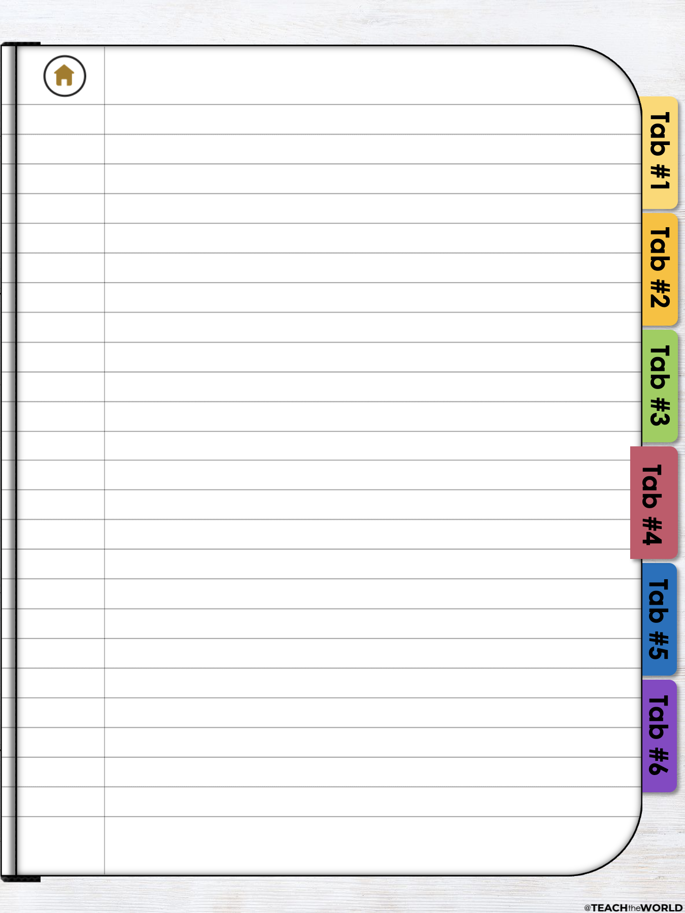
Type notes here...

Slide 15
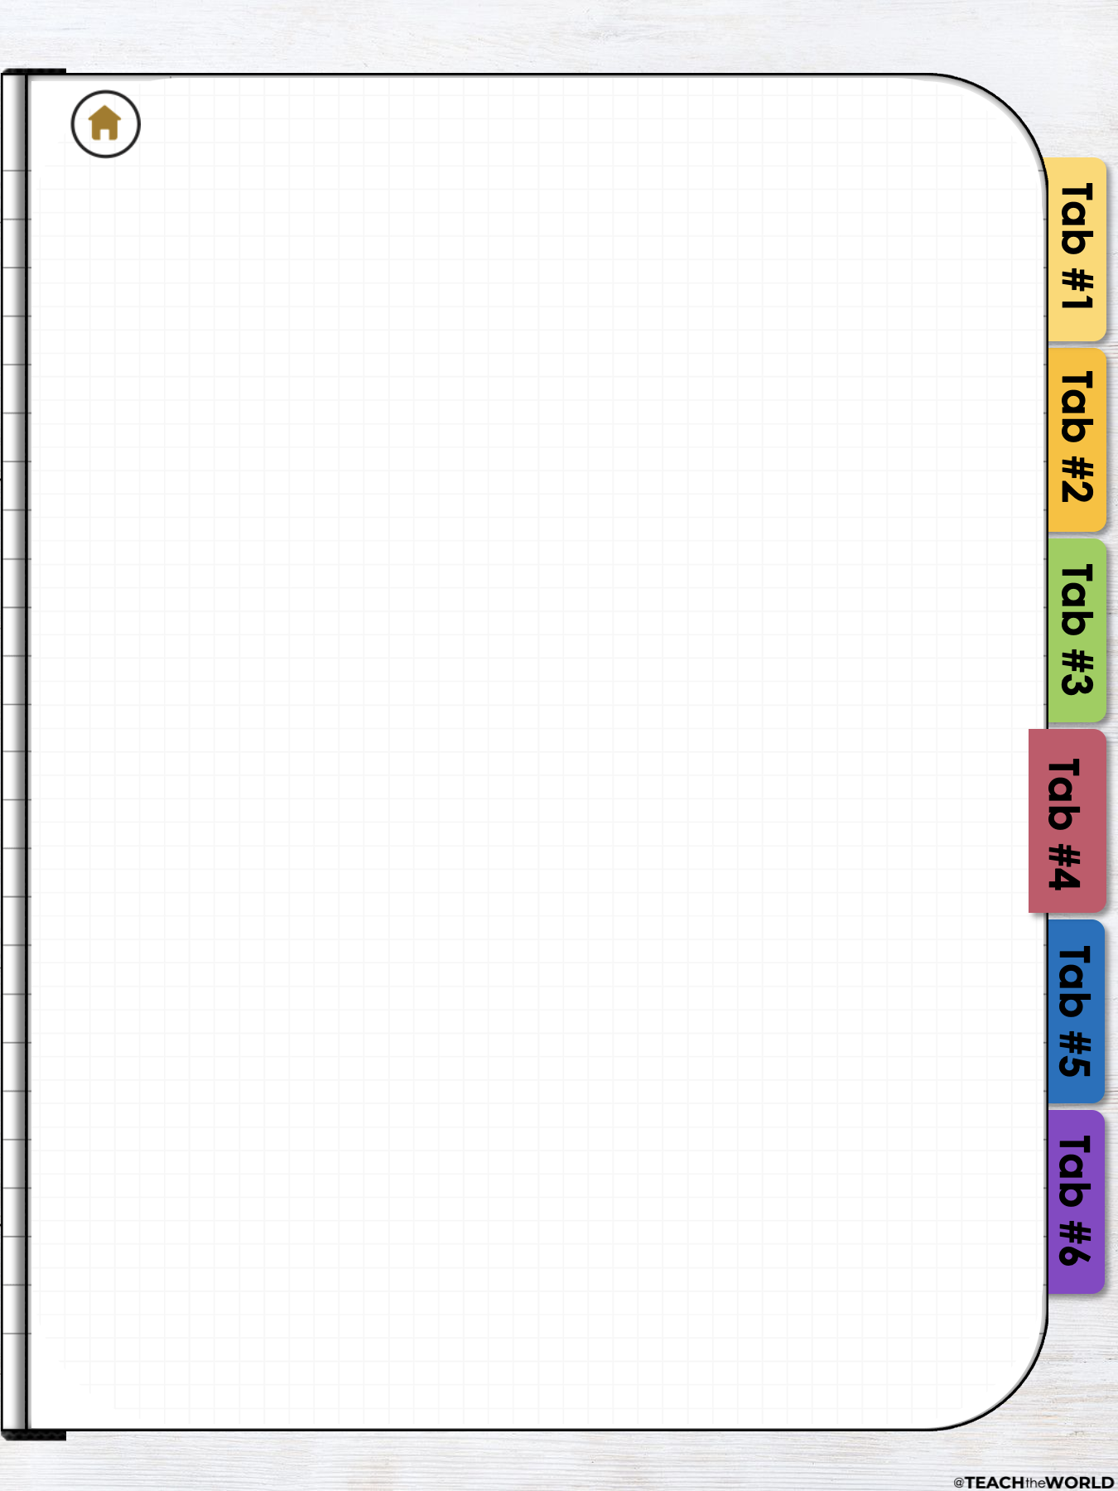

Slide 16
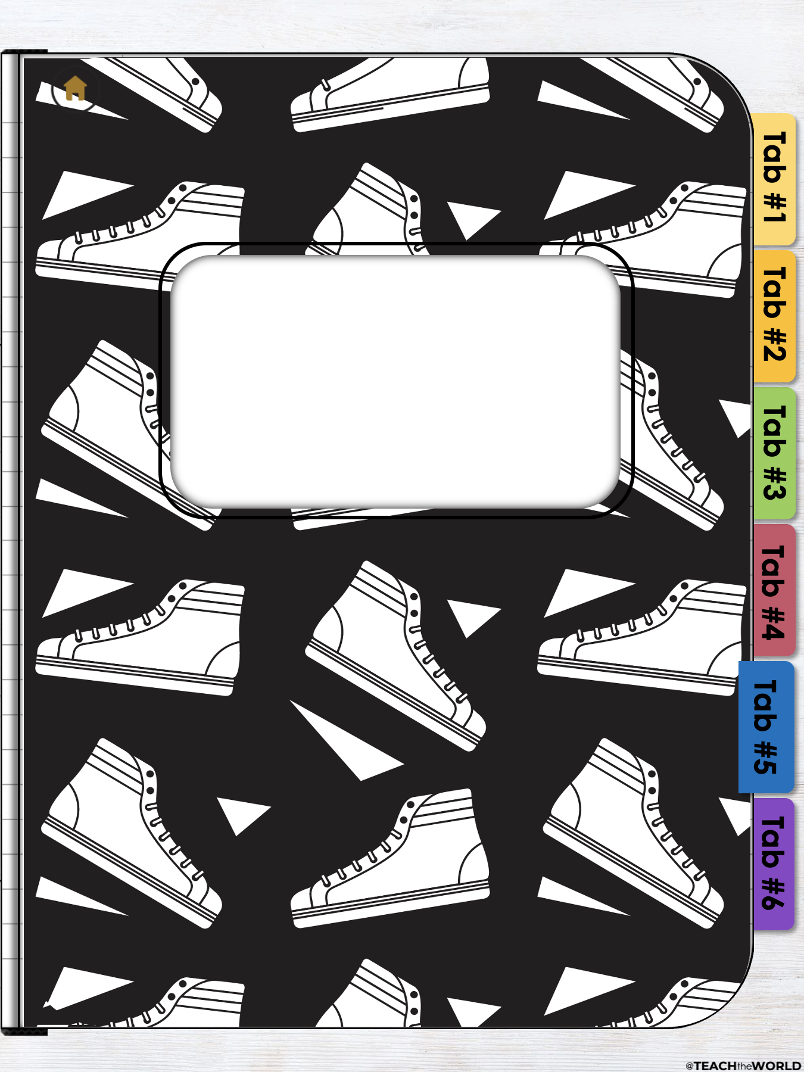
ADD TEXT HERE

Slide 17
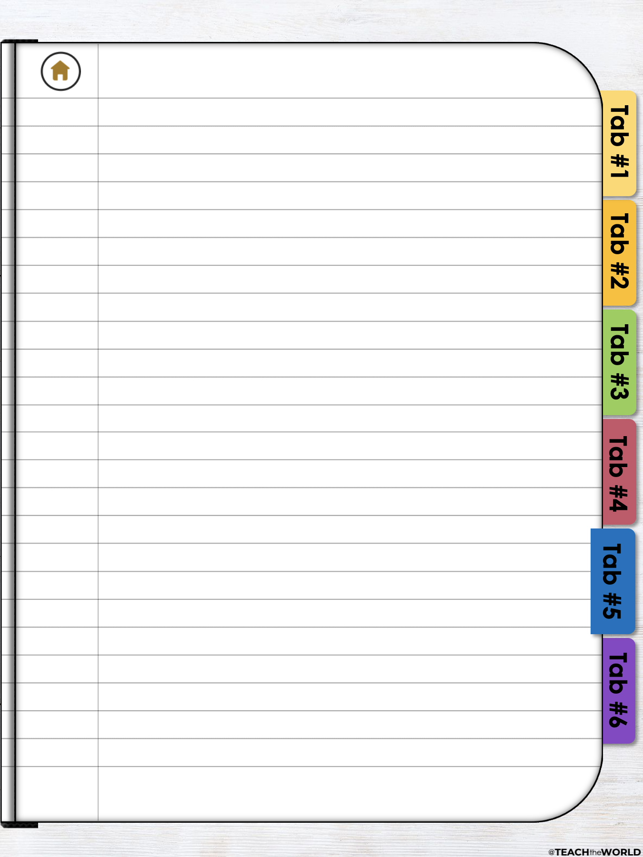
Type notes here...

Slide 18


Slide 19
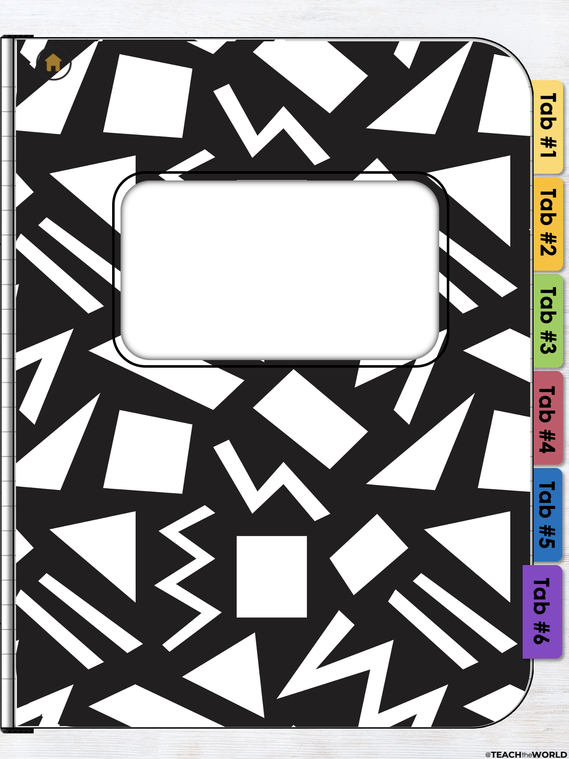
ADD TEXT HERE

Slide 20
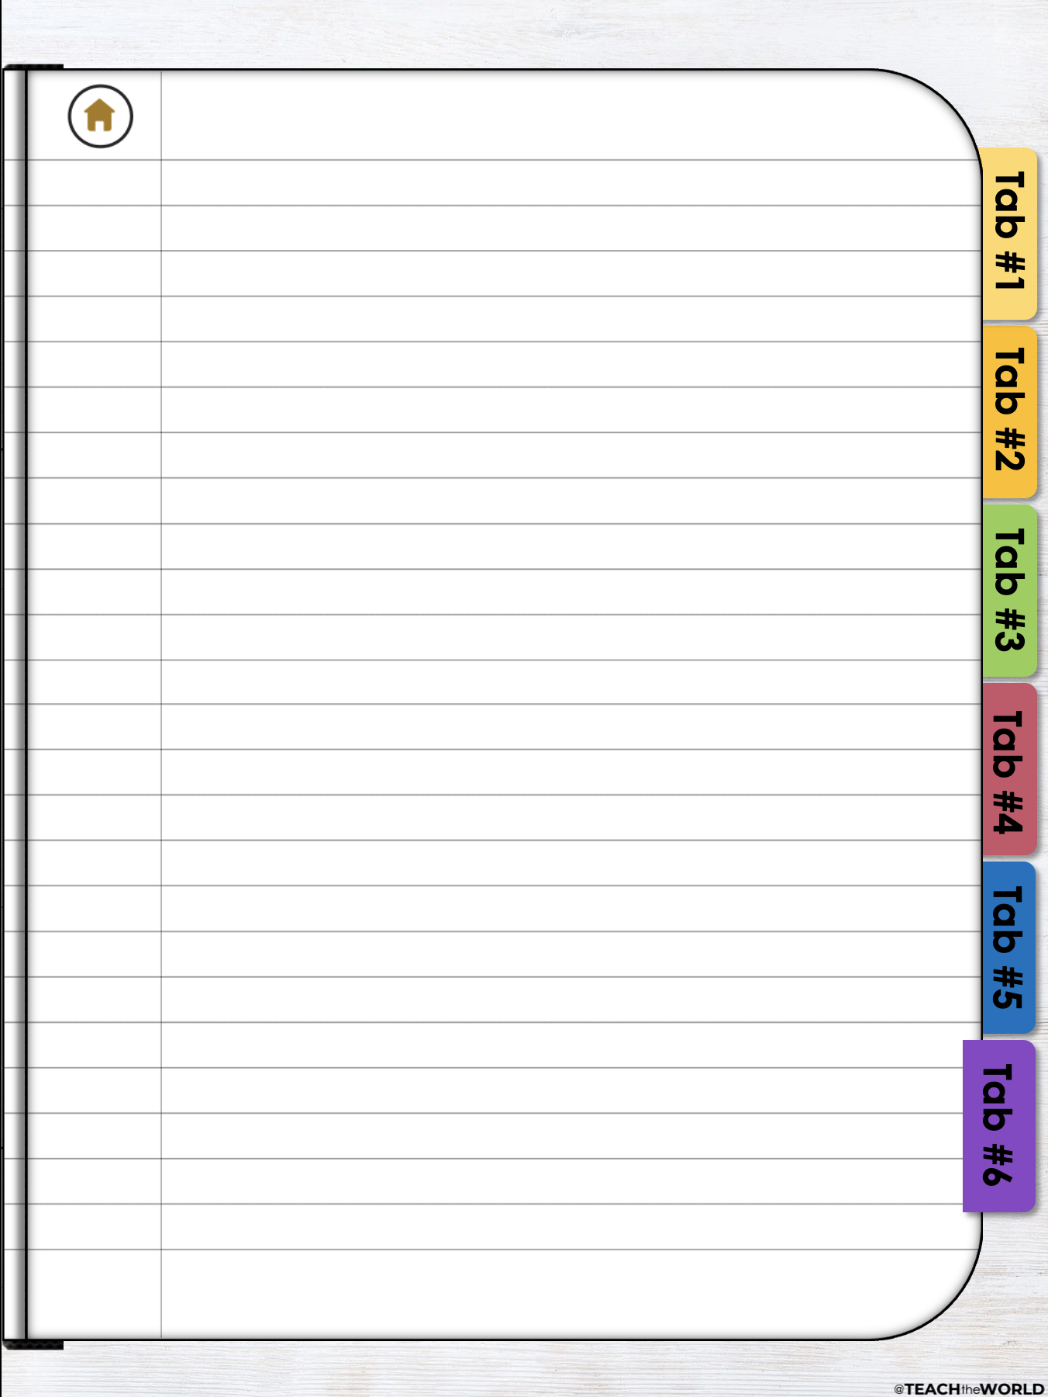
Type notes here...

Slide 21
