Slide 1
Contrasting Cases: Getting the MOST out of your STEM or PBL Activity Angela Compton
acompton@miami.edu For the SEALED REPOSITORY
Includes An Excerpt From: Project Based Learning as a Vehicle To Promote Engagement and Achievement: A Focus On STEM (2020)
By Angela Compton and Erica Auguste
Available at bit.ly/SEALEDSI

Slide 2
Contrasting Cases are a great way to get your CSS, Coach or Administration to BUY IN to the use of PBL or STEM in your classroom

Slide 3
The Value of PBL/STEM on Achievement
PBL, and especially STEM approaches, when implemented consistently and with fidelity, have the potential to increase achievement, interest, and engagement of marginalized student groups who are also underrepresented in STEM fields (Malkiewich and Chase, 2019, Scott-Parker and Barone-Nugent, 2019)
Bicer and Capraro (2019) conducted a quasi-experimental study of mathematics achievement growth at 64 STEM and non-STEM schools in Texas. While the study demonstrated no change in achievement growth in the entire student population, Latino students and African American students at the STEM schools demonstrated a higher growth rate than at their counterparts at non-STEM schools.
Notes:
Think back to the L25 we talked about earlier.

Slide 4
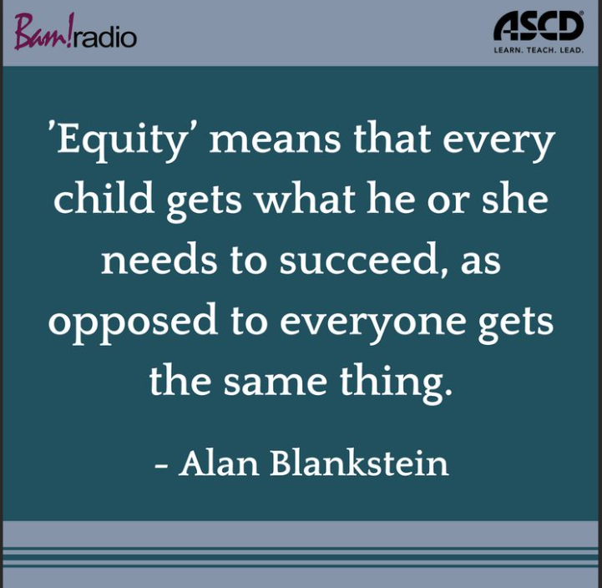
Notes:
The achievement gap is not going away with the methods we are currently using. If anything, student perceptions of ability and interest are DECREASING, especially in STEM fields, for marginalized student groups. By rethinking how we approach learning concepts, we offer our students an opportunity to see themselves as mathematicians, as engineers, as scientists.

Slide 5
The Value of PBL on Engagement
Scott-Parker and Barone Nugent (2019) conducted a small case study of 4 Year 10 Australian girls that demonstrated significant changes in student engagement student dispositions to both math and science. In addition, this study found that pairing the students with young, female mentors helped challenge the stereotype that science is conducted by old men. While this study had severe limitations, it supports the importance of authentic, hands on science as a vehicle for increasing student engagement.
Your students will remember the activities and the connections they make long after the things they have memorized have faded.
You will be able to use the survey measure provided with this section to gauge how YOUR students respond to the PBL you create. You will be amazed how perceptions will shift about learning over time.

Slide 6
How to get the most out of your PBL
Providing project goals that are content-focused can increase student retention of science/mathematics learning, as opposed to goals that are outcome-based (Malkiewich and Chase, 2019).
Example:
Make a brochure for fisherman that highlights the ways that sea grasses and seaweeds differ in terms of structure and classification
Vs
Make a brochure for fisherman that highlights the differences between sea grasses and sea weeds

Slide 7
How to get the most out of your PBL
Take the time to create resources that will utilize the concept of contrasting cases (comparisons) to promote students to make deeper meaning of their new content
Examining multiple representations of a concept provides instructional scaffolding to allow students to make deeper meaning from their new science/math content, thereby supporting the development of higher-order questioning (Hall and Miro, 2016; Malkiewich and Chase, 2019).
These contrasting cases are an excellent opportunity to link assessment-aligned questions to your PBL to prepare for end of year assessments.

Slide 8
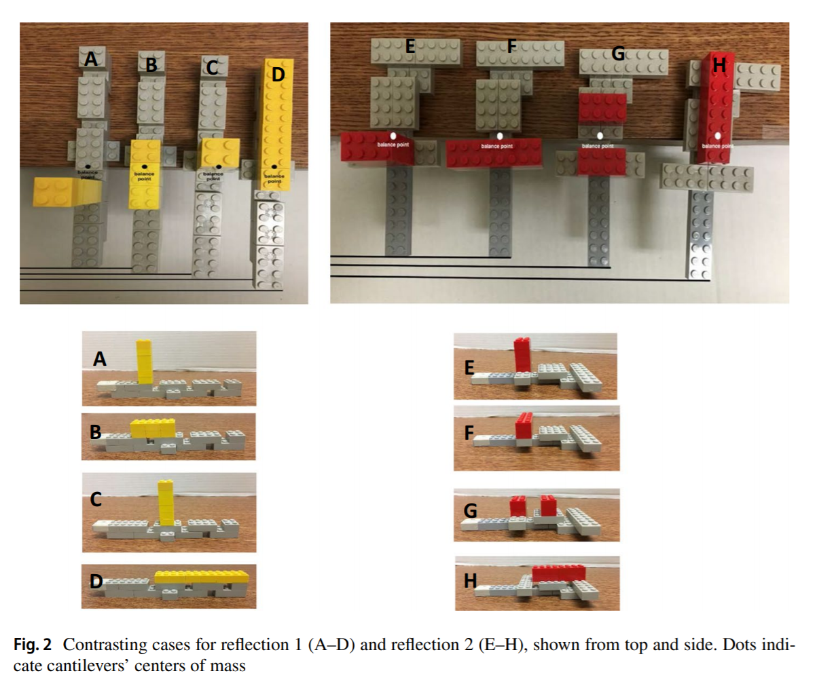
How to get the most out of your PBL
Contrasting cases are the BEST WAY to connect your accountability goals to your activity.
You can even use EOC/FSA style questions and visual representations.
Examples:
Ask students to evaluate parabolas for differences
Ask students to compare various representations of cells for difference
Source: Malkiewich and Chase (2019)

Slide 9
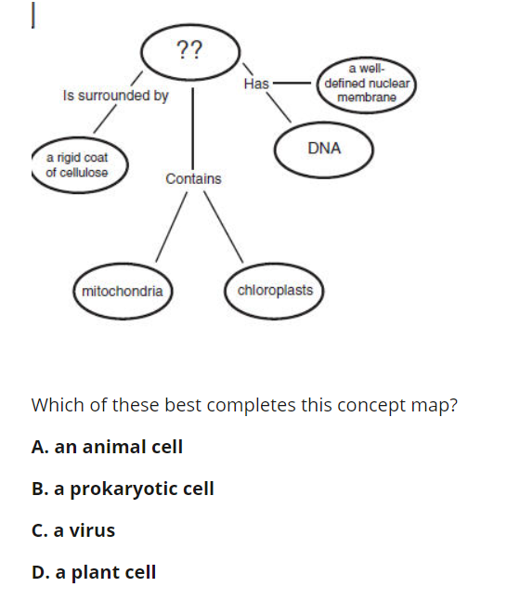
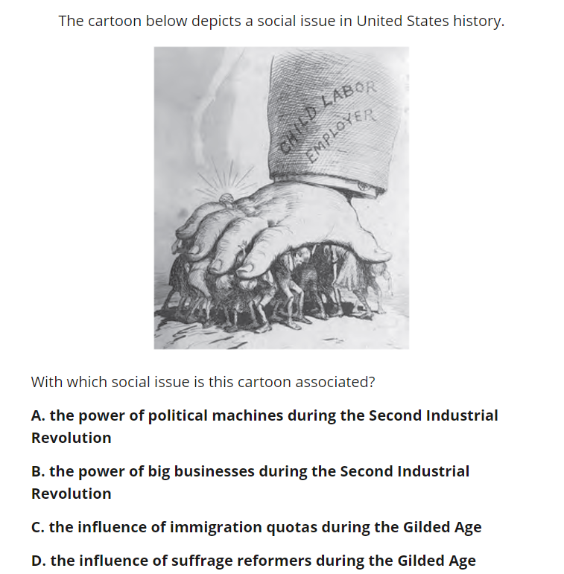
Many EOC or FSA questions are often, at their core, contrasting cases.
Question Source: Escambia Reviews: http://www.ecsd-fl.schoolloop.com/EOCReviews

Slide 10
Contrasting Cases Require . .
A basic understanding of key concepts and then critically applying and analyzing scenarios for or using those key concepts.
When you build contrasting case questions for an assessment after a PBL or STEM activity, consider the following:
-What were the content goals you wanted your students to deepen or improve?
-What did they find most challenging about those goals?
-How do those goals overlap with typical questions or items from standardized tests for your subject or others?

Slide 11
This tool kit contains a planning tool to assist in planning your own contrasting case questions:

Slide 12
References
Beckett, G.H., Hemmings, A., Maltbie, C., Wright, K., and Sherman, M. (2015). An evaluation study of the CincySTEM ITEST projects: Experience, peer support, professional development and sustainability. Journal of STEM Teacher Education, 50 (1), p. 3-17.
Bicer, A. and Capraro, R.M. (2019). Mathematics achievement in the secondary high school context of STEM and non-STEM schools. School Science and Mathematics.
Christensen, R., Knezek, G., and Tyler-Wood, T. (2015). Alignment of hands-on STEM engagement activities with positive STEM dispositions in secondary school students. Journal of Science Education and Technology, 24, p. 898-909. DOI https://doi.org/10.1007/s10956-015-9572-6
Duncan-Andrade, J.M., and Morrell, E. (2008). The art of critical pedagogy: Possibilities for moving from theory to practice in urban schools. Counterpoints, 285, p. 23-48.
Eisenkraft, A. and Freake, S.C. (Eds.). (2018). Beyond the Eggdrop: Infusing engineering into high school physics. NSTA Press
Fredricks, J.A., Wang, M., Linn, J.S., Hofkens, T.L., Sung, H., Parr, A., and Allerton, J. (2016). Using qualitative methods to develop a survey measure of math and science engagement. Learning and Instruction, 43, p. 5-15.
Gsahsa 4088. (2010, Decemeber 2) Student Disengagement [Video] YouTube https://www.youtube.com/watch?v=d8lxGL33WQE

Slide 13
References (Continued)
Hall, A. and Miro, D. (2016). A study of student engagement in project-based learning across multiple approaches to STEM education programs. School Science and Mathematics, 116 (6), p. 310-319.
Honey, M., Pearson, G., & Schweingruber, H. (2014). STEM integration in K-12 education: Status, prospects, and an agenda for research. The National Academies Press. (Free download available at: http://www.nap.edu/catalog/18612/stem-integration-in-k-12-education-status-prospects-and-an)
Lenz, B. (2015). Transforming schools using project based assessment and Common Core Standards.
Malkiewich, L.J. and Chase, C.C. (2019). What’s your goal? The importance of shaping the goals of engineering tasks to focus learners on the underlying science. Instructional Science, 47, p. 551-558. DOI: https://doi.org/10.1007/s11251-019-09493-2
SMU Maker Education Project. (2018). STEM Engineering Template. Southern Methodist University. Retrieved October 24, 2018, from http://smumakeredproject.org/. NO LONGER AVAILABLE.
Toshalis, E. (2015). Make me!: Understanding and engaging student resistance in school. Harvard Education Press.

