Slide 1
CER Claim-Evidence-Reasoning
A tool for developing writing and reasoning in your content area
Presented by Angela Compton
For the
University of Miami
SEALED Repository
acompton@miami.edu

Slide 2
Today’s students struggle with writing, especially in science.
-Writing in science is HARD.
-This resource is designed for developing written arguments to support claims in science, but can be modified for other subjects.
-It will speak about the need for a Claim-Evidence-Reasoning approach in all subjects, and then will give examples and supports specific to science.
-The resource that inspired this particular tool kit (Argument Driven Inquiry) offers curriculum for math, science and engineering.
-The focus of this tool kit is to help you support developing your student’s ability to explain and reason in your content area through intentional activities, explicit instruction, and embedded support.
-

Slide 3
By any other name . . .
Argumentation Argument Driven Inquiry
Argument Based Inquiry
And why it matters.
CER approaches often overlap or can be considered argumentation. There are many names that it can go by but the process is the relatively the same.
Making scientific arguments is how scientists make sense of nature, so it makes sense to teach students how to make arguments in the science classroom (Ford, 2012).
Argumentation is an important skill because it teaches students how to critique arguments and also make their own.
There is also an overlap between scientific thinking and inquiry and critical thinking (Soysal, 2021).
Students who receive inquiry-based instruction reach higher levels of achievement than students receiving commonplace instruction. (Wilson, Taylor, Kowalski & Carlson, 2010)
From https://www.argumentdriveninquiry.com/
CLAIM
EVIDENCE
REASONING

Slide 4
Components of CER
Students are given a guiding question to guide their investigation
In the most pure form of inquiry-driven CER, students design their own investigation. However, today’s students struggle with the scientific method and it’s up to the teacher how to scaffold or support this process.
Claim - a statement that answers the guiding question.
Evidence - the scientific data collected by the investigation that supports the claim (Usually a table or graphical representation of the data).
Reasoning - a written justification that explains how the data supports the claim.
(Wilson, Taylor, Kowalski & Carlson, 2010) Students struggle with data literacy, and with writing, so CER is a great way to address both!
CLAIM
EVIDENCE
REASONING

Slide 5
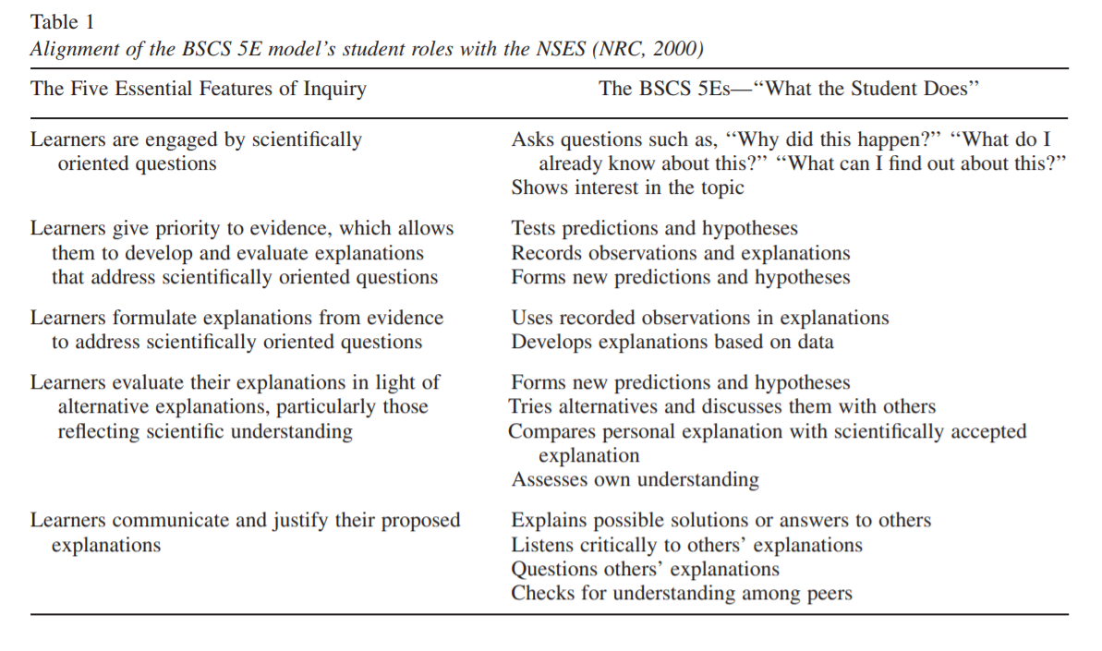
What Inquiry-Based Instruction Looks Like
Table 1, from Wilson, Taylor, Kowalski & Carlson (2010).
A Claim-Evidence-Reasoning approach is a great way to approach inquiry-based instruction.

Slide 6
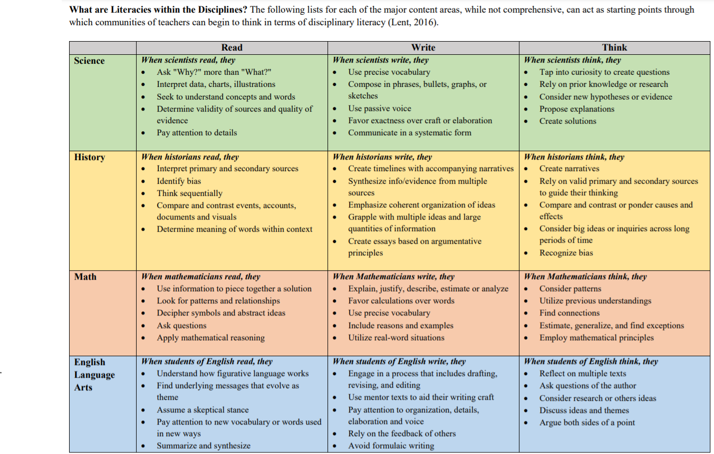
Understanding how claims in your subject area are different from what students are normally asked to write in ELA (So you can explicitly support that!)
From Lent, 2017.
Available here.
Evaluate how reading, writing and thinking is different in your content area, compared to how students do it on a daily basis. How can you support them?
This does not have to be JUST for science.

Slide 7
Strategies for success.
-Regular reading in science: Spend time reading articles and breaking them down.
-Practice reviewing examples and non-examples of writing in your content area.
-Practice peer review to build a culture of constructive feedback.
-Discuss science in your classroom often! Teacher talk during these discussions is statistically important. During discussions teachers should: -Probe students -Toss questions back to students -Make talk choices that improve student voice -When you can get your students to discuss with each other, you have truly succeeded.
-Provide embedded supports for writing using UDL principles.

Slide 8
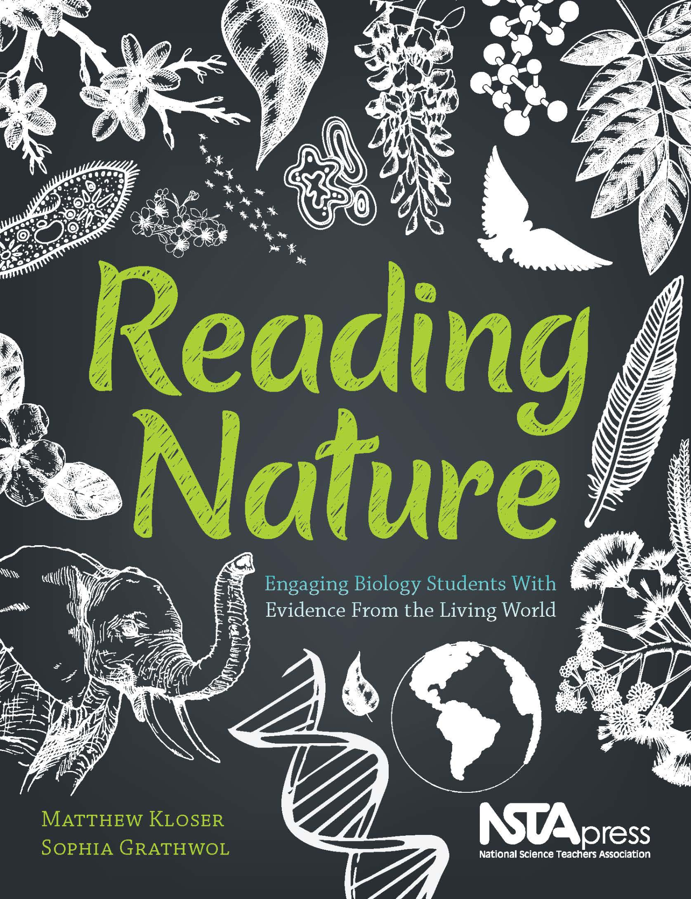
Regular Reading In Science (Or your content area)
The level of writing you are asking your students to read depends on the grade level you teach.
-11th+ should really be introduced to reading college level literature, especially if in an honors or AP course.
-Middle and high school underclassmen should at least be reading regularly about science
-current events or this week in science activities.
>Reading tool in the tool kit to assist with introducing upper level classes to reading in science (or your content area. - How to A Read Science Article (Purugganan and Hewitt, 2005).
>Reading Nature: Excellent example of how to incorporate regular reading for biology.
Sample available here from NSTA.

Slide 9
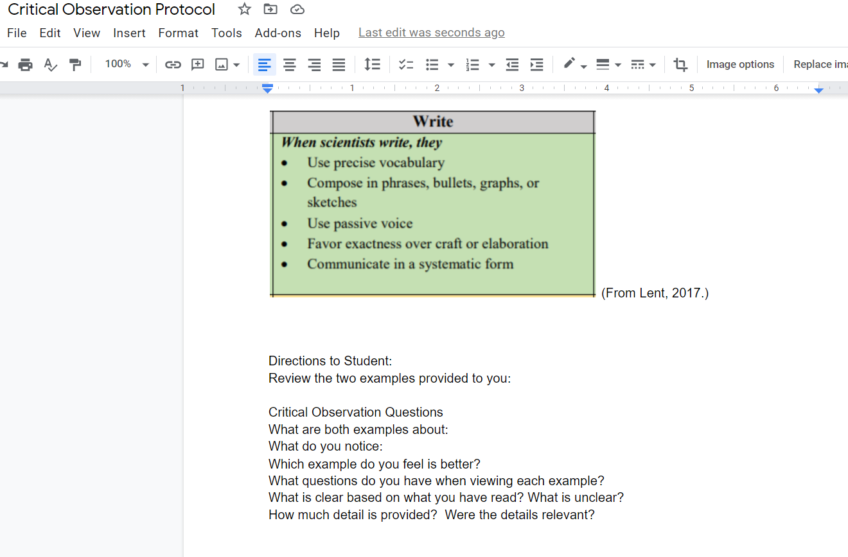
Examples and Non-Examples of Science Writing
Students will have an easier time writing in science if they are given opportunities to review and critique examples and non-examples of writing.
For this reason, a Critical Observation Protocol was developed and included in this tool kit. The critical observation protocol includes to examples, but is open-ended, so that you can adjust it to fit the context and needs of your students.
Explicit instruction in science writing is very important - you MUST show your students what they need to do and scaffold as required!

Slide 10
Peer Review
See Things From A Different Perspective
Peer editing is incredibly helpful.
In a traditional in person setting, you can have your students complete their CERs on manilla folders and then have them circulate the room to ask questions and give feedback on each other’s CERs.
This allows them to see other CERs as a reader rather than a writer and see gaps in the clarity. It also allows the students to practice giving constructive feedback.
Sticky notes are a student favorite for this method of peer review!
In a hybrid or online setting, this same concept can be executed using a Padlet.
Students can post their CER on to a shared padlet or Jamboard, and students can either leave feedback there (Jamboard has sticky notes!) or they can give feedback in a google form or similar document. (SEE SampleFeedback_PBL in this resource for an example of a peer feedback form)

Slide 11
The Role of Discussion in the Science Classroom
Why discussions should be included in the science classroom
Develop a deeper understanding of science
Improve skills in argumentation
Allow for students to speak the language of science and view themselves as active participants
Allows for opportunities for students to change their viewpoints (Pimental and McNeill, 2011)
A study by Pimental and McNeil (2013) found nearly all classroom discussions are teacher-centered and authoritative, which lended itself to students provided shortened responses.
Soysal (2021) found a statistically significant correlation between well-implemented teacher talk during argument-driven activities and increases in student critical thinking.
Short, Van der Eb and McKay (2020) found that productive science talk improved CER and content knowledge in 9th grade students.

Slide 12
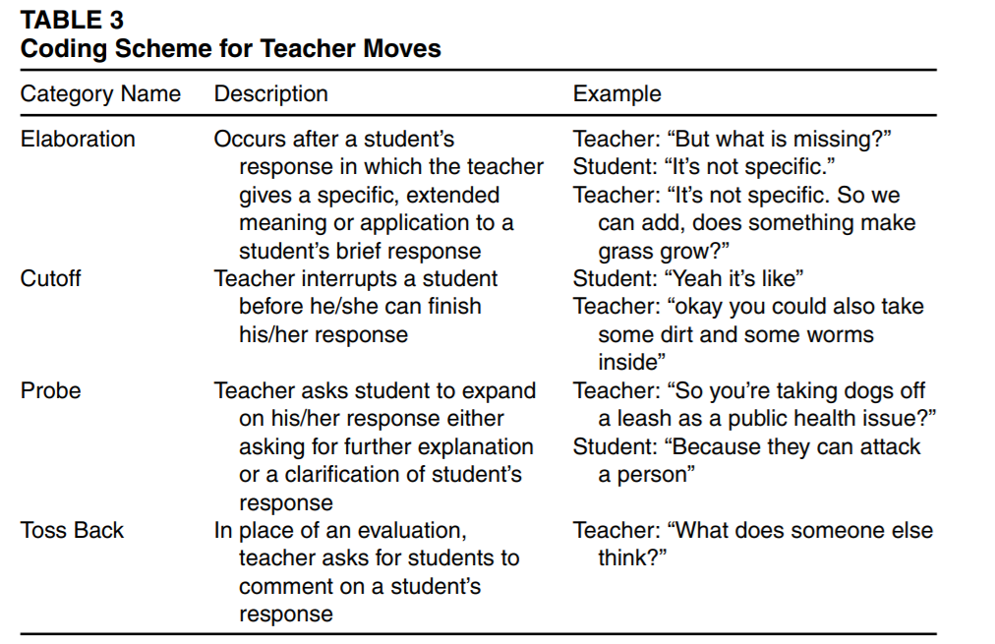
How teachers interact with students during whole class discussion can impact the effectiveness of in class discussions.
Students tend to provide single word responses.
How to push for more:
LIMIT teacher elaboration on student responses, instead either probe the student to provide their own elaboration or “toss back” the question to other students.
AVOID cutting off the student.
Table 3 Source: Pimentel and McNeill (2013).
Lower image: Talk moves to enhance critical thinking, from Soysal (2021).

Slide 13
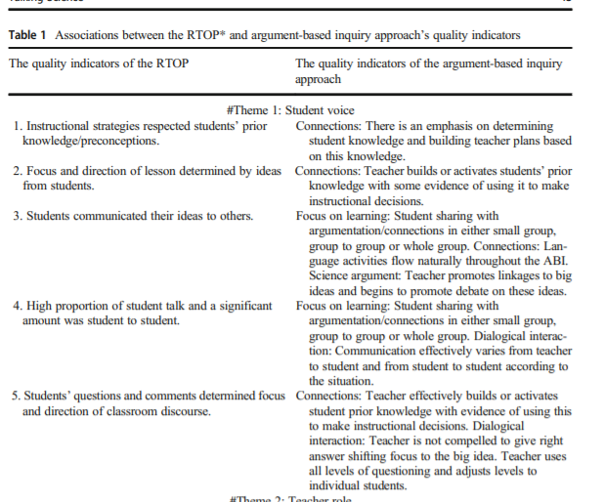
Excerpt from Table 1 from Soysal, 2021 showing examples of productive teacher talk moves as a part of argument driven activities that increase student voice.

Slide 14
Providing Embedded Support
How UDL Eliminates Frustration and Supports Learners
-Use Universal Design for Learning (UDL) to anticipate challenges and embed supports.
-Please refer to the UDL tool kit for additional support with this idea.
-UDL Planning tool: https://udlguidelines.cast.org/
Specifically: https://udlguidelines.cast.org/action-expression/expression-communication/construction-composition
Also please refer to Examples 1 and 2 in this repository resource for an example of using UDL to develop scaffolded supports for composition.
There is also a UDL Tool Kit located in the repository.

Slide 15
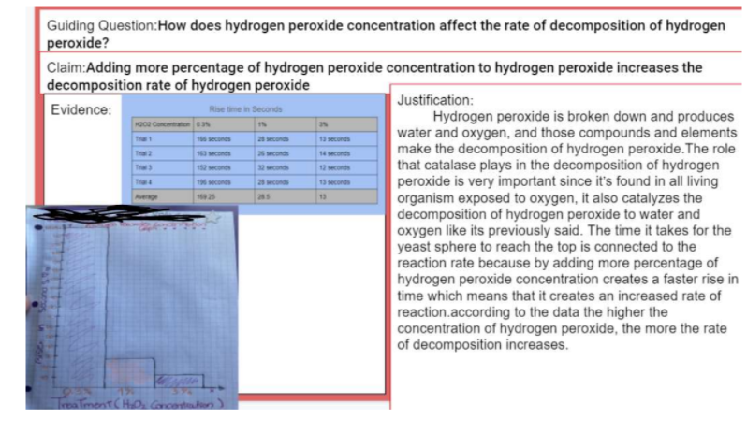
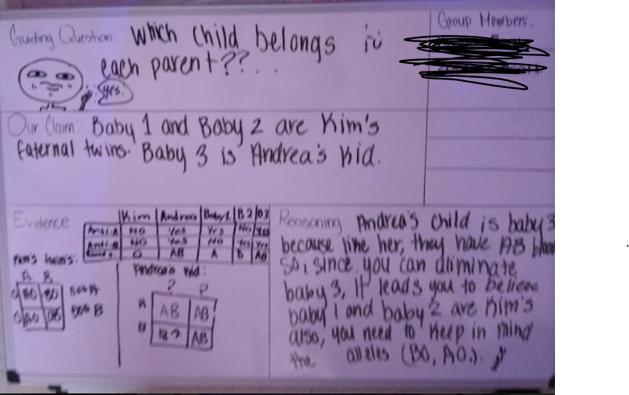
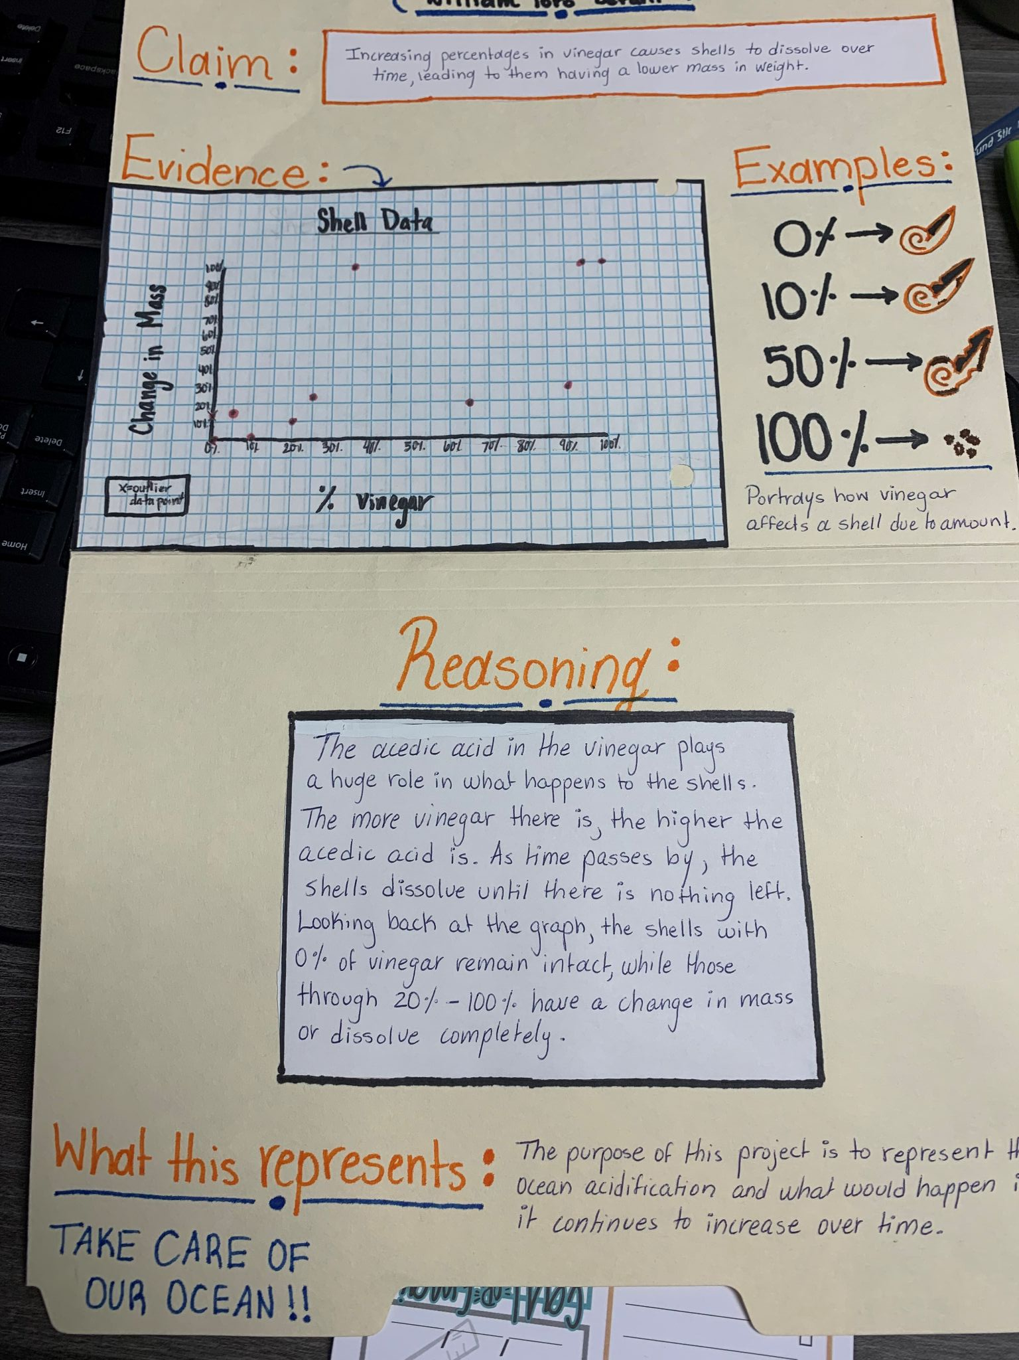
CER Formats Based On Your Context and Situation
Google Slides
-useful for remote Instruction
Manilla Folder
-compact
(From
White Board
-Easy to collaborate

Slide 16
Links and Resources to Help
-Argument Driven Inquiry
(PDs and Resources for a CER approach in math, science and engineering)
https://www.argumentdriveninquiry.com/
Click DOWNLOADS to view downloadable materials.
Talk Science Website (TERC) https://www.terc.edu/projects/talk-science/#:~:text=Talk%20Science%20PD%20is%20a,effectiveness%20of%20classroom%20science%20discussions.
How to Read a Science Article (https://www.owlnet.rice.edu/~cainproj/courses/HowToReadSciArticle.pdf) - Included in this toolkit
Santa Cruz-Watsonville Inquiry-Based Learning In Environmental Sciences Modules https://scwibles.ucsc.edu/learning-modules/module-gallery/
Ambitious Science Teaching planning tools https://ambitiousscienceteaching.org/tools-planning/

Slide 17
References
Ford, M.J. (2012). A diologic account of sense-making in scientific argumentation and reasoning. Cognition and Instruction, 30 (3), 207-245.
Lent, RaLeah. (2017). Disciplinary literacy: A shift that makes sense. ASCD Express 12:12. Retrieved from: http://www.ascd.org/ascd-express/vol12/1212-lent.aspx?fbclid=IwAR3nJ2hX6hQBEmwScBY2Py-eC8MhFvkpAnrvu2cnNONXBmYP02HzanY3DiE
Northwestern University NuWrite. (Accessed June 2021). Lab Reports: Advice and Samples. Retrieved from: https://nuwrite.northwestern.edu/communities/science-writing-community/science-writing-samples-advice/writing-lab-reports/index.html
Pimentel, D.S. & McNeill, K.L. (2013). Conducting talk in scecondary science classrooms: Investigating instructional moves and teacher beliefs. Science Education, 97 (3), 367-394.
Purugganan, M. & Hewitt, J. (2004). How to read a science article. Cain Project for Engineering, Rice University. Retrieved from: https://www.owlnet.rice.edu/~cainproj/courses/HowToReadSciArticle.pdf

Slide 18
References (continued)
Short, R.A., Van der Eb, M.Y., & McKay, S.R. (2020). Effect of productive discussion on written argumentation in earth science classrooms. The Journal of Educational Research, 113(1), 46-58.
Soysal, Y. (2021). Talking science: Argument-based inquiry, teachers’ talk moves, and students’ critical thinking in the classroom. Science and Education, 30, 33-65.
Wilson, C.D., Taylor, J.A., Kowalski, S.M., Carlson, J. (2010). The relative effects and equity of inquiry=based and commonplace science teaching on students’ knowledge, reasoning, and argumentation. Journal of Research in Science Teaching, 47 (3), 276-301.

