Slide 1
Yeast Sphere Lab
Objective: To explore chemical reactions through an inquiry approach
Team Members:
All of your answers should be typed in the red boxes - if you see a red box you should type an answer!

Slide 2
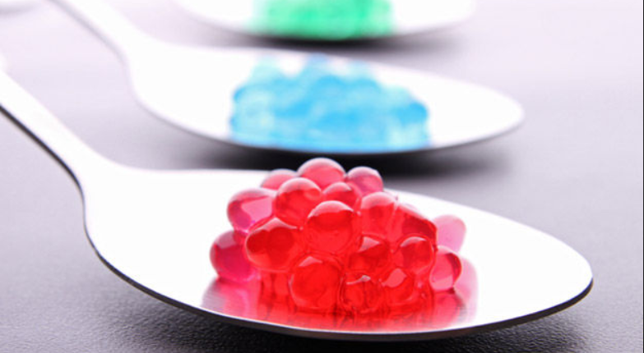
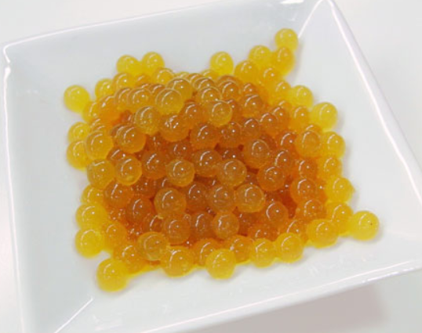
Read This!
“Did you know that you can turn just about any drink or pureed food into small spheres? The spheres have a gelatinous outside with a liquid center. Molecular gastronomy is the area of food science that explores how to make these spheres, as well as other ways ingredients in our food are physically and chemically changed when we prepare and cook it. In other words, molecular gastronomy looks at the molecules in our food and how they change. (Gastronomy is the study of picking, preparing, and eating good food.) The molecular gastronomy technique that is used to make food into spheres has a fitting name: spherification.” From Rowland, T. (2020, June 23). Juice Balls: The Science of Spherification. Retrieved from https://www.sciencebuddies.org/science-fair-projects/project-ideas/FoodSci_p074/cooking-food-science/juice-balls-science-of-spherification

Slide 3
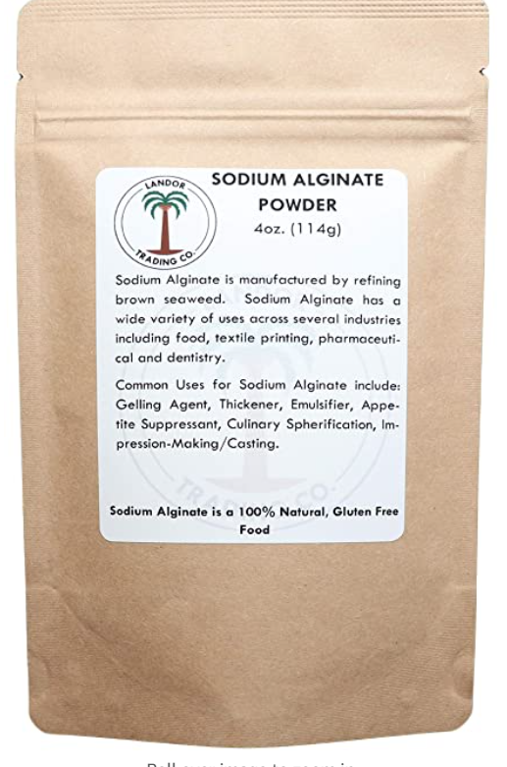
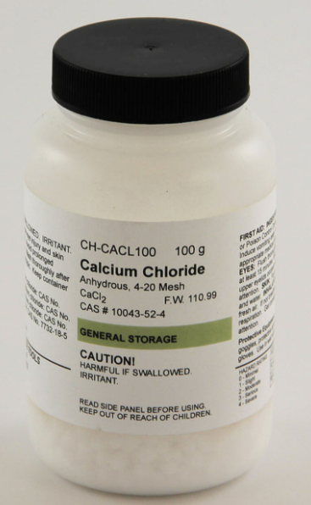
Read on!
“How does spherification work? Like much of food science, it is based on some specific chemical reactions. These reactions take place in solutions that are made up of key chemicals. The two key chemicals involved in spherification are sodium alginate and calcium chloride. Sodium alginate is made from seaweed and can form a gel-like substance when dropped into a calcium chloride solution. When the two chemicals come into contact with one another they rearrange so that the alginate binds to the calcium, forming calcium alginate, which is a gelatinous substance.” From Rowland, T. (2020, June 23). Juice Balls: The Science of Spherification. Retrieved from https://www.sciencebuddies.org/science-fair-projects/project-ideas/FoodSci_p074/cooking-food-science/juice-balls-science-of-spherification

Slide 4
Understanding the compounds in the reactants
The chemical formula for sodium alginate is NaC6H7O6.
The chemical formula for Calcium Chloride is CaCl2
Using ptable.com list the elements and the number of atoms in each of the compounds above:
Sodium alginate
Calcium Chloride

Slide 5
This is the chemical reaction you will be conducting today.
NaC6H7O6+CaCl2→ NaCl+CaC12H14O12
Fill in the blanks in the statement with the NAMES of the compounds from the previous slide. Use the equation above. and answer the table. The second half is already filled out for you! (ARROW is reacts to form.)
 | and |  | React to form
Sodium Chloride | and | Calcium Alginate
What type of reaction is this? (Decomposition, Synthesis, Single Replacement, Double Replacement, Combustion - Check your notes!)
How do you know?

Slide 6
This is the chemical reaction you will be conducting today.
NaC6H7O6+CaCl2→ NaCl+CaC12H14O12
Is this equation balanced?
How do you know?
The reactants are:
The products are:
If the equation is not balanced, go to the Chemical Equations Gizmo in Explore learning and use the Gizmo to balance it! Snip or paste the balanced equation below. Remember:
-You type the reactants and the products in the boxes at the top.
-You can only type a coefficient in the front of each “family” to balance it. (Stuck? Start with the first reactant!)

Slide 7
Lab Safety Review
Assume everything you use in the lab is
The first priority when conducting a lab is

Slide 8
Time for the lab portion!
You should read through ALL of the slides before you begin, and let me know if you have any questions!
Before each part, review the steps with your team.
REMEMBER, your goal is to follow the steps for a successful experiment.
Mistakes happen but if you carefully review the steps you should be good.
Don’t be afraid to ASK.

Slide 9
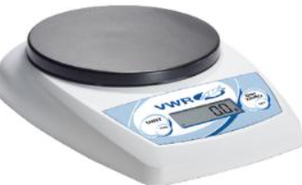
Use a balance to weigh 2 grams of yeast and prepare the yeast.
> Turn the scale on >Put a small container on the scale. > Hit the zero button so the scale reads zero grams. >Carefully use the metal spatula to transfer 5 grams of yeast to the small container.
> Use a graduated cylinder to carefully measure 50mL warm water. >Return any extra yeast to the teacher and use that beaker to mix your yeast and water. > Pour the water and the yeast into a beaker and stir.
> wipe your spatula with a paper towel.

Slide 10
2. Combine the yeast with the prepared sodium alginate.
>Add the amount of sodium alginate provided to you in a tray to the beaker of yeast.
>Stir the new solution with the spatula until well mixed.
STIR WELL and then clean off your spatula.

Slide 11
3. Make your catalase spheres! *you need at least 25 good spheres!
> Use the purple syringe to draw up the fluid. (Push plunger in all the way, put tip in the solution in the beaker, and pull the plunger back while making sure tip is submerged in solution).
>Wipe liquid from tip. >Tap out bubbles and wipe syringe again.
>Obtain a beaker of Calcium Carbonate from your teacher and put the tip close to the Calcium chloride without touching it. > Slowly press the plunger and try to make UNIFORM spheres. (Press the plunger evenly and try not to give them a tail).
>Dispose of floaters using a yellow inoculating loop. If they have a tail: it’s too thick – add more of the yeast solution to your mix

Slide 12
4. Transfer your catalase spheres
>Use your yellow inoculating loop to capture your spheres and carefully transfer them to the plastic vial provided by your teacher.
>Finally, carefully place your container in the bin for your class.
>Clean and sanitize your area and safety gear.
>Follow instructions for the placement of used containers.
>WASH YOUR HANDS.

Slide 13
Last but not least!
Choose with your group from the three available test treatments for next class.
· How does temperature affect the rate of reaction between H₂O₂ and catalase from yeast?
· How does salt affect the rate of reaction between H₂O₂ and catalase from yeast?
· How does soap affect the rate of reaction between H₂O₂ and catalase from yeast?
You will conduct a control of hydrogen peroxide and two different concentrations of the treatment you choose, with 5 replicates each.
Your choice:

Slide 14
Feedback - Anything that could have been more clear? Did you like it?

