Slide 1
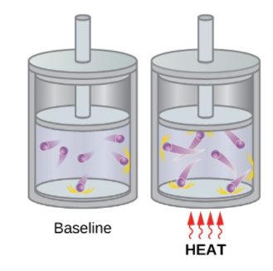
Kinetic Molecular Theory
Warm up to be completed in your notes or digitally
Look at the visual model below and explain what you think is happening.

Slide 2
Today’s Goals and Assessment
-To understand what temperature is and the units we use to measure it
-To understand the differences between theories and laws
-Plan and carry out an investigation into Kinetic Molecular Theory
-Understand what diffusion is.
-Support scientific claims with reasoning
Assessment (LAB GRADE)
-notes and practice questions (20%)
-CER slide and Data (80%)
UPLOAD your notes and data today, and you can finish the CER slide as needed next class Next class: Quizizz for classwork grade based on the goals of this class!

Slide 3
What is temperature?
Temperature is a measure of thermal energy (heat energy)
How hot or cold something is
A measure of the heat in something. . . .
Other types of energy
Radiant energy (light energy)
Mechanical → kinetic and potential energy
Chemical energy → this includes nuclear energy

Slide 4
How is temperature measured?
-Temperature is measured with a thermometer
-There are three main temperature scales . . .
Kelvin
Degrees Celsius--
Degrees Fahrenheit**

Slide 5
Temperature conversions
Write these down!!!!! 75 degrees fahrenheit.
C=5/9*(75-32)
C=23.9 Degrees C

Slide 6
Now practice.
In 1948, Ralph Alpher and Robert Herman calculate the temperature of the Cosmic Microwave Background present in space to be 5 K.
This temperature in Celcius is: C=5K-273=-268
The temperature in Fahrenheit is:
F=9/5*(-268)+32=-450.4 Degrees F
Step 1: Identify the formula
Step 2: Identify the knowns.
Step 3: Solve for the unknowns:

Slide 7
Recall: Theories and Laws - what is the difference?
Scientific Theory→ how or why things happen. They can change over time, but are generally accepted to be TRUE
THEORIES CAN NOT BECOME LAWS. Theories tell us how or why and LAWS tell us what.
Scientific Law-What is going to happen! Always mathematically proven

Slide 8
Break it Down: Kinetic Molecular Theory
Kinetic→ energy of motion
Molecular→ molecules
Theory→ how
How the energy and motion of molecules change (related to temperature)

Slide 9
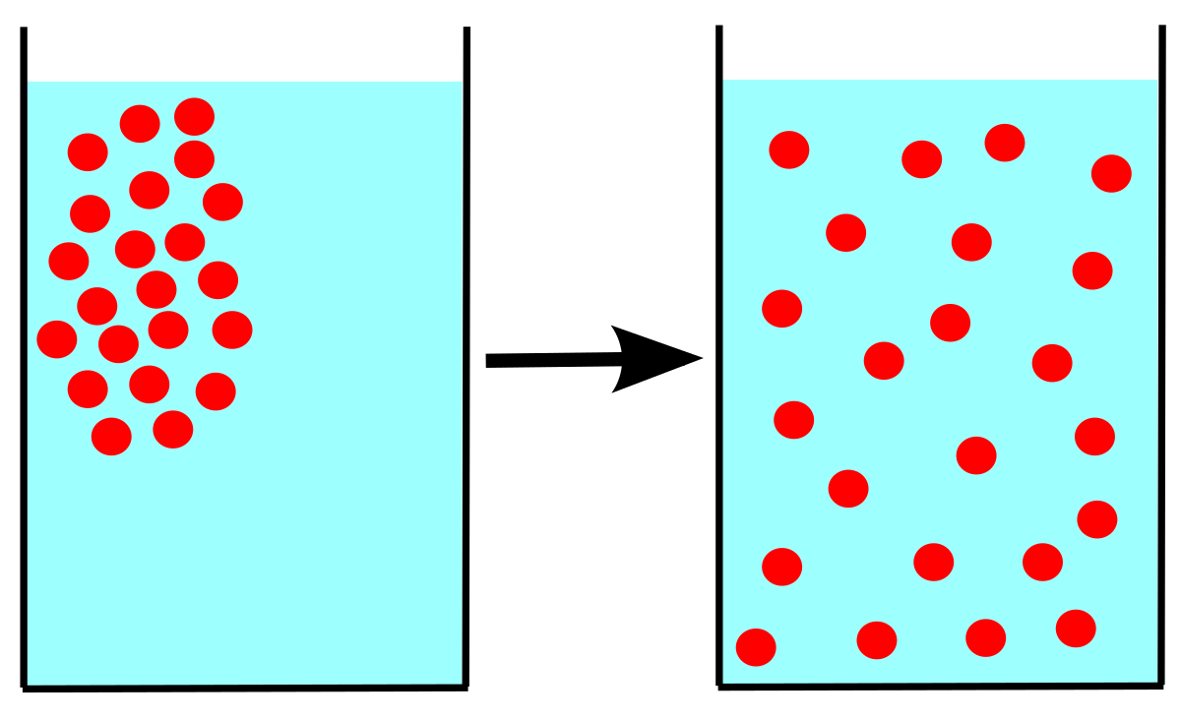
Diffusion
The spreading of a solute in a solution from areas of high concentration, to areas of low concentration, until it reaches equilibrium.

Slide 10
Amoeba Sisters Diffusion Video
2 things you noticed:

Slide 11
Lab: Safety Considerations
You will be using a hot plate today to heat water.
-Unplug when done. -Do not remove your beaker from the plate once it is heated. -Do not touch the hot plate or the liquid.
Handle glassware carefully
Remember that horseplay is unacceptable in the lab!

Slide 12
The data you will be collecting
You will have 2 treatments of water at different temperatures
-Water heated on hot plate - ice water
-You will record the temperature of each treatment.
-You will add two drops of food coloring to each treatment and time how long it takes it to fully diffuse through the water.

Slide 13
Procedures
-Fill each beaker with 300mL of water.
-Heat one on the hot plate until steam rises. While it is heating, you can do the other to treatment.
-Add ice to water in the other beaker.
-Take the temperature of the ice water. Remove the thermometer, then drop in two drops of food coloring and use a STOP WATCH to time how long it takes for the liquid to fully diffuse.
-Do the same for the hot water when steam is rolling off of it. DO NOT TOUCH
Record data in the CER slide table. When you are finished, write a STRONG paragraph for your justification.

Slide 14
Guiding Question: What effect does temperature have on the speed of particle motion?
Red
Claim: Heat increases the speed of particle motion
Evidence:
Justification:
Treatment | Temperature (degrees C) | Time for total diffusion (min:sec)
Ice Water
Hot Water
Notes:
For justification - explain HOW the time for total diffusion changes as temperature increases? Why does this happen and how does this support your claim? (Think back to the warmup and the information we collected!

