Slide 1
Completing your CER slide
Worth 50 points of Assessment Grade
Work through these slides BEFORE you turn in your “Yeast Sphere Inquiry” assignment (Due WEDNESDAY)

Slide 2
Step 1:
Graph your averages as a bar graph.
-Check to make sure you include:
A title that is detailed -it should tell what kind of data you collected
A y axis with units (Rise time in seconds)
A correctly scaled y axis - each box of your graph should be worth the same value)
An x axis label (treatments)
Labels for each of your treatments

Slide 3
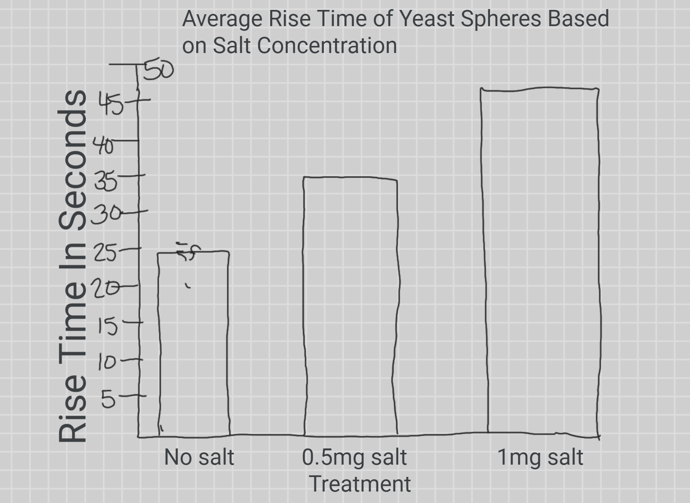
Example

Slide 4
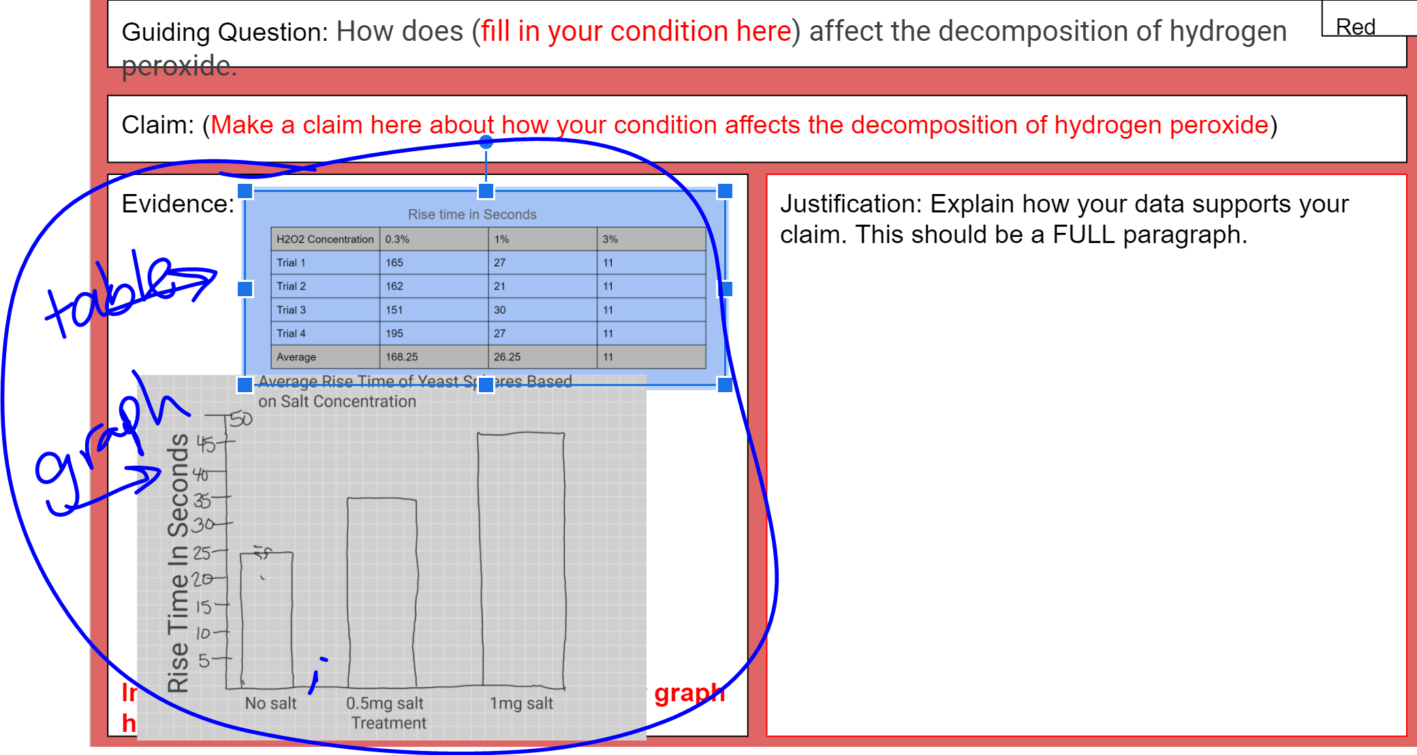
Step 2: include YOUR data table and graph in the evidence section

Slide 5
Step 3: write your guiding question
This is how your treatment affected the rate of Hydrogen Peroxide Decomposition
Yours should be one of these!
-How does hydrogen peroxide concentration affect the rate of decomposition of hydrogen peroxide?
-How does temperature affect the rate of decomposition of hydrogen peroxide?
-How does salt affect the rate of decomposition of hydrogen peroxide?
-How does soap affect the rate of decomposition of hydrogen peroxide?

Slide 6
Step 4: Make your CLAIM based on your data
Remember that slower rise times means a reduced rate of decomposition (less oxygen is made.per second so it takes more time for sphere to rise)
Faster rise time means an increased rate of reaction.
For Example, if your data looks like our example:
The rise time INCREASES, therefore the reaction Rate is slower (less O2 produced when there is salt)
Your claim would be “Adding salt to hydrogen peroxide reduces the decomposition rate of hydrogen peroxide.” MAKE SURE YOUR claim is backed by YOUR data!
Notes:
“Increasing the hydrogen peroxide concentration
increasing the decomposition rate of hydrogen peroxide.”

Slide 7
Need help answering your CER questions?
The next few slides might have your answer!

Slide 8
Step 5: make your justification
This connects your evidence to your claim. (If you aren’t sure about the next two check out slides 8 and 9)
Your first sentence should describe the decomposition of hydrogen peroxide.
Your second sentence should describe the role of catalase in the decomposition of hydrogen peroxide.
Your third sentence should describe how rise time is connected to the reaction rate.
Finally, explain how the data supports the claim you made. DO NOT WRITE THE DATA SUPPORTS MY CLAIM BECAUSE.

Slide 9
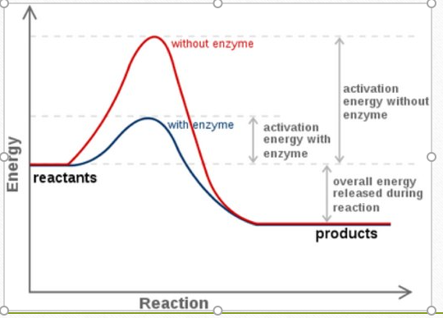
Reaction Diagrams (Answer it)
Examine the diagram and answer the following questions.
5. Describe how the activation energy changes without the enzyme and with it.
6. Drag the green boxes with the parts of the reaction to the correct place in the reaction diagram.
H2O+O2
H2O2
Catalase
Notes:
HINT: What is H2O2? What are H2O and O2? What is catalase? Look in the graph for words that represent what they are and place them there.

Slide 10
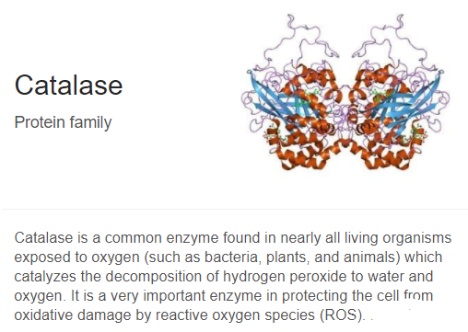

Slide 11
More Tips for Justification
-Write in the passive voice (do not say “I”)
-Check Slide 7 to make sure you have each of those items included.

Slide 12
Scoring
(50 Points Possible)
5 points guiding question
5 points claim
Evidence - 20 points 5 points data table 15 points proper graph with all items included
Justification - 20 points -describe the decomposition of hydrogen peroxide. -describe the role of catalase in the decomposition of hydrogen peroxide. -describe how rise time is connected to the reaction rate. - Connect your DATA TO YOUR CLAIM!

